Slide 1

Module 25: Hypochlorite
Drinking Water Plant Operator Certification Training

Slide 2
Unit 1 –Background and Properties
Learning Objectives
  Outline the history of hypochlorite use
  List the uses of hypochlorite
  Explain how hypochlorite is produced
  List and explain 6 properties of hypochlorite

Slide 3
Basic Information
History of Use
Uses
  Disinfection
  Oxidation
  Taste and Odor Control

Slide 4
Basic Information Cont’d
Hypochlorite Production - Manufactured
  Liquid: Sodium Hypo
  Solid (granular): Calcium Hypo
Hypo Production – On-site
ANSI Standard for hypochlorite

Slide 5
Chemistry of Hypo
Workbook Page 1-4:
Chlorine forms hypochlorous acid (HOCl) in water
Hypochlorous acid dissociates to hydrogen and hypochlorite
HOCl ↔ H⁺ + OCl⁻
Free Chlorine

Slide 6
Chemistry of Hypo
Hypochlorous Acid is much better at disinfection than hypochlorite. pH should kept below 8.5 to remain has hypochlorous acid

Slide 7
Chlorine and pH
14

Slide 8
Chlorine and Temperature

Slide 9
Knowledge Check
As pH increases, what happens to the effectiveness of chlorine?
As temperature increases what happens to the effectiveness of chlorine?

Slide 10
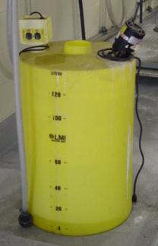
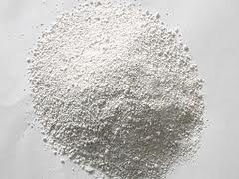
Basic Properties
Sodium Hypochlorite (NaOCl)
  Clear, light yellow-green liquid
  12-15% strength (laundry bleach is 5%)
On-site generated hypo
  Electrical charge applied to a salt brine
Calcium Hypochlorite
  65 to 70% available chlorine
  White granular powder or solid cake

Slide 11
Stability
Workbook page 1-8
Sodium Hypochlorite (liquid) Stability:
  Concentration
  heat
  storage time (30 day limit)
  light
  heavy metals

Slide 12
Stability
Workbook page 1-9
Calcium Hypochlorite (dry)
  Loses 3-5% chlorine a year
  Maximum 30-60 day stock
  Heat
  Organic material
Vapor Pressure
  Vent

Slide 13
Key Points
Turn to page 1-10 to summarize the unit key points.

Slide 14
Unit 1 Exercise
1. List and explain two uses of hypochlorite.
a.
b.
ANS: Answers may include disinfection, oxidation, and control of taste and odor.

Slide 15
Unit 1 Exercise
2. Matching: Please match the chemical with the available chlorine by weight by drawing lines between the matches:
Chemical | Available Chlorine by Weight
Sodium hypochlorite | 0.1 %
Household bleach | 5.25%
Calcium hypochlorite | 12 to 15%
 | 65 to 70%

Slide 16
Unit 1 Exercise
3. Which of the following affect the stability of hypochlorite:
a. Temperature
b. Color
c. Exposure to light
d. How long it is stored
Answer: a, c, and d.

Slide 17
Unit 1 Exercise
4. Circle the choice that best fills in the blank:
The higher / lower the concentration of sodium hypochlorite, the more stable it is.
Chlorine is less effective as the temperature decreases / increases.
Chlorine is less effective as the pH decreases / increases.

Slide 18
Unit 1 Exercise
Dry calcium hypochlorite will lose 3 to 5 percent available chlorine per year.
All hypochlorite solutions will release oxygen gas as the solution decomposes.
Answer = True

Slide 19
Unit 2 - Chemical Handling, Storage and Safety
After this unit, you’ll be able to:
  Explain proper handling and storage of hypochlorite
  Use the hypo MSDS sheet (now SDS sheet)
  Identify hypochlorite health and environmental hazards
  Identify personal protection equipment and first aid

Slide 20
Storage and Handling
Workbook Page 2-2
Quantities
Types of Storage Containers
Storage Rooms
Materials of Construction

Slide 21
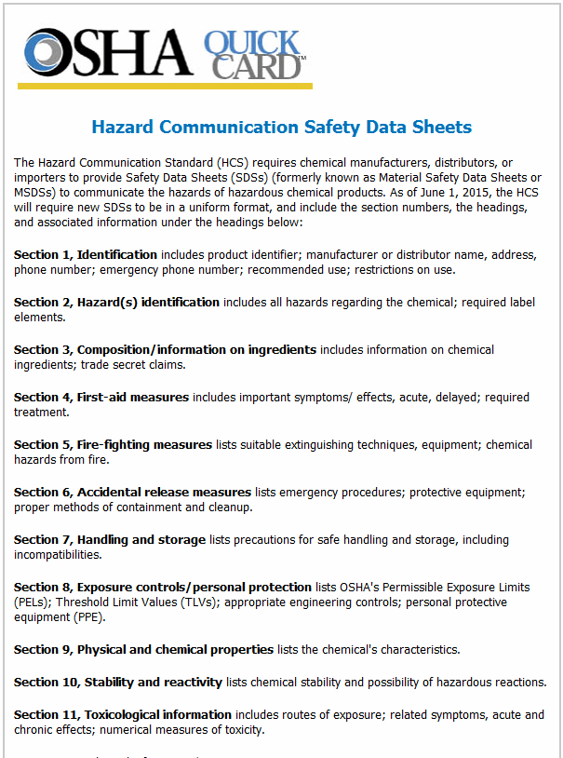
Safety
Workbook Page 2-4
MSDS

Slide 22


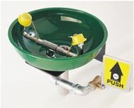
Safety
Hypochlorite Hazards
  Skin/eyes irritant; rash
Personnel Safety Protection
First Aid

Slide 23
Key Points
Turn to page 2-9 to summarize the unit key points.

Slide 24
Unit 2 Exercise
1. Sodium hypochlorite should not be stored longer than 45 days since its strength decomposes in storage.
2. Calcium hypochlorite should be stored in its original containers until it is used.
3. Hypochlorites decompose and release chlorine gas into the air.

Slide 25
Unit 2 Exercise
Forced air ventilation should be turned on whenever workers enter the hypochlorite storage or work area. a. True
MSDS is an abbreviation for Material Safety Data Sheet.

Slide 26
Unit 2 Exercise
Typical information in a Safety Data Sheets includes:
  a. The product name and its synonyms.
  b. Fire and explosion hazard data.
  c. Toxicity data.
  d. First aid procedures.
  e. All of the above.

Slide 27
Unit 2 Exercise
Hypochlorite spills should be washed with large amounts of water to dilute it.
8. Hypochlorite will react spontaneously with organic material and should be kept separate from all organic compounds such as: fats, sugar, oils, turpentine, paper, and other oxidizable materials. a. True

Slide 28
Unit 2 Exercise
9. First aid procedures for skin contact with hypochlorite include showering with large quantities of water and calling for medical assistance.
10. Hypochlorite should be stored so that it does not get direct exposure to: water, heat, direct sunlight, and organic matter.

Slide 29
Unit 3 – Math Principles and Process Control Calculations
Learning Objectives
Describe math terms, principles and rules for solving equations.
Review unit cancellation steps.

Slide 30
Unit 3 – Math Principles and Process Control Calculations
Learning Objectives
Perform calculations for the following types of situations:
    Calculating changing % concentrations of a chemical
    Dosage/Feed Rate/Flow
    Chlorine Demand or Dose
    CT

Slide 31
Known
Known
Conversion
Conversion

Slide 32
Davidson Pie
Feed Rate
lbs
Day
Flow
8.34
MGD
Dosage
mg
L

Slide 33
Davidson Pie
Feed Rate
lbs
Day
Flow
8.34
MGD
Dosage
mg
L

Slide 34
Davidson Pie
Feed Rate
lbs
Day
Flow
8.34
MGD
Dosage
mg
L

Slide 35
Chlorine Demand or Dose
Cl₂ Demand (mg/L) = Cl₂ Dose – Cl₂ Residual
Cl₂ Dose (mg/L) = Cl₂ Demand + Cl₂ Residual

Slide 36
CT
CT = disinfectant concentration x contact time
= C (mg/L) x T (minutes)

Slide 37
Key Points
Turn to page 3-40 to summarize the unit key points.

Slide 38
Unit 3 Exercise
1. In order to use the Feed Rate formula which is lbs/day = Flow or Volume x Dosage x 8.34, name the units of measurement for the flow or volume:
  a) MGD or MG
  b) gpm or gallons
  c) gpd or gallons
  d) All of the above units can be used

Slide 39
Unit 3 Exercise
2. If you have calculated the feed rate for a solution as if it’s 100% pure; but, your solution is a 65% calcium hypochlorite, what value do you use to represent the percent purity (as a decimal)? In other words, what value are you dividing by?
a) 65
b) 6.5
c) 0.65
d) 0.0065

Slide 40
Unit 3 Exercise
3. You have determined that you need to feed 100 lbs/day of chlorine. You are using 15% sodium hypochlorite which provides 1.2 lbs/gal available chlorine. In order to convert the “lbs/day” feed rate into “gallons/day,” what math step do you use?
a) 100 lbs/day X 1.2 lbs/gal
b) 100 lbs/day X 0.15
c) 100 lbs/day ÷ 1.2 lbs/gal
d) 100 lbs/day ÷ 0.15

Slide 41
Unit 3 Exercise
4. When calculating a CT value, what units are used in the detention time calculation?
a) Volume (MG) ÷ Flow (gpm)
b) Volume (Gal) ÷ Flow (gpm)
c) Volume (MG)÷ Flow (MGD)
d) Volume (Gal) ÷ Flow (MGD)

Slide 42
Unit 4 –Chemical Feed: Objectives
After this lesson, you’ll be able to:
  Explain the disinfection regulatory requirements.
  Explain breakpoint chlorination.
  Identify chemical feed equipment and explain important operation and maintenance considerations

Slide 43
Regulatory Requirements
All CWSs must provide continuous disinfection
All CWSs must meet the disinfection byproducts MCLs

Slide 44
Regulatory Requirements
Surface Water:
Must achieve 99.9 % inactivation (3-log) of Giardia
Must achieve 99.99% inactivation (4-log) of viruses
Groundwater
Must achieve 99.99% treatment (4-log) of viruses

Slide 45
MCLs and MRDLs
Disinfection byproducts have MCLs
Maximum Residual Disinfectant Levels (MRDLs)
Workbook Page 4-4: Secondary MCLs

Slide 46
Minimizing TTHM Formation
Reduce organic material before chlorination
Optimize chlorine usage
Change chlorine addition point
Alternative disinfection methods

Slide 47
Chlorination
Workbook Page 4-5
Chlorine Demand
Chlorine Residual
Chlorine Residual
Combined Chlorine
=
+
Free Chlorine

Slide 48
Breakpoint Chlorination

Slide 49
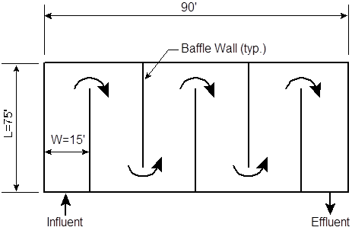
Chlorine Contact Tank
Maximize detention time

Slide 50
Typical Bulk Sodium Hypochlorite Feed System Schematic

Slide 51
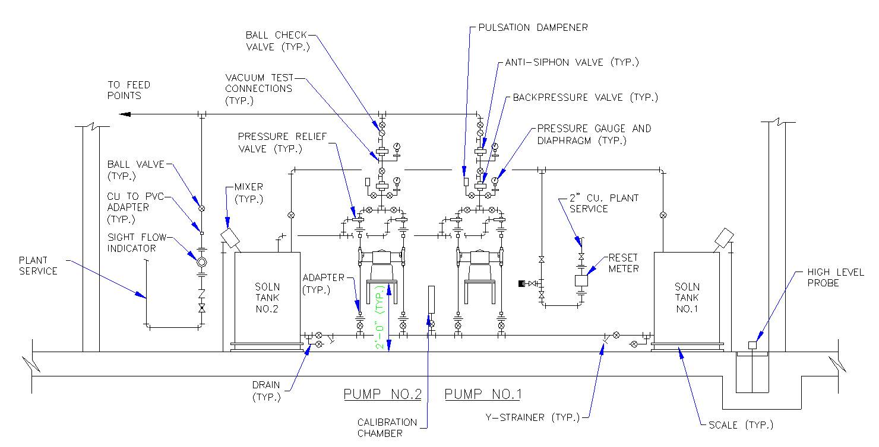
Typical Sodium Hypochlorite Drum Feed System

Slide 52
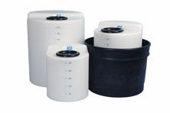
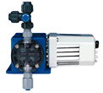
Hypochlorite Feed Equipment
Workbook Page 4-11
Storage/Solution Preparation Tanks
Scales
Transfer Pumps
Day Tank
Chemical Feeder
Chemical Feed Piping

Slide 53
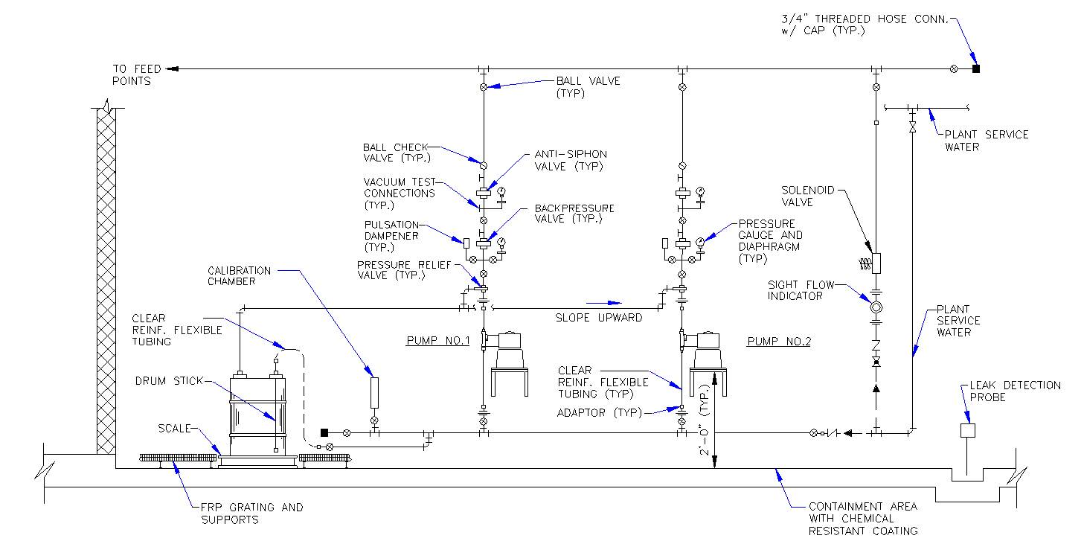
Typical Calcium Hypo Drum Feed System Schematic

Slide 54
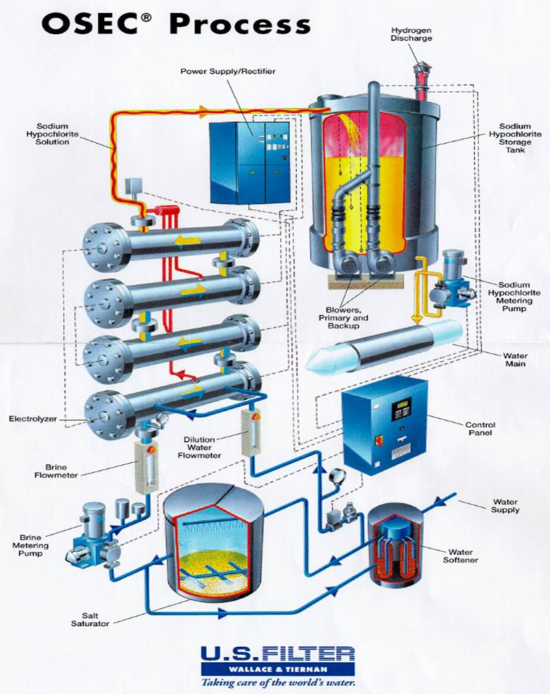
On-Site Hypochlorite Generation Process

Slide 55
Pump Calibration Curve

Slide 56
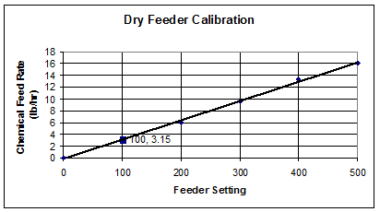
Pump Curve

Slide 57
Key Points
Turn to page 4-19 to summarize the unit key points.

Slide 58
Unit 4 Exercise
1. The disinfection process for surface water supplies must achieve 99.9 percent (3 log) inactivation of Giardia cysts and 99.99 percent (4 log) inactivation of enteric viruses.
Chlorine residual samples are taken at representative points within the distribution system. These samples are taken at the same time and at the same location as the coliform samples are taken. True

Slide 59
Unit 4 Exercise
3. The maximum residual disinfectant level (MRDL) is the maximum permissible level of a disinfectant added for water treatment that may not be exceeded at the consumer’s tap without an unacceptable possibility of adverse health effects.

Slide 60
Unit 4 Exercise
4. List one way a water supplier can reduce THM formation:
• Reduce the organic material before chlorinating the water.
• Optimize chlorine usage.
• Change the point of chlorine addition in the treatment series.
• Use alternative disinfection methods.

Slide 61
Unit 4 Exercise
5. Explain what breakpoint chlorination is.
Breakpoint chlorination is the addition of chlorine until all chlorine demand has been satisfied. At this point, further additions of chlorine will result in a free chlorine residual that is directly proportional to the amount of chlorine added beyond the breakpoint.

Slide 62
Unit 4 Exercise
6. The breakpoint chlorination curve can be used to determine how much chlorine is required for disinfection.
7. Chlorine dose = chlorine demand (mg/L) + chlorine residual (mg/L).

Slide 63
Unit 4 Exercise
8. A day tank stores daily amounts of chemical required for delivery by feeders.
9. Calcium hypochlorite solutions are typically prepared with a 1 to 3% strength.

Slide 64
Unit 4 Exercise
10. A pump calibration curve plots feed rate delivery versus the pump setting.
11. In the event of an abnormal operation, be sure to inform your Supervisor about the problem.

Slide 65
Module 25 Review Questions
The following questions review the entire module 25.
Be sure to review the entire student workbook and do the extra practice math questions in preparation for the certification exam.

Slide 66
1. The effectiveness of chlorine______ as the pH increases.
  Decreases
  Increases

Slide 67
2. Calcium Hypochlorite available chlorine content:
  Is 5-6%
  Is 12-25%
  Is 35-45%
  Is 65-70%

Slide 68
3. Chlorine existing in water as hypochlorous acid and hypochlorite ions:
  Free Available Chlorine
  Advance Chlorine Residual
  Total Chlorine
  Chlorine Demand

Slide 69
4. In 24 hours, 4.2 gallons of 12% hypochlorite solution is fed. How much (in gallons) would you have to use if the concentration was 7%?
  2.4 gallons
  5 gallons
  7.2 gallons
  10.1 gallons

Slide 70
5. Uses of hypochlorite’s include:
  Disinfection
  Oxidation
  Taste and Odor Control
  All of the above

Slide 71
6. Hypochlorite should be kept separate from:
  Nothing
  Organic material
  Water
  All other chemicals

Slide 72
7. A tank holds 575,000 gallons of water. If the tank is ¾ full, how much water is in the tank?
  431,250 gallons
  287,500 gallons
  143,750 gallons
  600,000 gallons

Slide 73
8. The stability of hypochlorite solutions is greatly affected by:
  Nothing
  Concentration, heat, light, time, heavy metals
  Heavy metals and light
  Concentration and heat

Slide 74
9. The material safety data sheet for calcium hypochlorite might indicate:
  It can irritate skin and eyes
  It is a safe chemical
  It can irritate skin, eyes, lungs and/or cause a rash
  It is only hazardous once mixed with water

Slide 75
10. Minimum free, combined or chlorine dioxide residual at the entry point of a surface water system may not be less than ___________ for more than 4 hours and be maintained as a minimum detectable residual throughout the distribution system.
  0.02 mg/L
  0.2 mg/L
  4 mg/L
  2.0 mg/L

Slide 76
11. Minimum free chlorine residual at the entry point of a ground water system may not be less than ___________or its equivalent to provide 4-log treatment of viruses:
  0.02 mg/L
  0.04 mg/L
  0.20 mg/L
  0.40 mg/L

Slide 77
12. Appropriate protective clothing when working with hypochlorite’s includes:
  Eye protection
  Gloves
  Rubber Apron
  All of the above

Slide 78
13. The addition of chlorine until all chlorine demand has been satisfied:
  Chlorination Curve
  Breakpoint Chlorination
  Disinfecting Tendencies
  Proportional Chlorination

Slide 79
14. A material safety data sheet contains detailed assessment of:
  Chemical Characteristics
  Chemical Hazards
  Both A and B
  None of the above

Slide 80
15. When calculating a CT value, what units are used in the detention time calculation?
  Volume (MG) ÷ Flow (gpm)
  Volume (Gal) ÷ Flow (gpm)
  Volume (MG) ÷ Flow (MGD)
  Volume (Gal) ÷ Flow (MGD)

Slide 81
16. A system is switching from gas chlorine to sodium hypochlorite. They typically use about 37 pounds of gas chlorine. How many pounds of 12.5% sodium hypochlorite can the system expect to use each day?
  296 pounds
  37 pounds
  0.3 pounds
  30 pounds

Slide 82
17. The effectiveness of chlorine _____as the temperature increases.
  Increases
  Decreases

Slide 83
18. The Maximum Residual disinfectant level (MRDL) for chlorine is set at:
  1.0 mg/L
  2.0 mg/L
  3.0 mg/L
  4.0 mg/L

Slide 84
19. A change in water temperature impacts chlorine residual by:
  Decreasing the residual
  Increasing the residual
  No effect on the residual
  Decreasing the residual if the temperature increases.

Slide 85
20. Which residual has the highest disinfecting ability:
  Total Available Chlorine Residual
  Free Available Residual Chlorine
  Combined Available Residual Chlorine
  Combined Total Residual Chlorine

Slide 86
21. 375 gpm is how many MGD?
  540,000 MGD
  540 MGD
  0.54 MGD
  0.375 MGD

Slide 87
22. At breakpoint, further addition of chlorine will result in a:
  Free chlorine residual that is indirectly proportional to the amount of chlorine added beyond the breakpoint.
  Free chlorine residual that is directly proportional to the amount of chlorine added beyond the breakpoint.
  Free chlorine residual that is disproportional to the amount of chlorine added beyond the breakpoint.
  Total chlorine residual that is indirectly proportional to the amount of chlorine added beyond the breakpoint.

Slide 88
23. A free chlorine residual of 1.7 mg/L is measured at the end of the clearwell after 4 hours of detention time, what is the CT value in mg-min/L?
  6.8 mg-min/L
  80 mg-min/L
  240 mg-min/L
  408 mg-min/L

Slide 89
24. To determine chlorine feed rates:
  Need lbs used per day and Plant Flow in MGD
  Need the Cl₂ dose and Plant Flow in MGD
  Need the Cl₂ dose and Plant Flow in gpd
  Need lbs used per day and Plant Flow in gpd

Slide 90
25. The chlorine demand of a water is 1.4 mg/L. If the desired chlorine residual is 0.5 mg/L, what is the desired chlorine dose, in mg/L?
  0.9 mg/L
  1.3 mg/L
  1.5 mg/L
  1.9 mg/L

Slide 91
26. The most stable solutions of sodium hypochlorite are:
  Purchased solution of about 12% strength.
  Solutions of about 10% strength stored at 77○F.
  On-site generated solution of about 1% strength.
  Sodium Hypochlorite has no stability issues and never deteriorates.

Slide 92
27. Normal operation of a hypochlorite feed system requires:
  Regular observation of the facilities
  Regular observation of the equipment
  Regular preventative maintenance program as per the manufacturer’s specifications
  All of the above

Slide 93
28. How many gallons of water are in a 700,000 gallon tank that is ²/₃ full?
  466,666 gallons
  233,333 gallons
  175,000 gallons
  116,666 gallons

Slide 94
29. To develop a feed pump calibration curve, you need:
  Pump feed rate
  Pump Speed Setting
  Only A
  Both A and B

Slide 95
30. If you have calculated the feed rate for a solution as if it’s 100% pure; but, your solution is 15% sodium hypochlorite, what value are you dividing by:
  15
  1.5
  0.15
  0.0015

Slide 96
31. Name the units of measurement for the flow or volume when using: lbs/day = flow or volume X dosage X 8.34
  gpm or gallons
  gpd or gallons
  MGD or MG
  All of the above units can be used

Slide 97
32. Uses of hypochlorite include:
  Oxidation
  Taste and Odor Control
  Both A and B
  None of the above

Slide 98
33. The ___________the concentration of sodium hypochlorite, the faster the rate of deterioration:
  Lower
  Higher

Slide 99
34. Hypochlorite solutions which release oxygen gas as the solution decomposes:
  Sodium Hypochlorite
  Calcium Hypochlorite
  Both a and b
  Neither a or b

Slide 100
35. The quantity or weight of chemical delivered from a feeder over a given period of time:
  Pump Setting
  Feed Rate
  Calibration Curve
  Feed Setting

Slide 101
36. You should not store sodium hypochlorite longer than_______ days since its strength decomposes in storage.
  15 days
  30 days
  45 days
  60 days

Slide 102
37. In CT, the C refers to _________and the T refers to the______________
  Concentration in mg/L, Contact Time in minutes
  Concentration in mg/L, Contact Time in hours
  Chlorine Demand in mg/L, Contact Time in minutes
  Chlorine Demand in mg/L, Contact Time in hours

Slide 103
38. If a plant feeds 36 pounds of gas chlorine each day, how many pounds does it feed during an 8 hour shift?
  3 pounds
  6 pounds
  12 pounds
  18 pounds

Slide 104
39. The best reason to calibrate a chemical feed pump is to:
  Make a new pump calibration curve
  Comply with all regulatory agencies
  Compete all necessary maintenance as per the manufacture directions
  Assure that the selected dosage is delivered

Slide 105
40. In a ground water system, a minimum of ________ of contact time must be provided.
  2 minutes
  10 minutes
  15 minutes
  20 minutes

Slide 106
41. General operation procedures for hypochlorite feed systems include:
  Verifying operation of the chemical transfer pumps
  Verifying the chemical supplies on-hand
  Cleaning and lubricating equipment in accordance with manufacturer’s recommendations
  All of the above

Slide 107
42. Drinking water systems can reduce THM formation by:
  Reducing the organic material before chlorinating the water.
  Optimizing the chlorine dosage.
  Changing the point of chlorine addition in the treatment series.
  All of the above

Slide 108
43. A condition that occurs in a tank or basin when some of the water travels faster than the rest of the flowing water:
  Overflowing
  Short-Circuiting
  Simulate-Flow
  None of the above

Slide 109
44. The ______________ _______________ determines how a chemical will be added to the water and could be expressed in mL/min.
  Feed Rate
  Pump Flow
  Calibration Rate
  Flow Zone

Slide 110
45. 3 hours is how many minutes?
  30 minutes
  60 minutes
  120 minutes
  180 minutes

Slide 111
46. The amount of chlorine needed to satisfy the chlorine demand plus the amount of chlorine needed as a residual for disinfection:
  Chlorine Dose
  Chlorine Residual
  Chlorine Demand
  None of the above

Slide 112
47. A regular preventative maintenance program for equipment is:
  In the manufacturer’s specifications
  Not needed
  Developed when equipment shows signs it needs repaired
  Regularly modified by system staff

Slide 113
48. Calcium hypochlorite will lose _____________of available chlorine per year.
  1-2%
  3-5%
  7-8%
  10-12%

Slide 114
49. A residual in the form of _______________ _______________ residual chlorine has the highest disinfecting ability.
  Combined available
  Total available
  Minimum available
  Free available

Slide 115
50. ______________ assures safe and healthful working conditions for men and women.
  EPA
  RSPS
  OSHA
  NIOSH

Slide 116
Summary
Review a little each day.
Study, study, study!

