Slide 1


Refresher Training for
X-Ray Equipment Operators
Developed for the
Department of Environmental Protection
Bureau of Radiation Protection
Presented by
David R. Simpson, CHP, PhD
Bloomsburg University

Slide 2
Outline of Course
Part 1: Introduction and Overview of the Training Program
Part 2: Fundamentals of Radiation Science
Part 3: Review of X-ray Imaging
Part 4: Safety Plan, Documentation and QA
Part 5: Regulations

Slide 3
Introduction and Overview of Training Program
Part 1

Slide 4
Introduction and Background
X-rays a key component of diagnostic medicine for many years
BUT will result in exposure of patient and staff to ionizing radiation
Food and Drug Administration (FDA) recommends two steps for medical X-rays:
  Justification of procedure
  Optimization of procedure

Slide 5
Justification of Imaging Procedure
Imaging procedure should do more good than harm; therefore, exams should be performed only when necessary to:
  Answer a medical question
  Treat a disease
  Guide a procedure

Slide 6
Optimization of Imaging Procedure
Exams should use techniques that are adjusted to:
  Administer lowest radiation dose that yields image quality adequate for diagnosis or intervention
That is, radiation doses should be “As Low As Reasonably Achievable,” referred to as the ALARA Principle

Slide 7
Purpose of Training
According to the National Council on Radiation Protection and Measurements (NCRP Report No. 134) there are four major reasons for training:
1. Development of worker skills so that tasks may be performed efficiently and with confidence

Slide 8
Purpose of Training
2. Individuals aware of risk of exposure become active participants in accepting and, where possible, reducing those risks
3. Number and seriousness of accidents can be reduced
4. Workers will be aware of regulatory requirements involved with radiation exposure

Slide 9
State Requirements for Training
Pennsylvania Department of Environmental Protection (DEP) regulations require individuals operating X-ray equipment to:
  Receive initial instructions in safe operating procedures
  Be competent in the safe use of equipment
  Receive continuing education

Slide 10
State Requirements for Continuing Education
PA Title 25 Chapter 221 Appendix A lists the following topics for continuing education:
  Basic properties of radiation
  Units of measurement
  Sources of radiation exposure
  Methods of radiation protection
  Biological effects of radiation exposure

Slide 11
Topics for Continuing Education
  X-ray equipment
  Image recording and processing
  Patient exposure and positioning
  Procedures
  Quality assurance program
  Regulations

Slide 12
To provide the generic portions of this training for operators performing low-risk medical procedures
Training Goal

Slide 13
Fundamentals of Radiation Science
Part 2

Slide 14
Fundamental Properties of Radiation for X-ray Imaging
Properties of Radiation
Units of Measurement
Sources of Radiation
Biological Effects of Radiation

Slide 15
Ionizing Radiation
High energy particles or electromagnetic (EM) energy
Capable of removing orbital electrons from atoms
Effect called ionization
Resulting atom and electron called ion pair

Slide 16
Particulate vs. EM Ionizing
Radiation
Particulate
  Includes alpha, beta, neutrons
  Usually easier to shield
  Not used in diagnostic medicine (some applications in therapy)
EM
  Includes gamma, and X-rays
  Generally more difficult to shield
  X-rays are major tool in diagnostic medicine

Slide 17
Types of EM Radiation
Most EM radiation is non-ionizing
Common names for various energies of EM radiation:
  Radio waves (very low energy, non-ionizing)
  Microwaves (non-ionizing despite common perception)
  Infra-red, visible, and Ultraviolet (non-ionizing, though intense forms may damage skin or eyes)
  X-rays (ionizing)
  Gamma rays and cosmic rays (ionizing)

Slide 18
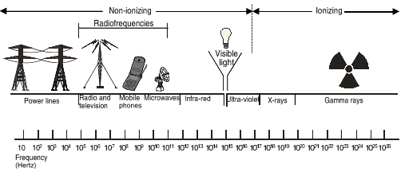
EM Radiation Types

Slide 19
X-rays vs. Other Forms of Ionizing Radiation
X-rays (with some minor exceptions) are produced by machines.
Particulate radiations and gamma rays primarily come from radioactive materials.
X-rays cannot make a person radioactive and cannot result in contamination (loose radioactive materials).

Slide 20
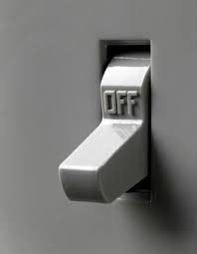
X-rays vs. Other Forms of Ionizing Radiation
X-ray machines have an on-off switch
They can be immediately turned off, removing the source of radiation

Slide 21
Quantities & Their Units of Measurement
Three Basic Quantities
  Exposure – measure of charge in air produced by X-ray or gamma radiation
  Absorbed Dose – measure of energy deposited by any type of ionizing radiation in any material
  Equivalent Dose – measure of biological damage to the human caused by various types of ionizing radiation

Slide 22
Why Three Quantities?
Exposure
  Easy to measure using inexpensive instruments
  Can be related to other two quantities
Absorbed Dose
  Widely applicable to measuring effects of radiation
  Often difficult to measure
Equivalent Dose (or Dose equivalent)
  Allows for biological differences in humans for different types of radiations
  Used for regulatory limits

Slide 23
Exposure Units
Roentgen
  Oldest unit, defined as 0.000258 coulombs/kg in air
  Still widely used in USA but not defined in the current international scientific unit system (SI)
  Symbol: R
Air kerma (closest SI equivalent)
  Defined as 1 joule/kg in air
  Symbol: Gy_{a} (grays in air – see absorbed dose)
To a close approximation 1R = 0.01 Gy_{a}

Slide 24
Absorbed Dose Units
rad
  Traditional unit defined as 100 ergs/g of energy deposited by any type of ionizing radiation in any mass (g) of material
Gray (Gy)
  SI unit defined as 1 joule/kg of energy deposited by any type of ionizing radiation in any mass (kg) of material
1 rad = 0.01 Gy

Slide 25
Effective Dose Equivalent Dose Units
rem – traditional unit defined as absorbed dose in rad multiplied by modifying factors to account for responses in the human
Sievert (Sv) – SI unit defined as absorbed dose in gray multiplied by modifying factors to account for responses in the human
1 rem = 0.01 Sv

Slide 26
Relationship of Units
For X-ray radiation, to a close approximation we can assume that:
  1 R = 1 rad = 1 rem
  and
  1 Gy_{a} = 1 Gy = 1 Sv

Slide 27
Common Numerical Prefixes
Numeric Value | Prefix | Symbol
10⁶ | mega- | M
10³ | kilo- | k
10⁻² | centi- | c
10⁻³ | milli- | m
10⁻⁶ | micro- | μ
10⁻⁹ | nano- | n

Slide 28
Dose and Dose Rate
Radiation often measured as a dose rate (dose per time) so dose received is calculated as follows:
Dose received = Dose Rate x Time exposed

Slide 29
Example of Dose Rate
& Conversions
Exposure rate in area is 2 mR/hr.
Is yearly limit of 5 rem exceeded?
(Assume occupancy of 40 hours/week and 50 work weeks in year).
Exposure = 2mR/hr x 40 hr/wk x 50 wks/yr
Exposure = 4000 mR/yr = 4 R/yr
Assume 1R = 1 rad = 1 rem, so
Equivalent dose = 4 rem/yr; limit not exceeded

Slide 30
Sources of Radiation
Radiation exposure to the general public comes from a number of sources:
  Natural background radiation (in soil, air, our bodies, etc.)
  Medical procedures
  Occupational exposures
  Consumer products
Following slide shows breakdown of exposures and recent trends

Slide 31
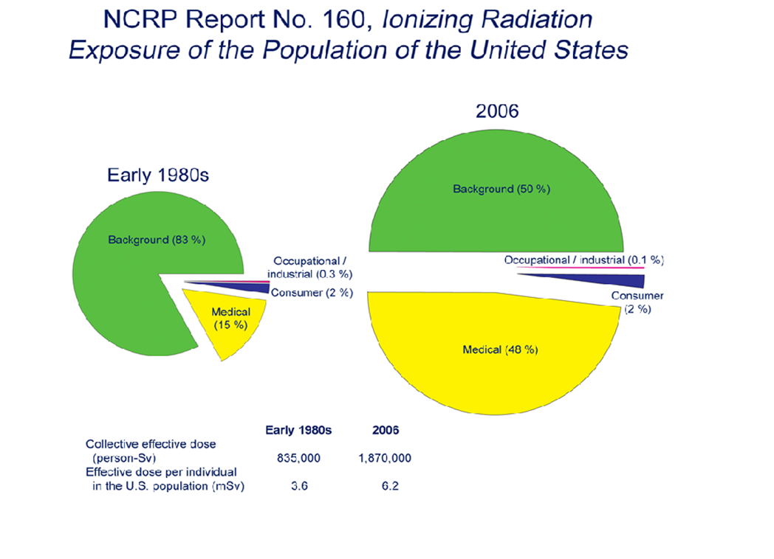

Slide 32
So what has happened?
Background levels are the same, but in % they have decreased to only about half of the total average exposure
Occupational and consumer product levels have remained very low
Medical exposures have increased significantly (on the average)
Why?

Slide 33
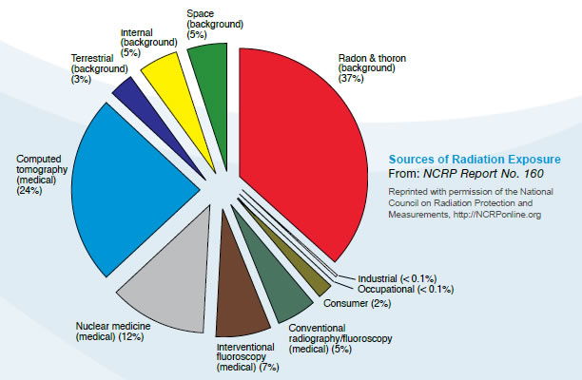

Slide 34
So what has changed?
Large increase in number of CT scans
Increase in nuclear medicine procedures
Newer techniques involve higher doses to the patient

Slide 35
High-Risk vs. Low-Risk Procedures
Pennsylvania has divided X-ray medical procedures into two risk classes:
  High-risk procedures – utilize energies of < 1 MeV that could exceed skin doses of 200 rads (2 Gy).
    Examples: CT scans, interventional radiography
  Low-risk procedures – any radiologic procedure that is not a “high-risk” procedure.
    Examples: conventional x-rays, dental, podiatry, chiropractic, and veterinary
High-risk results in more dose per patient, but many more patients receive low-risk procedures (especially children and young adults).

Slide 36
Biological Effects of Radiation
Harmful effects discovered very early
  (Thomas Edison ceased work on X-rays in 1904 following a serious injury and subsequent death of his assistant due to radiation)
“Law of Bergonie and Tribondeau” developed in France in 1906:
  “The more rapidly a cell is dividing, the greater the sensitivity to radiation”
  Not always true but helpful in explaining effects on certain organs such as skin, blood-forming organs, gonads and unborn children.

Slide 37
What is the primary biological effect?
Research has found that the primary hazard is to DNA
Can result in cell death leading to organ failure, illness, and possible death of exposed person
Or can result in cell mutations leading to cancer in exposed person and possible genetic effects to future generations
Greatest risk at low doses is cancer to exposed person – regulations based on this risk

Slide 38
Acute vs. Delayed Effects
Acute effects (also referred to as early effects or deterministic effects)
  Typically occur at high doses and appear within days or weeks of exposure
  Examples: skin burns, sterility, loss of hair, etc.
Delayed effects (also referred to as late effects or stochastic effects)
  Occur at low doses over long periods of time
  Cancer is greatest concern

Slide 39
Goal of Radiation Regulations
Prevent acute effects to exposed person
  Shield sensitive organs such as lens of eye, thyroid, unborn child
Reduce likelihood of delayed effects
  Keep doses low and make sure they are justified
In other words, ALARA:
As low as reasonably achievable

Slide 40
Review of X-ray Imaging
Part 3

Slide 41
Basic Components of X-ray Tube
Cathode – heated wire to produce large source of electrons and focusing cup to direct them
Anode – target of high atomic number struck by electrons to produce X-rays
Voltage supply – high voltage supply to accelerate electrons from cathode to anode
Envelope – glass or metal vacuum tube containing anode and cathode
Tube housing – shielding around envelope to protect tube and shield unwanted X-rays

Slide 42
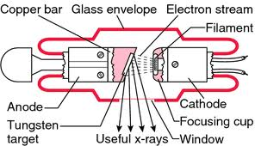

Slide 43
Other Parts of X-ray Machine
Collimator – restricts X-ray beam to only the area of interest
Filtration – removes unwanted low energy X-rays
Transformer – converts low voltage to high voltage needed for tube
Rectifier – converts AC input voltage to DC needed for X-ray tube

Slide 44
Primary Settings on X-ray Tube
Current to cathode – measured in milliamps (mA)
Timer for current in seconds
  Current and timer together are measured in mAs
Voltage across the cathode and anode – measured in kVp (kilovoltage peak, the maximum possible energy a photon exiting the X-ray tube can reach)
  kVp determines the energy of electrons which is directly related to energy of X-rays produced

Slide 45
Quantity and Quality of X-rays
Medical X-rays characterized by quantity and quality
Quantity – number of X-rays reaching the patient
Quality – penetrability or ability of X-ray beam to pass through tissue
(low quality X-rays have little chance of penetrating so they deliver dose to patient while providing no useful medical information)

Slide 46
Factors Affecting Quantity
mAs | when increased | Increases quantity proportionately
kVp | when increased | Increases quantity by square law
distance | when increased | Decreases quantity by inverse square law
filtration | when increased | Decreases quantity

Slide 47
Factors Affecting Quality
mAs | when changed | does not change quality
kVp | when increased | improves quality
distance | when changed | does not change quality
filtration | when increased | increases quality

Slide 48
Impact of Digital Imaging
Digital (computer) imaging replacing conventional (film) systems
  Images immediately available, can be stored and transmitted electronically and post processed to improve image after the fact
Should result in lower dose to patients due to fewer retakes

Slide 49
Dose Creep in Digital Imaging
In some cases doses increased in digital systems
Effect called dose creep
  Digital resulted in good images without changing factors, even if patient dose was higher, so factors were not optimized to lower dose.
  Also, techniques were used to reduce signal noise that resulted in increased dose.
Manufacturer’s recommendations should be reviewed to minimize dose to patient

Slide 50
Reducing Patient (and employee) Dose from Medical X-rays
Sources of radiation in Medical X-ray Imaging:
  Primary beam – also called the useful beam; the X-ray beam coming from the tube, through the patient, to the image receptor.
  Scatter radiation – radiation resulting from the primary beam interacting with other materials. The patient is often the largest source of scatter.
  Leakage radiation – leakage radiation from tube housing, generally a minor source from a properly housed tube.

Slide 51
Administrative Controls for Reducing Radiation Doses
Chapter 221.11 of the Pa. Code, Title 25 - Environmental Protection, has a list of responsibilities for registrants to ensure doses are ALARA
These responsibilities are summarized in the following tables:

Slide 52
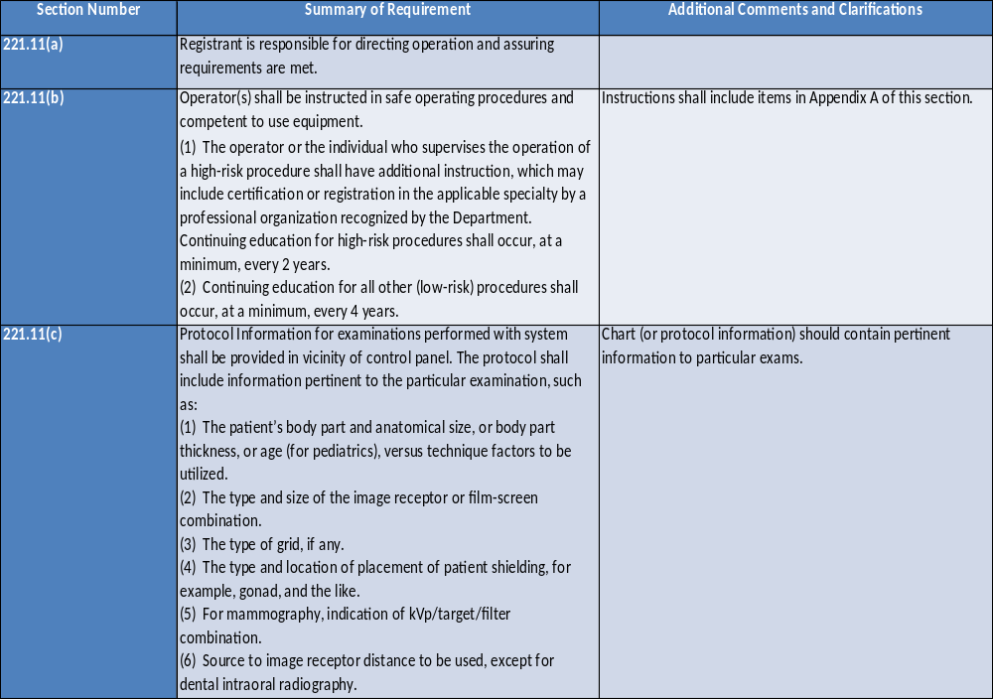

Slide 53
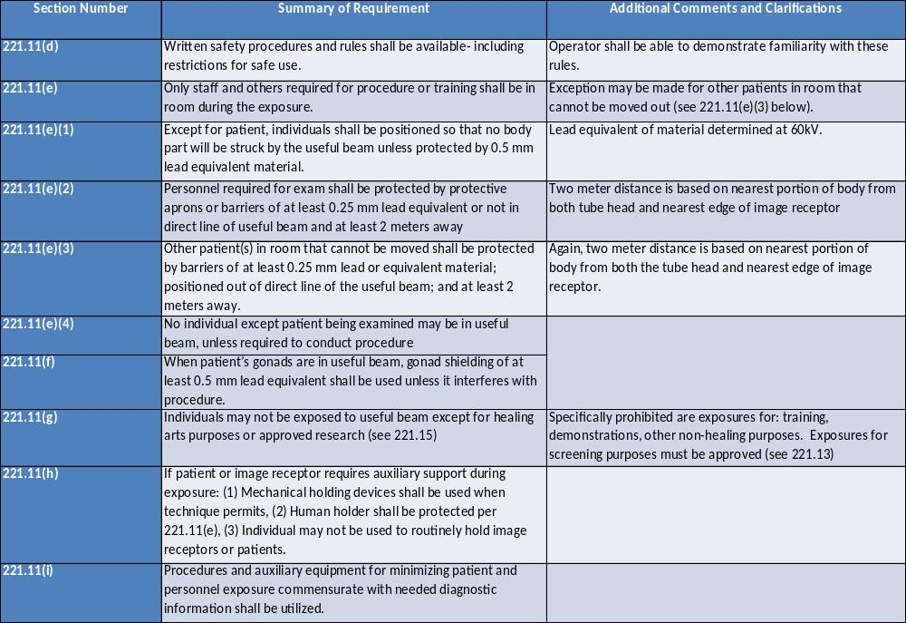

Slide 54
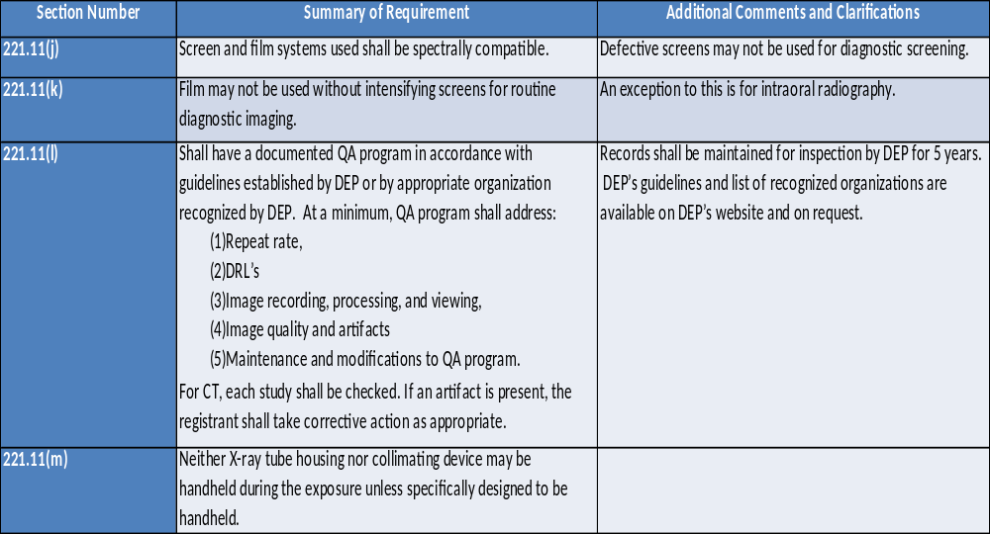

Slide 55
Additional Techniques for
Reducing Dose
kVp and mAs settings
  Generally lowest dose is achieved when kVp settings are increased and mAs settings decreased within the limits of obtaining a good image.
  Prevent dose creep by “technique creep” – gradually increase kVp while decreasing mAs over successive exams as long as image quality remains satisfactory until optimum reached.

Slide 56
Additional Techniques for
Reducing Dose
Use of grids
  While grids can reduce scatter radiation and increase image quality, they increase dose to patient.
  Use only as necessary and avoid on children.
Reducing Dose from scatter radiation
  Workers should increase distance from patient, especially from beam side.
  Use carbon fiber or similar material for cassettes, grids and tables.

Slide 57
Additional Techniques for
Reducing Dose
Collimation and Beam Size
  Primary beam should be sized to cover area of interest but not overly exceed it.
  Collimation to the clinical region of interest should be performed prior to patient exposure.

Slide 58
Special Cases - Children
Historically, children have been imaged with settings similar to adults – resulting in unnecessary dose.
IMAGE GENTLY campaign designed to make medical staff and parents aware of potentially unnecessary exposure to children.
See website at: https://www.imagegently.org/

Slide 59


Slide 60


Slide 61
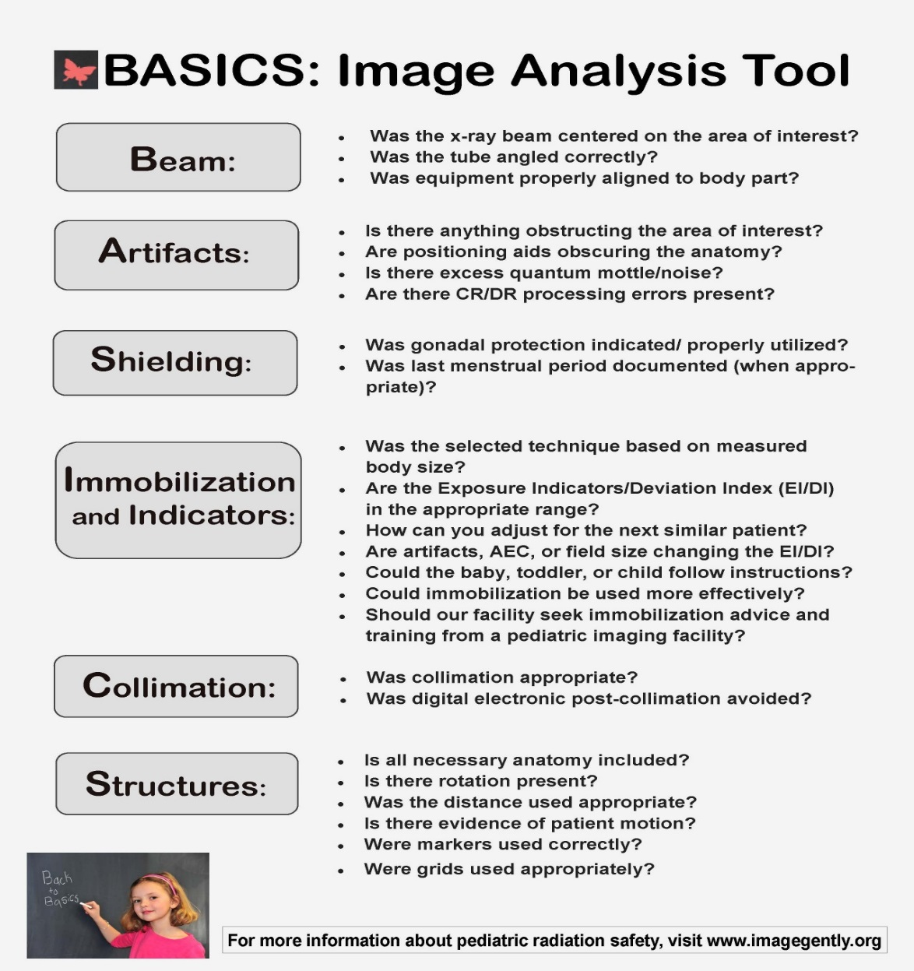

Slide 62
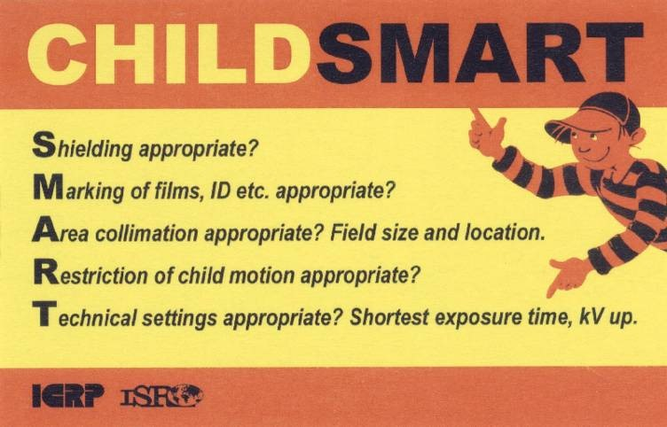
Additional Sources of Information
International Atomic Energy Agency has PowerPoints available for free:
http://rpop.iaea.org/RPOP/Content/AdditionalResources/Training/1 TrainingMaterial/PaediatricRadiology.htm
Poster from site:

Slide 63
Other Special Cases – Patient Size
  Larger patients often require adjustments to kVp and mAs that result in higher dose.
  Example: An increase of body thickness from 16 to 24 cm increases scatter 5X.
  Staff should take additional precautions such as increasing distance from patient or use of portable shields.

Slide 64
Pregnant Patients
Special care should be taken to reduce dose to fetus:
  Females of child-bearing age should be informed of risks.
  Warning signs should be posted.
  If X-ray is necessary, efforts should be made to reduce dose to fetus through shielding and/or positioning.

Slide 65
Pregnant Workers
Female medical staff required by federal and state regulations to be instructed on risks.
Special limits apply to “declared” pregnant female (woman has option to declare pregnancy).
NRC Regulatory Guide 8.13 provides information on risks, instructions on declaring pregnancy, and lower limits that then apply.

Slide 66
Radiation Safety Plan, Documentation and QA/QC
Part 4

Slide 67
Radiation Safety Plan
Mechanism that ensures registrant properly directs X-ray program.

Slide 68
Guidance for Diagnostic & Interventional X-ray Procedures
From Federal Guidance Report No. 14
Plan should ensure that:
  Radiation activities are performed in accordance with existing laws and regulations.
  Staff are equipped with knowledge of available options regarding risk vs. benefit determinations and appropriate examinations.
  X-ray users and surrounding public receive adequate protection.

Slide 69
Documentation of Medical
X-ray Program
Charts, records, procedures and other documentation are essential for safety and compliance.
Pennsylvania regulations require certain documentation.

Slide 70
Pennsylvania Requirements for Documentation
25 Pa. Code § 221.11(d)
  Written safety procedures and rules available at facility.
  Operators able to demonstrate familiarity with rules.
  Procedures and rules should be specific for particular applications planned at facility.

Slide 71
Pennsylvania Requirements for Documentation
25 Pa. Code § 221.11(c)
  Protocol Information provided in vicinity of control panel specifying techniques for exams on that system.
25 Pa. Code § 221.12
  Registrant shall maintain records of surveys, calibrations, maintenance, and modifications including names of person performing service.
  Records kept for inspection for minimum of 5 years.

Slide 72
Pennsylvania Requirements
for Documentation
See 25 Pa. Code, Chapter 221 (X-rays in the Healing Arts) for other documentation requirements for specific applications.

Slide 73
Quality Assurance
According to FDA Regulations, Quality Assurance is defined as:
“…the planned and systematic actions that provide adequate confidence that a diagnostic X-ray facility will produce consistently high-quality images with minimum exposure of the patients and healing arts personnel.”

Slide 74
FDA Statement on QA Actions
Should include both “quality control” techniques and “quality administration” procedures:
  QC techniques – techniques used in monitoring or testing and maintenance. Concerned directly with equipment.
  QA procedures – management actions intended to guarantee monitoring techniques are properly performed and evaluated and corrective actions taken.

Slide 75
Pennsylvania Regulatory Requirements for QA Program
25 Pa. Code, § 221.11(l) states:
“…the registrant shall have a quality assurance program. This quality assurance program shall be documented and in accordance with guidelines…”

Slide 76
Guidelines for Developing
QA Program
Available on DEP’s website at:
https://www.dep.pa.gov/Business/RadiationProtection/RadiationControl/X-rayMachineProgram/Pages/Quality.aspx
Pennsylvania guidelines and links to guidelines developed by appropriate professional organizations
Fact sheets on:
  “Minimum QA Requirements for Healing Arts Radiography”
  “Model QA Guidelines for Dental, Diagnostic Radiology and Mammography”

Slide 77
Regulations
Part 5

Slide 78
Brief History and Overview of Radiation Regulations
X-ray machines regulated by states since their early development.
Shortly after WW II, most radioactive materials and all nuclear reactors assigned to be regulated by federal government.
  Originally under the Atomic Energy Commission (AEC) and later under the Nuclear Regulatory Commission (NRC).

Slide 79
Agreement State Status
Because of overlap of many regulatory issues regarding X-rays and radioactive materials, Agreement State arrangements were made.
Federal agency (AEC and later NRC) would allow state regulatory oversight of most radioactive materials.
Federal government maintained control over reactors and certain materials dealing with defense.

Slide 80
Pa. Agreement State Status
Pennsylvania became Agreement State in 2008.
State regulations found in 25 Pa. Code – Environmental Protection, Chapters 215-240.
Federal regulations from Title 10 of the Code of Federal Regulations (or more commonly: 10 CFR) incorporated into some Pennsylvania regulations by reference.

Slide 81
Role of FDA
Federal Food and Drug Administration (FDA) responsible for protecting public from hazardous or unnecessary exposure to radiation-emitting electronic products.
Oversees manufacturer compliance and studies biological effects of radiation.
FDA regulations found in 21 CFR.

Slide 82
FDA, DEP and the MQSA
FDA also regulates mammography facilities under the Federal Mammography Quality Standards Act (MQSA).
In Pennsylvania, DEP’s Bureau of Radiation Protection contracts with FDA to perform annual inspections of mammography facilities.
Pennsylvania also maintains list of certified mammography facilities.

Slide 83
Regulations Related to Use of Diagnostic X-rays
Following slides briefly review regulations regarding diagnostic X-rays in 25 Pa. Code and the incorporated section of 10 CFR.
Not intended to be comprehensive; registrants should always refer directly to the regulations for issues at their facilities.

Slide 84
Registration of Radiation-Producing Machines
25 Pa. Code Chapter 216
Provides requirements for registration, renewal, expiration, or termination of certificate of registration and transfer or disposal of machine.
Applications for renewal sent out at least 2 months prior to expiration.
DEP must be notified of transfer or disposal of X-ray devices.

Slide 85
Standards for Protection Against Radiation
25 Pa. Code Chapter 219
Largely parallels federal regulations in 10 CFR Part 20, which are incorporated by reference.
Many sections not relevant to X-ray facilities since they apply to radioactive materials.
Will highlight those that apply to medical X-ray devices.

Slide 86
Occupational Dose Limits
25 Pa. Code §§ 219.21-22
Applies only to occupational workers – individuals exposed in course of their work.
Does not include background radiation, medical administration to the worker, or other exposures as a member of the public.
Note: this means that radiation doses to an individual from medical procedures performed on them do not fall under these regulations – a frequent concern of radiation workers.

Slide 87

Annual Occupational Dose Limits for Diagnostic X-ray Workers with no Other Occupational Exposure
Effective Dose Equivalent to Whole Body | 5 rem (0.05 Sv)
Lens of Eye Dose Equivalent | 15 rem (0.15 Sv)
Shallow dose equivalent to skin of whole body or extremity | 50 rem (0.5 Sv)
Dose limits for minors (occupational) (< 18 years old) | 10 % of adult limits
Dose equivalent to embryo/fetus of declared pregnant female (See NRC Reg. Guide 8.13) | 0.5 rem (5 mSv) during entire pregnancy (See 10CFR20.1208 for additional information and guidelines)

Slide 88
Dose Limits for Public
25 Pa. Code § 219.51
Shall not exceed 0.1 rem (1 mSv) in a year.
Excludes background radiation or medically administered radiation.
Example: This limit applies to a patient (or other family member) in a waiting room, but not to the medical treatment of the patient.
Note: Value was changed from 0.5 rem in 1990s; Pennsylvania does not require retrofitting of shielding for installations existing before Nov. 18, 1995 as long as similar equipment is used.

Slide 89
Shielding of X-ray Facilities
X-ray facilities are shielded to protect individuals in adjoining areas and are based on expected use of those areas outside the X-ray room.
Major renovations of facilities or replacement of machines resulting in higher workloads may require a review of the shielding in-place to ensure that it is still adequate.

Slide 90
Storage and Control
25 Pa. Code §§ 219.131-132
Sources of radiation (including X-ray machines) shall be secured from unauthorized removal or access while in storage or available for use.

Slide 91
Posting Requirements
25 Pa. Code §§ 219.159-160
Radiation-producing machines are required to be labeled indicating that radiation is produced when energized:
CAUTION – RADIATION
THIS EQUIPMENT PRODUCES RADIATION WHEN ENERGIZED
(Caution signs based on radiation level not required for rooms with machines used solely for diagnosis in the healing arts).

Slide 92
Reporting Requirements
25 Pa. Code §§ 219.221,222,229
Report shall be made to the state of stolen, lost or missing sources of radiation including radiation-producing machines.
Report required to state if determination by physician of actual or suspected damage to organ or system of patient exposed to therapeutic or diagnostic radiation.

Slide 93
Notices, Instructions & Reports to Workers; Inspections &Investigations
Registrants required to post:
  Pa. Code Chapters 219 and 220
  Certificate of Registration
  Applicable operating procedures
  Notices of violations
Alternatively, registrant may post notice describing documents and where they may be examined.

Slide 94
Notices to Employees”
DEP Form 2900-FM-RP0003 “Notice to Employees” required to be posted.
Available on DEP’s website.
Outlines employer’s and worker’s responsibilities, items covered by regulations, reports on workers’ radiation history and inspections.
Provides contact information for DEP’s Bureau of Radiation Protection.

Slide 95
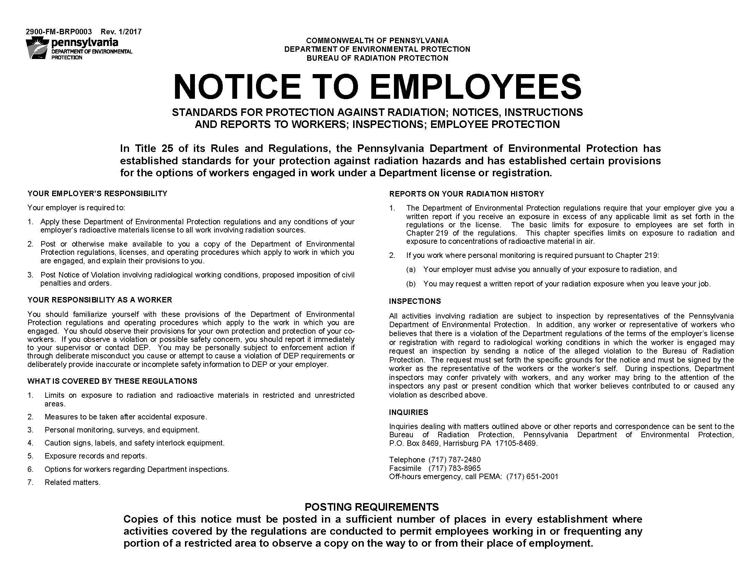

Slide 96
X-rays in the Healing Arts
Chapter 221 provides detailed information on requirements for medical X-rays
  General Provisions (§§ 221.1 and 221.2) discuss purpose and scope of this chapter and provide extensive list of definitions.
  Administrative Controls (§§ 221.11-221.15) cover registrant responsibilities, reports, records, applicability and associated information. These controls have largely been covered during the section on X-ray machines.

Slide 97
X-rays in the Healing Arts
  Diagnostic Installations General Requirements (§§ 221.21-221.50) provide specific regulations for operation, maintenance, and control of X-rays used in healing arts.
  Registrant should review these regulations for their specific facility to determine application.
  A table of the section titles and a brief review of the requirements follows:

Slide 98
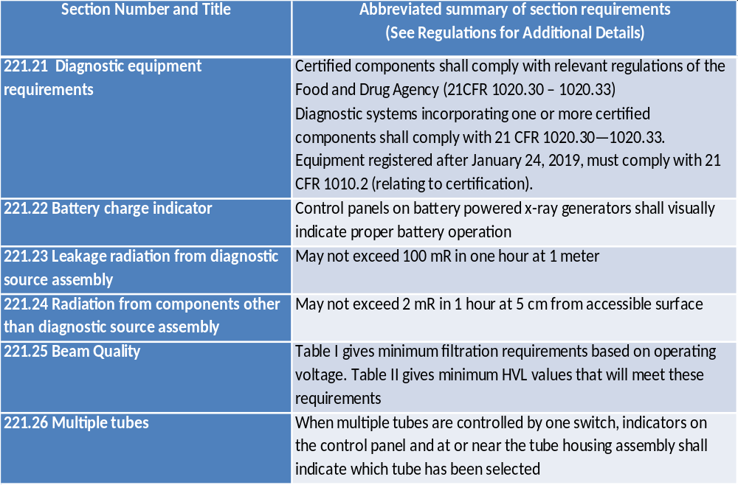

Slide 99
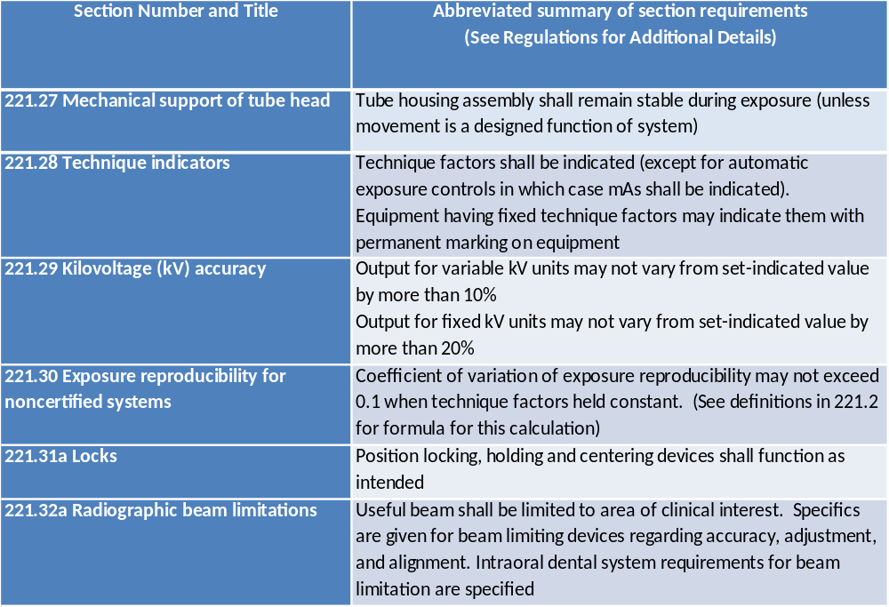

Slide 100
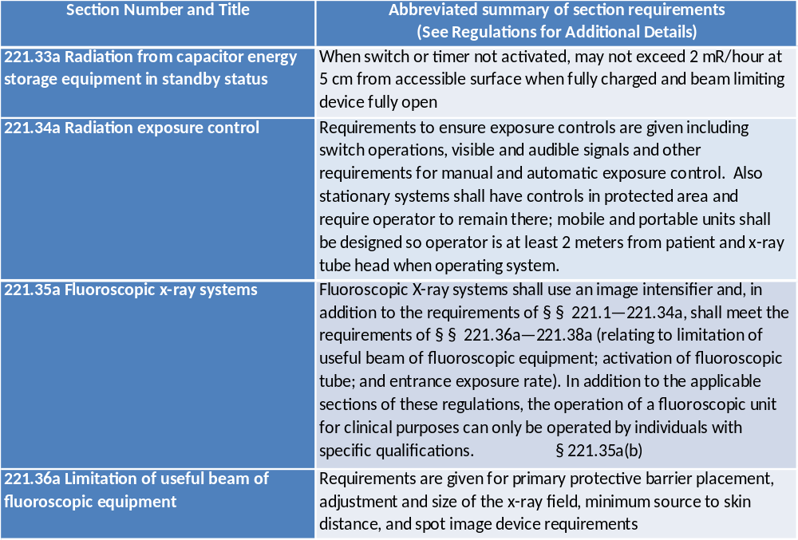

Slide 101
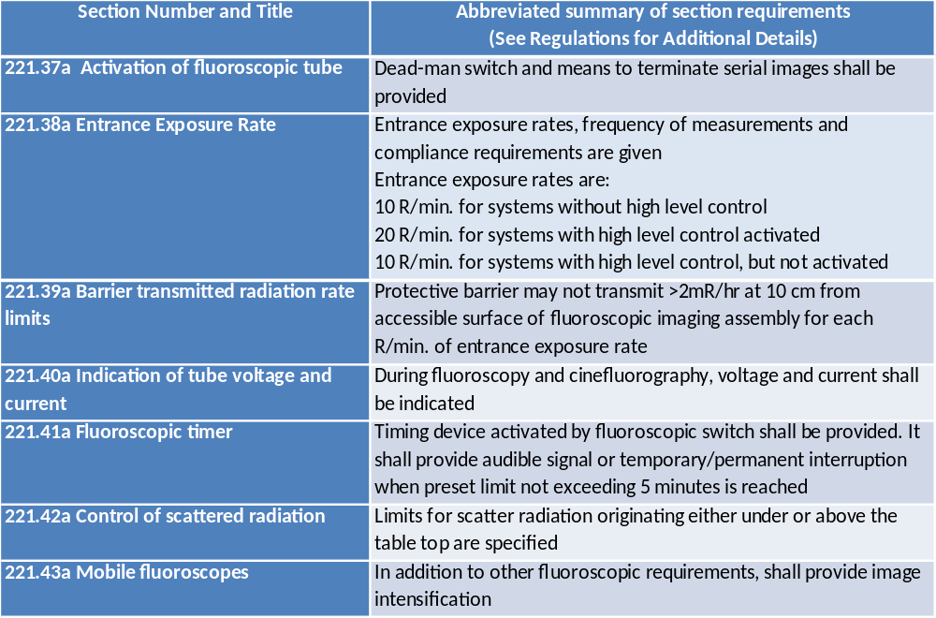

Slide 102
X-rays in the Healing Arts
Remainder of Chapter 221 deals with radiation therapy simulations systems, therapeutic X-rays systems with energies less than 1 MeV and computed tomography X-ray systems and are beyond the scope of this training program.

Slide 103
Conclusion
This section has presented an overview of the regulations that apply to medical X-rays used in low-risk procedures. Registrants should directly consult the applicable regulations or contact the Pennsylvania Department of Environmental Protection, Bureau of Radiation Protection, for questions or concerns.

Slide 104
Online Continuing Education Radiation Safety Quiz
The Online Continuing Education Radiation Safety Quiz is found at:
https://www.pa.gov/agencies/dep/programs-and-services/radiation-protection/radiation-control-division/x-ray-machine-program/continuing-education-requirements/safety-quiz
Upon successful completion of the quiz, print out the confirmation webpage and retain in your records.

Slide 105
Contact Information
Pa. Department of Environmental Protection
Bureau of Radiation Protection
P.O. Box 8469
Harrisburg, PA 17105-8469
Telephone (717) 787-3720
Email: RA-EPRadiationContro@pa.gov
Off-hours emergency call PEMA (717) 651-2001

