Slide 1
Nuclear Power Plant Decommissioning Low-Level Waste Advisory Committee Annual Meeting October 4, 2019
Tom Wolf, Governor
Patrick McDonnell, Secretary

Slide 2
What is Decommissioning?
Removal of a facility from service and reduction of residual radioactivity to a level that permits termination of the NRC license
NRC requires the licensees to decommission the nuclear plant after it ceases power operations
NRC regulates and provides oversight of the decommissioning process

Slide 3
Decommissioning Methods
DECON (immediate dismantling) - The equipment, structures and portions of the facility containing radioactive contaminants are removed and decontaminated to a level that permits release of property and termination of the NRC license.
SAFSTOR (deferred dismantling) – The facility is maintained and monitored in a condition that allows the radioactivity to decay; afterwards the plant is dismantled and property decontaminated.
ENTOMB – Radioactive contaminants are permanently encased on site in structurally sound material such as concrete and the facility is maintained and monitored until radioactivity decays to a level that permits termination of the license.

Slide 4
Decommissioning Methods (Cont.)
The licensee may decide to adopt a combination of the first two choices (DECON and SAFSTOR)
Reactor decommissioning actions start 5 years before end of operating license
Decommissioning must be completed within 60 years of permanent cessation of operations

Slide 5
Decommissioning Funds
The licensee must establish or obtain a financial mechanism to ensure there will be sufficient funds for ultimate decommissioning of the facility
Prepayment, External Sinking Fund, Surety Method, Insurance or other Guarantee Method
Each nuclear power plant must report to NRC every two years the status of its decommissioning trust fund (DTF)
Once a plant is within 5 years of permanently ceasing operations, NRC will begin to review the DTF annually
The report must estimate the minimum amount needed for decommissioning using the formulas in 10 CFR 50.75

Slide 6
Phases of Decommissioning
Phase 1. Transition from Operation to Decommissioning
Certificate of permanent cessation of operations
Certificate of permanent removal of fuel from reactor
Post shutdown decommissioning activity report
Phase 2. Major Decommissioning Activities
Permanent removal of major components
Owner can use up to 3 percent of funds for decommissioning planning
Phase 3. License Termination Activities
Submit a license termination plan for final radiation surveys and updated estimates of remaining decommissioning costs
Requires NRC approval of a license amendment and a public meeting
NRC issues a letter terminating the operating license

Slide 7
U.S. Reactor Decommissioning Business Model
Licensee carries out decommissioning activities
Licensee manages a decommissioning contractor
Temporary license transfer to a decommissioning company and return the land and spent nuclear fuel to the utility
Asset sale and license transfer to a non-utility

Slide 8
Reactor Decommissioning Public Involvement
Post Shutdown Decommissioning Activities Report (PSDAR) meeting
License Termination Plan (LTP) meeting
Opportunity for hearing when a licensee submits a License Amendment Request (LAR)
Opportunity to provide comments whenever the licensee submits a PSDAR, LTP or LAR
Opportunity to form a Citizens Advisory Panel for decommissioning activities

Slide 9
Current Decommissioning Issues of Public Stakeholders
Adequacy of decommissioning funding
Decommissioning strategies: prompt vs. deferred
Long-term storage of SNF
Transportation of SNF
Security of the facility
Emergency response reductions
Environmental monitoring

Slide 10
Status of Nuclear Power Plant Decommissioning
10 commercial nuclear power plants have been decommissioned in the U.S.
11 nuclear power plants are in active decommissioning
11 nuclear power plants are in SAFSTOR
11 nuclear power plants have announced shutdowns thru 2025
Source: Nuclear Regulatory Commission (as of August 2019)

Slide 11
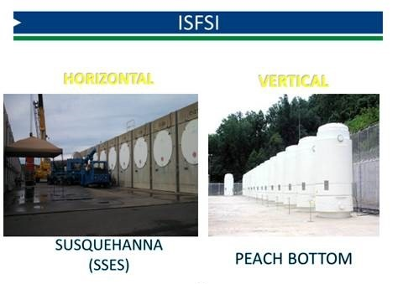
Independent Spent Fuel Storage Installation

Slide 12
ISFSIs in the U.S.
Spent Nuclear Fuel (SNF) Inventory
Approximately 81,518 MTU and increases about 2-2.4K MTU per year
ISFSI Storage
130,252 assemblies; 36,696 MTU (45%); 2,966 casks loaded; 72 operating ISFSIs; fuel from 119 reactors
Long-term commitment to ISFSIs
Licenses being extended to 60 years
License extensions approved at 30 sites
NRC has found 100 years storage to be safe
Source: Nuclear Energy Institute (as of 12/31/2018)

Slide 13
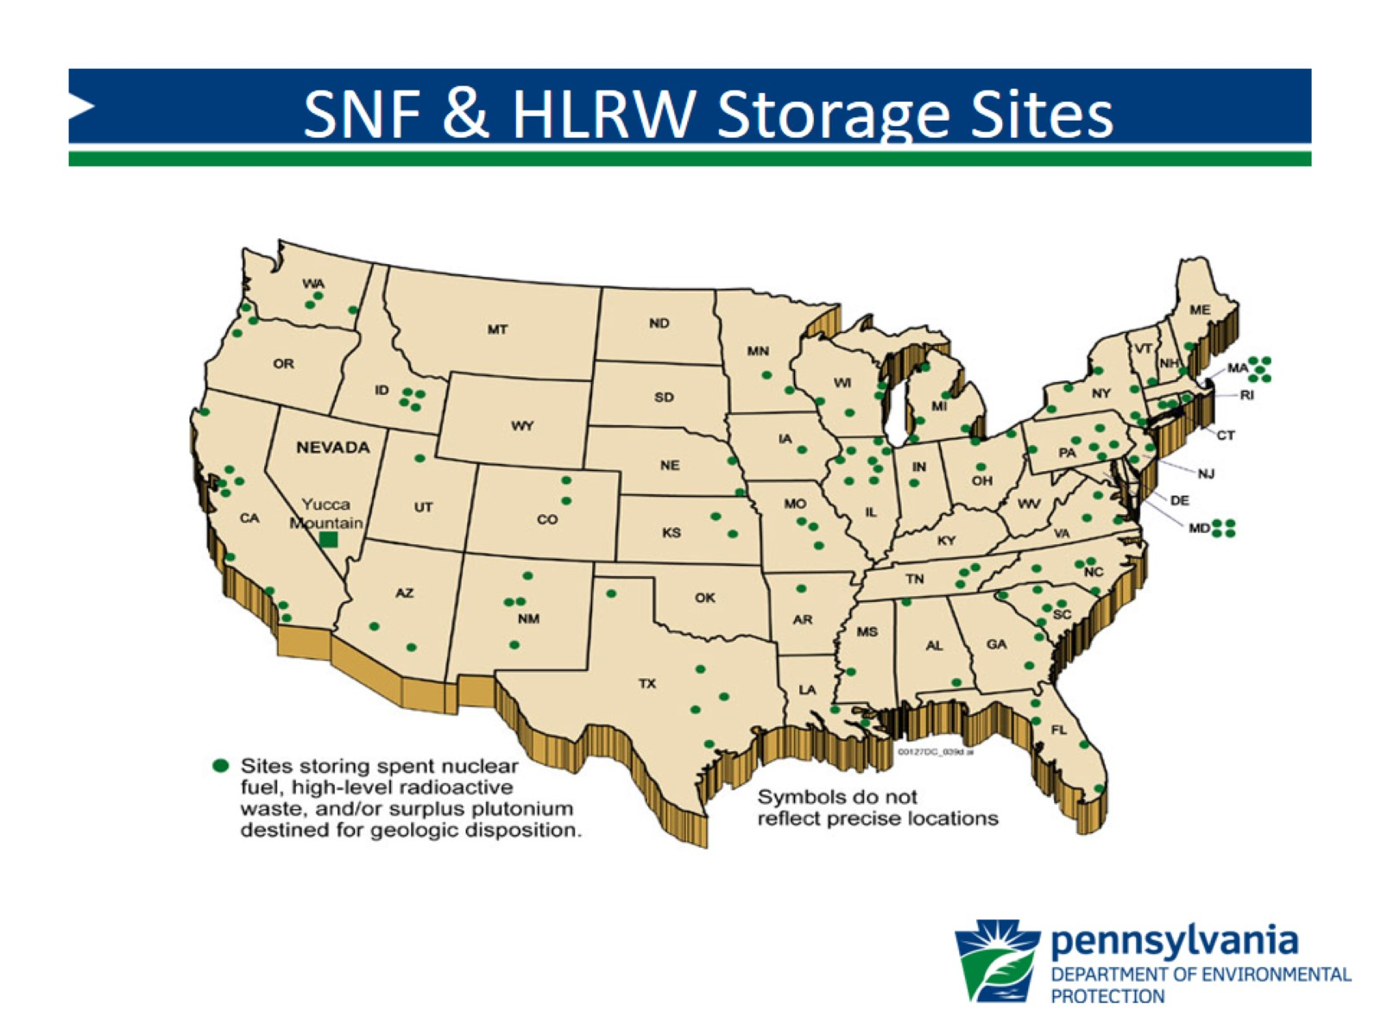

Slide 14
Estimated LLRW Associated with TMI-1 Decommissioning
Waste Type Volume (cubic feet)
High Activity Waste
Class B and C 1,770
Class A 28,152
Low Activity Waste (Class A) 3,373
Very Low Activity Waste (Class A) 316,251
Source: TMI-1 Post Shutdown Decommissioning Activity report

Slide 15
Questions? Rich Janati, M.S. Chief, Division of Nuclear Safety Administrator, Appalachian Compact Commission Phone: 717-787-2163 rjanati@pa.gov

