Slide 1
Exelon Generation Radwaste Oversite and Management Mark Ross – Exelon Corporate Manager Radwaste Low-Level Waste Advisory Committee Meeting October 10, 2017

Slide 2
Exelon Generation Nuclear Fleet
14 sites covering Illinois, Maryland, New Jersey, New York and Pennsylvania.
9 sites are BWR (6 dual unit, 3 single unit)
5 sites are PWR (3 dual unit, 2 single unit)
23 reactors total

Slide 3
Corporate Radwaste
Corporate Vice President Fleet Support – Shane Marik
Corporate Manager Chemistry – Chris Cooney
Corporate Manager Radwaste – Miguel Azar, Cantera IL
Corporate Manager Radwaste – Mark Ross, Kennett Square PA
Roles and responsibilities:
Governance and Oversite of the Radwaste programs, policies and procedures.
Includes vendor contract management, budget forecasting, goal setting at the fleet/station level.

Slide 4
Radwaste System Challenges
Many components in the Radwaste systems are run to failure
Many of these systems are in hi dose areas
Alternate flow paths exists to keep the system processing
Radwaste systems do not get the same attention as others systems
Plants are utilizing vendor processing systems but the influent parameters are not being met

Slide 5
Radwaste System Management
Each Site has a Radwaste Specialist
SPOC – Single Point of Contact for all things RW
Roles and Responsibilities
Manages the following – RW Vendor Contracts, Site RW budget/accrual, RW processing system performance, Improvements/Action Plans and planning/scheduling/bundling work activities including shipment coordination.

Slide 6
Radwaste System Solutions
Program Improvement
Radwaste Control Room annunciators are treated like the Main Control Room as far as priority
If deemed a ‘processing deficiency’ then the Work Management Process increases the priority level
FIN (Fix it Now) team is utilized for most repairs
Radwaste Performance Indicators are used and are always evolving to prevent getting stagnant or meaningless

Slide 7
Radwaste System Solutions
Performance Indicators
Various levels/tiers of performance indicators
At the site level, Radwaste has 5 indicators:
- Corporate Performance Assessment (5 sub-indicators)
- BWR Floor Drain Sump Inputs/PWR Releases
- Resin Generation
- Liner Backlog/Shipping Schedule
- Radwaste System Health

Slide 8
Radwaste System Solutions
Corporate Performance Assessment – (5 sub-indicators)
Cost Savings Initiatives
Report Submittals
Suppliers Observation (SFMS Supplier Fundamental
Management System)
Attendance on Fleet Call
Radwaste Manager Rating

Slide 9
Radwaste System Solutions
Cost Savings
Each site is responsible to establish 3 cost savings initiatives
Tangible
Intangible
Cost avoidance
Track and discussed on monthly fleet calls
Dollar amounts assigned where applicable
Best practices shared with fleet
Budgets adjusted as necessary

Slide 10
Radwaste System Solutions
Report Submittals
2 reports each month
Supplier SFMS
2 observation’s each month
Attendance on Peer Call
Station required on the call – report on IR’s of concern, RW processing status, help or questions
Radwaste Manager Rating
Accruals, procedures, communications, etc.

Slide 11
Radwaste System Solutions
Additional Station Indicators
BWR Floor Drain Sump Inputs/PWR Releases
Resin Generation
Liner Backlog/Shipping Schedule
Radwaste System Health

Slide 12
Exelon owned casks
The Exelon cask fleet has 4 Type A casks and one Type B cask
Two (2) Type A Super 200 casks which are a 14-215 size cask and heavily shielded
Two (2) 14-210 H Casks that serve as ‘normal’ shipments for disposal
One RT-100 Type B Cask that serves the Class B waste which are higher dose rate shipments
Energy Solutions/Hittman provides transportation services, maintenance and scheduling for the Exelon cask fleet
Energy Solutions also provides transportation services for a wide range of trailer, cask and sea-van options

Slide 13
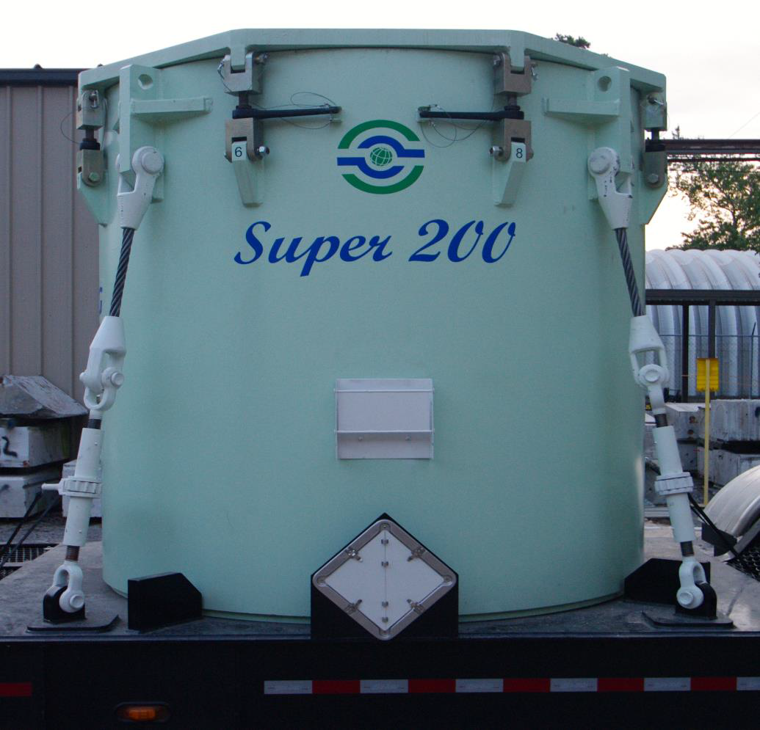
USA DOT SPECIFICATION 7A TYPE A

Slide 14
Super 200 Cask
All the 200 series casks appear to be the same except slight variation of lead equivalence – Exelon Corporation move forward with an improved design that yielded higher shielding than the current 8-120B cask. The S200 cask has 3.65” lead equivalent to support our long Term LLW Strategy.
Most commonly used by Exelon are the industry standard 200 series, which includes the 14-215, 14-210 and 212 Type A casks.
Station’s needs are “next generation” DOT Specification 7A Type A transportation cask that will accommodate standard 200 series disposal containers and provide a higher density shielding than currently available 200 series Type A casks.

Slide 15
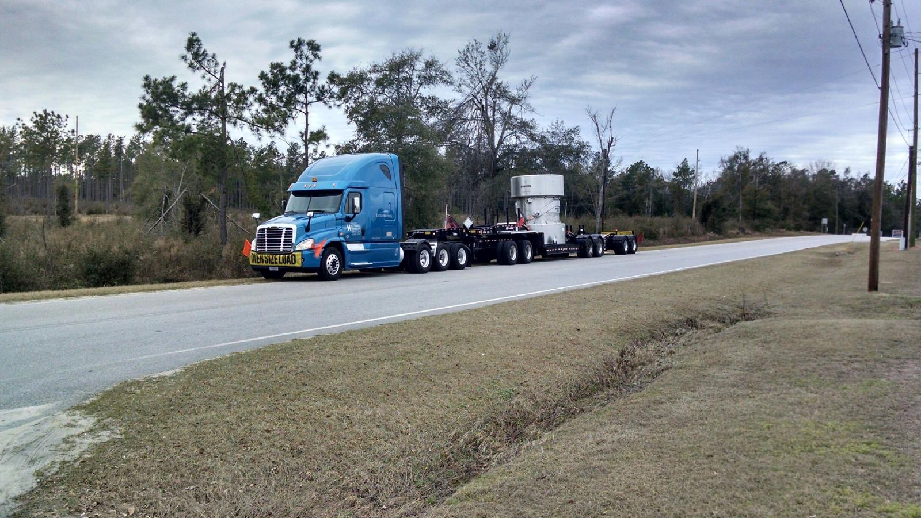
RT-100 Cask
The RT-100 is the first new, large volume Type B shipping cask licensed by the NRC in over 2 decades
Fully loaded, the cask and trailer will be up to 13ft. high, 65 ft. long and weigh over 120,000 pounds

Slide 16
RT-100 Type B Cask
100% Stainless steel construction inside and out
Cask stands 11-feet high, 8.5-feet in diameter – designed to fit in the same loading areas currently used by nuclear power plants
Will accommodate containers up to 160 cubic feet in volume which includes all containers currently used to ship Type B quantities of resins & filters
Payload capacity of 15,000 lbs handles heavier loads
Accommodating containers with contact dose rates up to 500R/hr

Slide 17
Services Provided
Energy Solutions (ES) is our contact and Hittman is the hauler
Energy Solutions/Hittman provides transportation services for all our facilities
On time delivery and communication is key to a successful business relationship

Slide 18
Question/discussions

