Slide 1
Transportation of Radwaste from Exelon Sites Mark Ross – Exelon Corporate Manager Radwaste Date: 10/07/2016

Slide 2
Exelon owned casks
The Exelon cask fleet has 4 Type A casks and one Type B cask
Two (2) Type A Super 200 casks which are a 14-215 size cask and heavily shielded
Two (2) 14-210 H Casks that serve as ‘normal’ shipments for disposal
One RT-100 Type B Cask that serves the Class B waste which are higher dose rate shipments
Energy Solutions/Hittman provides transportation services, maintenance and scheduling for the Exelon cask fleet
Energy Solutions also provides transportation services for a wide range of trailer, cask and sea-van options

Slide 3
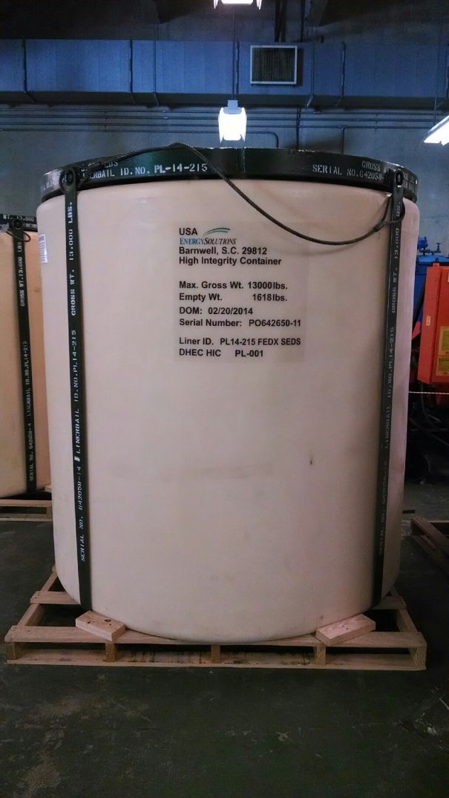
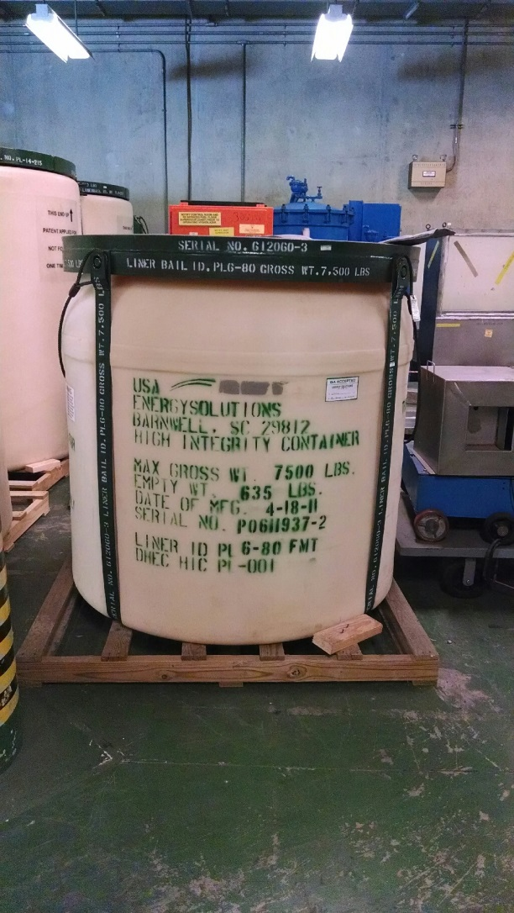
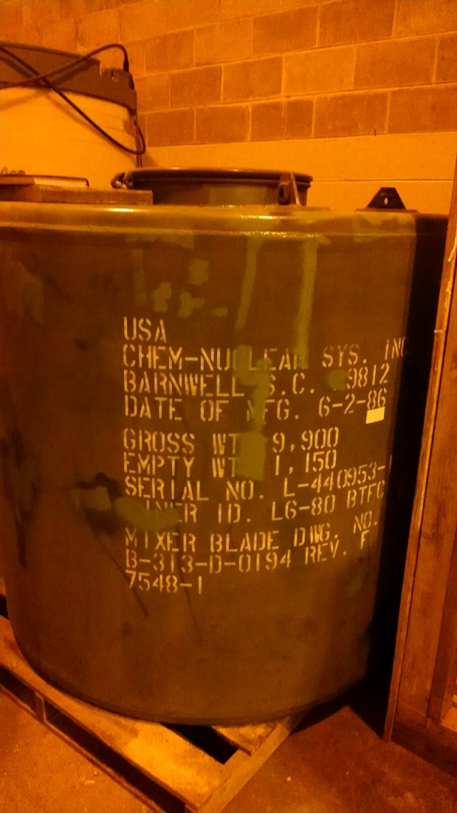
Liners
Poly or Steel – placed inside casks

Slide 4
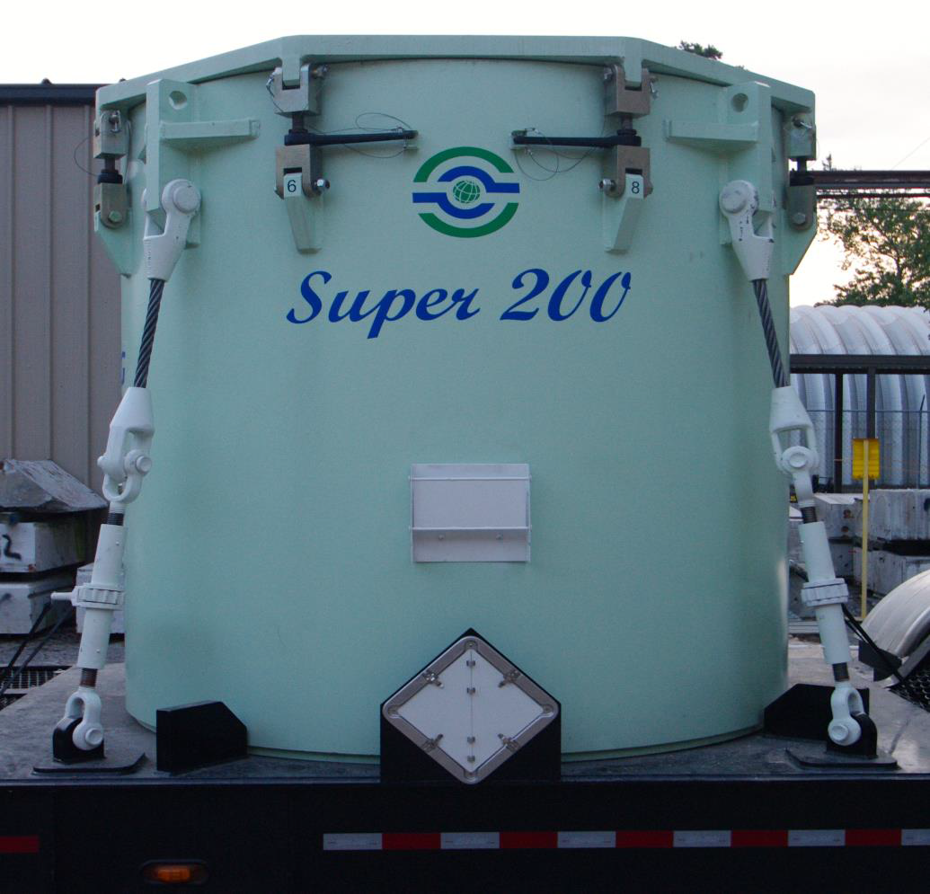
USA DOT SPECIFICATION 7A TYPE A

Slide 5
Super 200 Cask
All the 200 series casks appear to be the same except slight variation of lead equivalence – Exelon Corporation move forward with an improved design that yielded higher shielding than the current 8-120B cask. The S200 cask has 3.65” lead equivalent to support our long Term LLW Strategy.
Most commonly used by Exelon are the industry standard 200 series, which includes the 14-215, 14-210 and 212 Type A casks.
Station’s needs are “next generation” DOT Specification 7A Type A transportation cask that will accommodate standard 200 series disposal containers and provide a higher density shielding than currently available 200 series Type A casks.

Slide 6
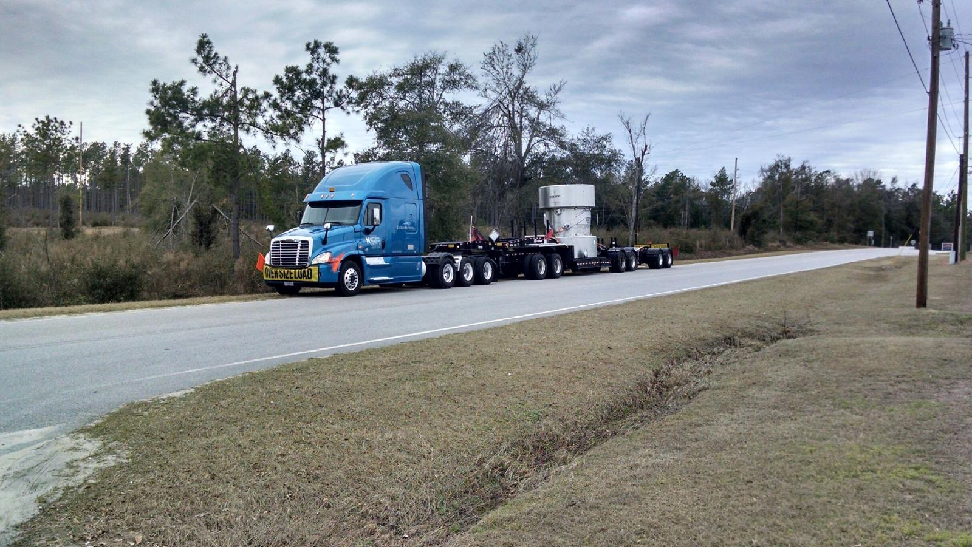
RT-100 Cask
The RT-100 is the first new, large volume Type B shipping cask licensed by the NRC in over 2 decades
Fully loaded, the cask and trailer will be up to 13ft. high, 65 ft. long and weigh over 120,000 pounds

Slide 7
RT-100 Type B Cask
100% Stainless steel construction inside and out
Cask stands 11-feet high, 8.5-feet in diameter – designed to fit in the same loading areas currently used by nuclear power plants
Will accommodate containers up to 160 cubic feet in volume which includes all containers currently used to ship Type B quantities of resins & filters
Payload capacity of 15,000 lbs handles heavier loads
Accommodating containers with contact dose rates up to 500R/hr

Slide 8
Services Provided
Energy Solutions (ES) is our contact and Hittman is the hauler
Exelon manages a fleet of 14 Nuclear Power Plants across 5 states
Energy Solutions/Hittman provides transportation services for all our facilities
On time delivery and communication is key to a successful business relationship

Slide 9
Question/discussions

