Slide 1
Status of Low-Level Radioactive
Waste (LLRW) Compacts and Update
on Commercial LLRW Disposal
Facilities
Tom Wolf, Governor Patrick McDonnell , Acting Secretary

Slide 2
Background - Federal Legislation
States Responsible
Compacts Encouraged
Exclusion of out-of-Compact Waste
Federal
Low-Level
Radioactive Waste
Policy Act

Slide 3
Background – LLRW Disposal Facility Siting Process in PA
Statewide Screening 1991
↓
Regional Screening 1993
↓
Local Screening 1994
↓
Community Partnering Process 1996-1998 ↓
Siting Process Suspended December 1998
Eliminated 78% of Land in PA

Slide 4
Background - Reasons for Suspension of PA siting Process
Significant reduction in the amount of LLRW due to high cost of disposal
High cost of developing new facilities
Availability of out-of-state disposal facilities

Slide 5
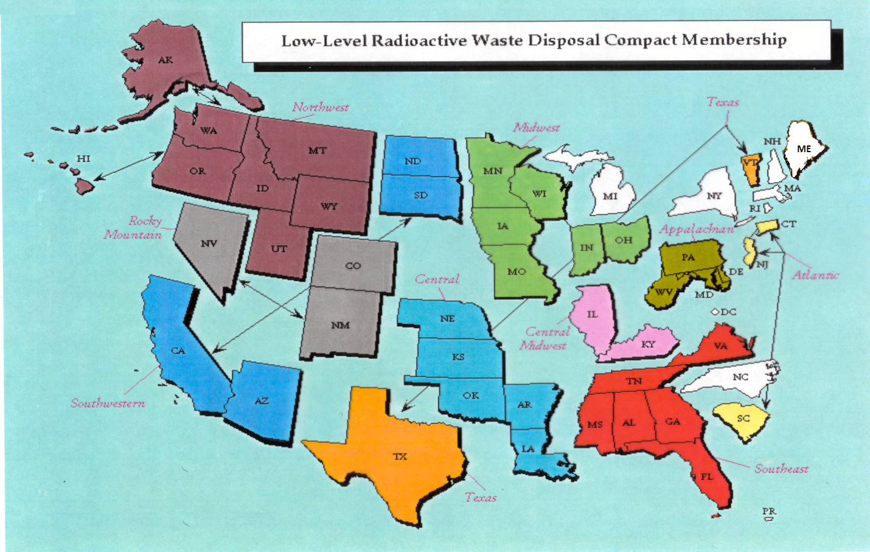
Status of LLRW Compacts

Slide 6
Status of Commercial LLRW Disposal Facilities
Barnwell Disposal Facility in South Carolina (Regional Facility)
Accepts Class A, B and C wastes from the Atlantic Compact (CT, NJ, SC)
Closed to generators outside the Atlantic Compact as of July 1, 2008
Current projected closure date is 2038
Richland Facility in Washington (Regional Facility)
Accepts Class A, B and C wastes from the Northwest and Rocky Mountain Compacts (11 states in 2 compacts)
Accepts NORM/NARM waste from states throughout the nation
Current projected closure date is 2056
Energy Solutions Facility in Utah (not a Regional Facility)
Accepts Class A waste from the entire nation except the Northwest and Rocky Mountain Compacts
Provides for disposal of bulk waste, containerized waste, large components, and mixed waste
Transports large components such as steam generators for disposal

Slide 7
Status of Commercial LLRW Disposal Facilities
(EnergySolutions Cont.)
Regulatory review for disposal of large quantities of depleted
uranium (DU) underway
Utah granted license variance for disposal of Class A sealed sources
Received and managed 41,190 sealed sources between 2013
and 2015 under the CRCPD Source Collection and Threat Reduction
(SCATR) Program
Approval for disposal of Class A sealed sources has been requested
and is part of the permanent license amendment
Current projected closure date is 2050

Slide 8
Status of Commercial LLRW Disposal Facilities
WCS Disposal Facility in Texas (Regional Facility)
Two facilities: one license
Compact facility (initially licensed for 2.3 Mft³ and 3.9 MCi)
Federal facility for DOE waste (26 Mft³ and 5.6 MCi)
Accepts commercial LLRW (Class A, B and C) and federal LLRW and mixed waste
Annual limit on radioactivity of out-of-compact waste is 275,000 Ci
No annual limit on volume of out-of-compact waste
Volume expansion from 2.3 Mft³ to 9 Mft³ granted by TCEQ
Disposal of Depleted Uranium (DU) and Greater-Than-Class C (GTCC) waste is being considered
Current projected closure date is 2045
TCEQ – Texas Commission on Environmental Quality

Slide 9
PA Nuclear Power Plants License Expiration Date
Power Plant | Utility | License Expiration Date
Beaver Valley Power Station, Unit1 | First Energy | 2036
Beaver Valley Power Station, Unit 2 | First Energy | 2047
Limerick Generating Station, Unit 1 | Exelon | 2044
Limerick Generating Station, Unit 2 | Exelon | 2049
Peach Bottom Atomic Power Station, Unit 2 | Exelon | 2033
Peach Bottom Atomic Power Station, Unit 3 | Exelon | 2034
Susquehanna Steam Electric Station, Unit 1 | Talen * | 2042
Susquehanna Steam Electric Station, Unit 2 | Talen | 2044
Three Mile Island Nuclear Generating Station Unit 1 | Exelon | 2034
* Formerly PPL Susquehanna

Slide 10
Recent Developments
NRC issued Final Environmental Impact Statement (EIS) for Bell Bend reactor site near Berwick, PA (NUREG-2179)
DOE issued Final EIS for Disposal of Greater-Than-Class C (GTCC) low-level radioactive waste (DOE/EIS-0375)
SHINE Medical Technologies receives construction permit from NRC for a medical isotope production facility in Janesville, WI
NRC releases results of Byproduct Material Financial Scoping Study including recommendations for next step (SECY-16-0046)

Slide 11
NRC Issues Final EIS for Bell Bend Nuclear Power Plant (BBNPP)
In October 2008, PPL Bell Bend submitted to NRC an application for the COL at the BBNPP site is seeking approval to build and operate a 1600 MWe EPR in Berwick, PA
In April 2016, the NRC issued a final EIS for BBNPP (NUREG-2179)
NRC and the USACE concluded that environmental impacts would not prevent issuing a COL for the BBNPP site
AREVA, the EPR designer, has requested that NRC suspend its safety review of the U.S. EPR design certification
Reactor design certification review and BBNPP safety review are on hold until further notice
COL – Combined License
EPR – Evolutionary Power Reactor
USACE – U.S. Army Corp on Engineers

Slide 12
DOE Issues Final EIS on GTCC Waste Disposal
In February 2016, DOE issued the final EIS for GTCC LLRW and GTCC-like waste (DOE/EIS-0375D)
Currently, there is no disposal capability for GTCC waste
(420,000 ftᶟ, 160 MCi)
EIS evaluates the potential environmental impacts of the proposed development, operation, and long-term management of the disposal facility for GTCC waste
DOE reviewed five alternative options for disposal of GTCC waste
The preferred alternative is disposal at WIPP and/or land disposal at generic commercial facilities
DOE will submit a report to the Congress on disposal alternatives and await action by Congress before it issues a Record of Decision

Slide 13
SHINE Receives Construction Permit from NRC
In February 2016, NRC issued a construction permit to SHINE Medical Technologies for a facility (57,000 ft²) in Janesville, WI
The facility will produce molybdenum-99 (Mo-99) through fission of low-enriched uranium (<20%)
Mo-99 has not been produced for medical use in the U.S. for more than two decades
SHINE applied for the permit in 2013 and NRC completed it technical review in October 2015 under 10 CFR Part 50
Construction is expected to begin in early 2017 and SHINE expects to begin commercial sales from the facility in early 2019
PEC, Inc. has informed NRC of its intention to begin the licensing process for an Mo-99 production facility in Utah

Slide 14
NRC Releases Results of Byproduct Material Financial Scoping Study
In April 2016, NRC released the results of Byproduct Material Financial Scoping Study and its recommendations (SECY-16-0046)
NRC reviewed current regulations and guidance, internal and external reports, and received feedback from the stakeholders
NRC recommends that financial assurance requirements in Part 30.35 be expanded to include byproduct material Category 1 and 2 sealed sources that are in the NSTS
NRC staff plans to develop a rulemaking plan SECY paper to the Commission to initiate rulemaking
NSTS – National Source Tracking System

Slide 15
Categories of Radioactive Sealed Sources
Category 1: greater than or equal to Category 1 threshold (e.g., for Co-60: 810 Ci) – irradiators, teletherapy machines
Category 2: less than the Category 1 threshold but equal to or greater than the Category 2 threshold - 1/100th of Category 1 (e.g., for Co-60: 8.1 Ci) – industrial gamma radiography equipment, well logging gauges
Category 3: less than the Category 2 threshold but equal to or greater than the Category 3 threshold - 1/10th of Category 2 (e.g., for Co-60: 0.81 Ci) – industrial gauges, industrial calibration sources
Category 4: less than the Category 3 threshold but equal or greater than the Category 4 threshold -1/100th of Category 3 (e.g., for Co-60: 0.0081 Ci) ‒ thickness gauges, bone densitometers
Category 5: less than the Category 4 threshold down to IAEA exempt quantities – x-ray fluorescence devices, static eliminators
IAEA – International Atomic Energy Agency

Slide 16
Rich Janati, M.S.
PA DEP Bureau of Radiation Protection
PO Box 8469
Harrisburg, PA 17105-8469
Tel: 717-787-2163
rjanati@pa.gov

