Slide 1
Status of Low-Level Radioactive
Waste (LLRW) Compacts and update
on Commercial LLRW Disposal
Facilities
Tom Wolf, Governor John Quigley , Secretary

Slide 2
Federal and State Legislation
1980 - Federal LLRW Policy Act
1985 - Federal LLRW Amendment Act
1985 - Appalachian States LLRW Act
1988 - Pennsylvania LLRW Act
1990 - Pennsylvania LLRW Regional Facility Act

Slide 3
Federal Legislation
States Responsible
Compacts Encouraged
Exclusion of out-of-Compact Waste
Federal
Low-Level
Radioactive Waste
Policy Act

Slide 4
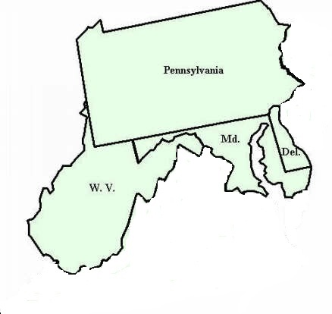
Pennsylvania Responded
Passed Appalachian States LLRW Compact Act in 1985 and formed a compact with Maryland, Delaware and West Virginia.
Is initial host state for facility.
Can legally exclude out-of-compact waste.
Passed Pennsylvania LLRW Disposal Act in 1988.
Passed PA LLRW Regional Facility Act in 1990.

Slide 5
Appalachian States LLRW Compact Commission
Provides for the regional management and disposal of LLRW.
Appalachian States LLRW Compact Act of 1985 established the compact.
Congress consented to the compact in May 1988.
Commission consists of 10 members – PA (4), MD (2), DE (2), WV (2).
Commission became operational in June 1990.

Slide 6
LLRW Disposal Facility Siting Process in PA
Statewide Screening 1991
↓
Regional Screening 1993
↓
Local Screening 1994
↓
Community Partnering Process 1996-1998 ↓
Siting Process Suspended December 1998
Eliminated 78% of Land in PA

Slide 7
Reasons for Suspension of PA siting Process
Significant reduction in the amount of LLRW due to high cost of disposal.
High cost of developing new facilities.
Availability of out-of-state disposal facilities.

Slide 8
Appalachian Compact LLRW Generation Trend
This data is from the Manifest Information Management System –
The Idaho National Engineering and Environmental Laboratory.
Volume is in cubic feet

Slide 9
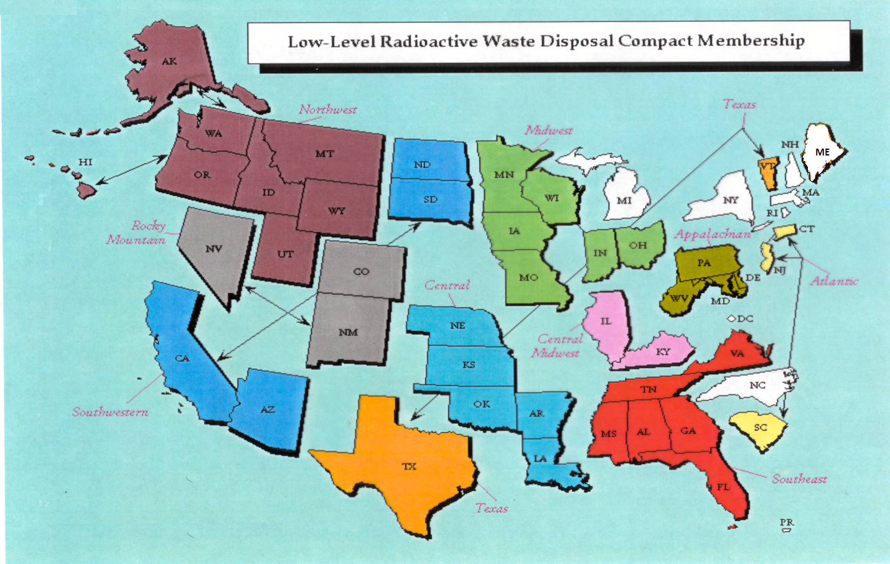
Status of LLRW Compacts

Slide 10
Status of Commercial LLRW Disposal Facilities
Barnwell Disposal Facility in South Carolina (Regional Facility)
Accepts Class A, B and C wastes from the Atlantic Compact (CT, NJ, SC)
Closed to generators outside the Atlantic Compact as of July 1, 2008
Current projected closure date is 2038
Richland Facility in Washington (Regional Facility)
Accepts Class A, B and C wastes from the Northwest and Rocky Mountain Compacts (11 states in 2 compacts)
Accepts radium sources for disposal from other compacts
Current projected closure date is 2056
Energy Solutions Facility in Utah (not a Regional Facility)
Accepts Class A waste from the entire nation except the Northwest and Rocky Mountain Compacts
Approval for disposal of Class A radioactive sealed sources expected
Current projected closure date is 2050

Slide 11
Status of Commercial LLRW Disposal Facilities
WCS Disposal Facility in Texas (Regional Facility)
Two facilities: one license
Compact facility (initially licensed for 2.3 Mft³ and 3.9 MCi)
Federal facility for DOE waste (26 Mft³ and 5.6 MCi)
Accepts commercial LLRW (Class A, B and C) and federal LLRW and mixed waste
Annual limit on radioactivity of out-of-compact waste is 275,000 Ci
No annual limit on volume of out-of-compact waste
Volume expansion from 2.3 Mft³ to 9 Mft³ granted by TCEQ
Disposal of Depleted Uranium (DU) and Greater-Than-Class C (GTCC) waste is being considered
Current projected closure date is 2045
TCEQ – Texas Commission on Environmental Quality

Slide 12
PA NUCLEAR POWER REACTORS LICENSE EXPIRATION DATE
Power Plant | Utility | License Expiration Date
Beaver Valley Power Station, Unit1 | First Energy | 2036
Beaver Valley Power Station, Unit 2 | First Energy | 2047
Limerick Generating Station, Unit 1 | Exelon | 2044
Limerick Generating Station, Unit 2 | Exelon | 2049
Peach Bottom Atomic Power Station, Unit 2 | Exelon | 2033
Peach Bottom Atomic Power Station, Unit 3 | Exelon | 2034
Susquehanna Steam Electric Station, Unit 1 | Talen * | 2042
Susquehanna Steam Electric Station, Unit 2 | Talen | 2044
Three Mile Island Nuclear Generating Station Unit 1 | Exelon | 2034
* Formerly PPL Susquehanna

