Slide 1
Appalachian States Low-Level Radioactive Waste Commission
Status of LLRW Compacts and Update on Commercial LLRW Disposal Facilities
November 5, 2021
1

Slide 2
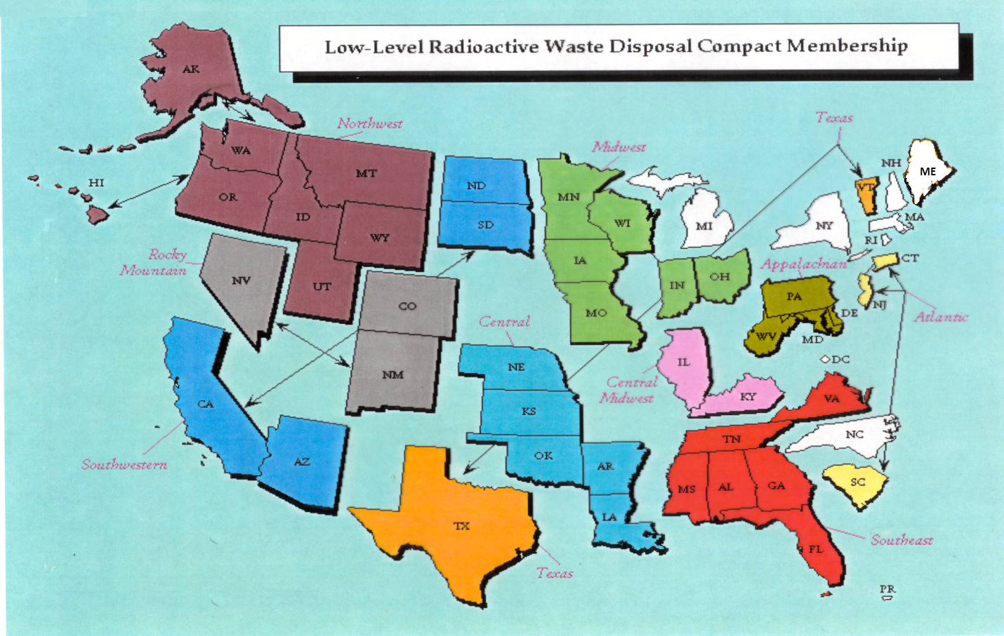
Status of LLRW Compacts
2

Slide 3
Status of Commercial LLRW Disposal Facilities
Barnwell Disposal Facility in South Carolina (Regional Facility)
Accepts Class A, B and C wastes from the Atlantic Compact (CT, NJ, SC)
Closed to generators outside the Atlantic Compact as of July 1, 2008
Richland Facility in Washington (Regional Facility)
Accepts Class A, B and C wastes from the Northwest and Rocky Mountain Compacts (11 states in 2 compacts)
EnergySolutions Facility in Utah (not a Regional Facility)
Accepts Class A waste
Processes radioactive liquids
Provides for disposal of bulk waste, containerized waste, large components, and mixed waste
Transports large components for disposal
Submitted several license amendments related to 11e.(2) cell, disposal of depleted uranium (DU) in the Federal cell, and a proposed exempt cell
3

Slide 4
Status of Commercial LLRW Disposal Facilities
WCS Disposal Facility in Texas (Regional Facility)
Accepts commercial LLRW (Class A, B and C) and federal LLRW and mixed waste
Annual limit on radioactivity of out-of-compact waste is 275,000 Ci
No annual limit on volume of out-of-compact waste
Texas Compact Commission (TCC) Published a Contingency Plan
TCC Forms Capacity Committee
4

Slide 5
LOW-LEVEL WASTE STATISTICS FOR 2020*
Disposal Facility Volume (ft3) Activity (Ci)
WCS, TX 31,560 23,933
Barnwell, SC 31,478 643
Clive, UT 930,528 6,511
Richland, WA 15,291 9,236
TOTAL 1,008,857 40,323
*Source – Nuclear Regulatory Commission
https://www.nrc.gov/waste/llw-disposal/licensing /statistics.html

Slide 6
Questions?
Thank you
Rich Janati, M.S.
Bureau of Radiation Protection
Phone: 717-787-2163
rjanati@pa.gov

