Slide 1
Status of Low-Level Radioactive
Waste (LLRW) Compacts and update
on Commercial LLRW Disposal
Facilities
Tom Wolf, Governor Patrick McDonnell, Secretary

Slide 2
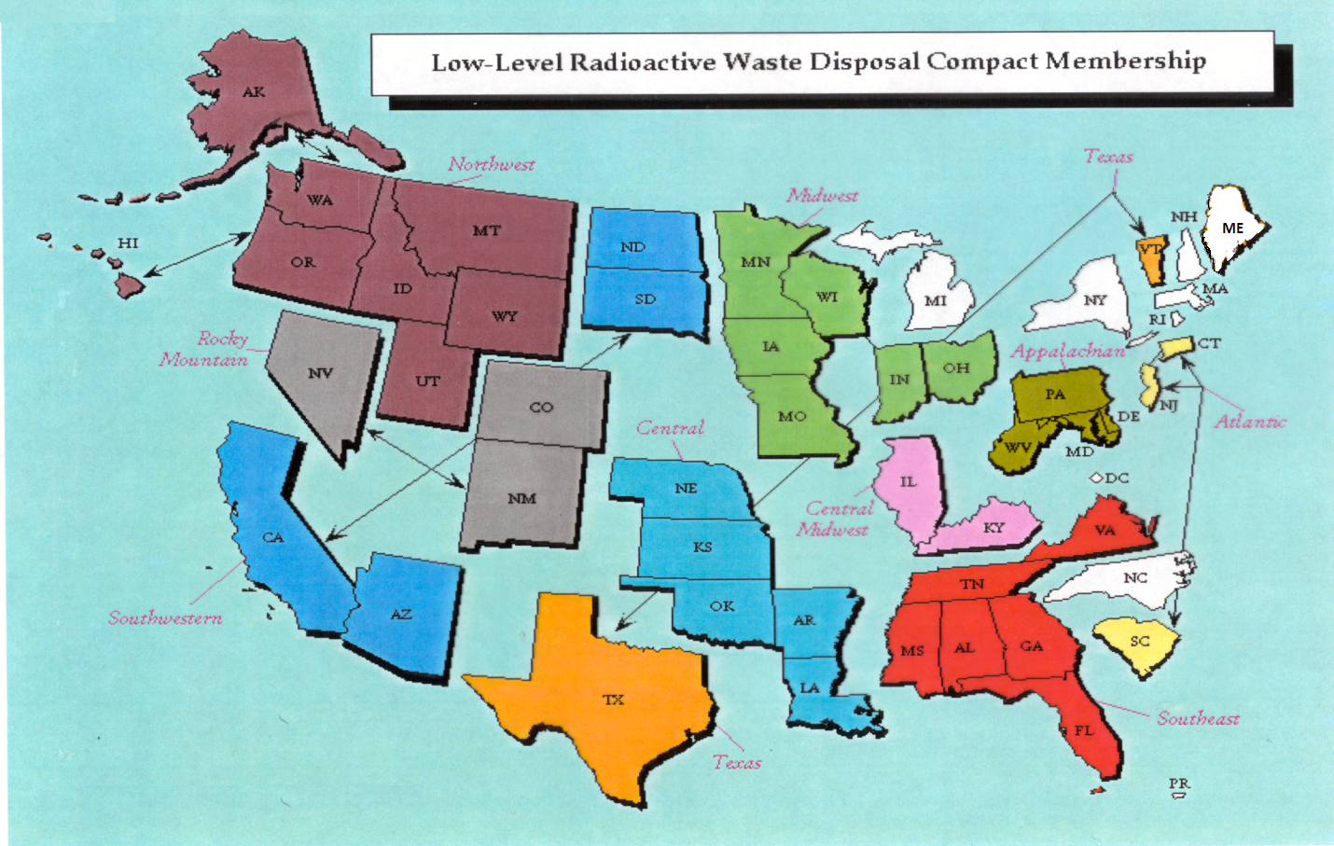
Status of LLRW Compacts

Slide 3
Status of Commercial LLRW Disposal Facilities
Barnwell Disposal Facility in South Carolina (Regional Facility)
Accepts Class A, B and C wastes from the Atlantic Compact (CT, NJ, SC)
Closed to generators outside the Atlantic Compact as of July 1, 2008
Current projected closure date is 2038
Richland Facility in Washington (Regional Facility)
Accepts Class A, B and C wastes from the Northwest and Rocky Mountain Compacts (11 states in 2 compacts)
Current projected closure date is 2056
EnergySolutions Facility in Utah (not a Regional Facility)
Accepts Class A waste from the entire nation except the Northwest and Rocky Mountain Compacts
Provides for disposal of bulk waste, containerized waste, large components, and mixed waste
Transports large components such as steam generators for disposal

Slide 4
Status of Commercial LLRW Disposal Facilities
EnergySolutions Cont.)
Regulatory review for disposal of large quantities of depleted
uranium (DU) underway
Utah granted license variance for disposal of sealed sources
Received and managed 41,192 sealed sources between 2013
and 2016 under the CRCPD Source Collection and Threat
Reduction (SCATR) Program
Approval for disposal of Class A sealed sources has been
requested and it is part of the permanent license amendment
Current projected closure date is 2050

Slide 5
Status of Commercial LLRW Disposal Facilities
WCS Disposal Facility in Texas (Regional Facility)
Two facilities: one license
Compact facility (initially licensed for 2.3 Mft³ and 3.9 MCi)
Federal facility for DOE waste (26 Mft³ and 5.6 MCi)
Accepts commercial LLRW (Class A, B and C) and federal LLRW and mixed waste
Annual limit on radioactivity of out-of-compact waste is 275,000 Ci
No annual limit on volume of out-of-compact waste
Volume expansion from 2.3 Mft³ to 9 Mft³ granted by TCEQ
Disposal of Depleted Uranium (DU) and Greater-Than-Class C (GTCC) waste is being considered
Current projected closure date is 2045
TCEQ – Texas Commission on Environmental Quality

Slide 6
Recent Developments re Management and Disposal of LLRW
Update on EnergeySolutions’ Acquisition of Waste Control Specialists
NRC released a rulemaking plan on financial assurance for disposition of Category 1 and 2 byproduct material radioactive sealed sources (SECY-16-0115)
Commission issued the 10 CFR Part 61 Staff Requirements Memorandum (SECY-16-0106)
NRC plans to issue a FRN to launch a scoping study on the issue of whether and how to define, as well as the potential impacts of defining a new category of “very low activity” radioactive waste

