Slide 1
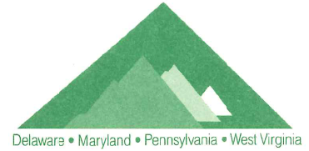
Status of Low-Level Radioactive Waste (LLRW) Compacts and Update on Commercial LLRW Disposal Facilities

Slide 2
LLRW Classification
NRC regulations (10 CFR Part 61) has specified a waste classification system for LLRW.
There are three (3) classes of LLRW: Class A, Class B and Class C.
The majority of LLRW is Class A waste.

Slide 3
Table 1
Radionuclide | Concentration, curies per cubic meter
C-14........................................................... C-14 in activated metal............................. Ni-59 in activated metal............................ Nb-94 in activated metal........................... Tc-99…....................................................... I-129.......................................................... Alpha emitting transuranic nuclides with half-life greater than 5 years…………………. Pu-241....................................................... Cm-242...................................................... | 8 80 220 0.2 3 0.08 *100 *3,500 *20,000
*Units are nanocuries per gram

Slide 4
Table 2
Radionuclide | Concentration, curies per cubic meter
 | Col. 1 | Col. 2 | Col. 3
Total of all nuclides with less than 5 year half-life…… H-3.............................................................................. Co-60 ......................................................................... Ni-63........................................................................... Ni-63 in activated metal............................................. Sr-90........................................................................... Cs-137......................................................................... | 700 40 700 3.5 35 0.04 1 | * * * 70 700 150 44 | * * * 700 7000 7000 4600
*There are no limits established for these radionuclides in class B or C wastes

Slide 5
10 CFR Part 61 – Licensing Requirements for Land Disposal of LLRW
Performance objectives (Subpart C) assure safe disposal of LLRW:
Protection of general public
Protection of inadvertent intruder
Protection of individuals during operations
Stability after site closure
Demonstrate performance via technical analysis and waste classification.
NOTE: PA equivalent regulations is contained in Title 25, Chapter 236.

Slide 6
Federal and State Legislation
1980 - Federal LLRW Policy Act
1985 - Federal LLRW Amendment Act
1985 - Appalachian States LLRW Act
1988 - Pennsylvania LLRW Act
1990 - Pennsylvania LLRW Disposal Regional Facility Act

Slide 7
Federal Legislation
States Responsible
Compacts Encouraged
Exclusion of out-of-Compact Waste
Federal
Low-Level
Radioactive Waste
Policy Act

Slide 8
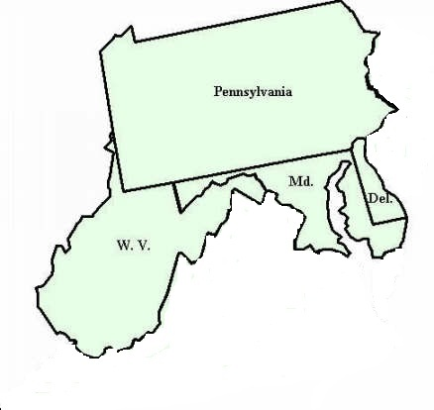
Pennsylvania Responded
Passed Appalachian States LLRW Compact Act in 1985 and formed a compact with Maryland, Delaware and West Virginia.
Is initial host state for facility.
Can legally exclude out-of-compact waste.
Passed Pennsylvania LLRW Disposal Act in 1988.
Passed PA LLRW Regional Facility Act in 1990.

Slide 9
Appalachian States LLRW Compact Commission
Provides for the regional management and disposal of LLRW.
Appalachian States LLRW Compact Act of 1985 established the compact.
Congress consented to the compact in May 1988.
Commission consists of 10 members – PA (4), MD (2), DE (2), WV (2).
Commission became operational in June 1990.

Slide 10
LLRW Disposal Facility Siting Process in PA
Statewide Screening 1991
↓
Regional Screening 1993
↓
Local Screening 1994
↓
Community Partnering Process 1996-1998
↓
Siting Process Suspended December 1998
Eliminated 78% of Land in PA

Slide 11
Reasons for Suspension of PA siting Process
Significant reduction in the amount of LLRW due to high cost of disposal.
High cost of developing new facilities.
Availability of out-of-state disposal facilities.

Slide 12
Appalachian Compact Waste Generation Trend 1986-98
This data is from the Manifest Information Management System – The Idaho National Engineering and Environmental Laboratory. Volume is in cubic feet

Slide 13
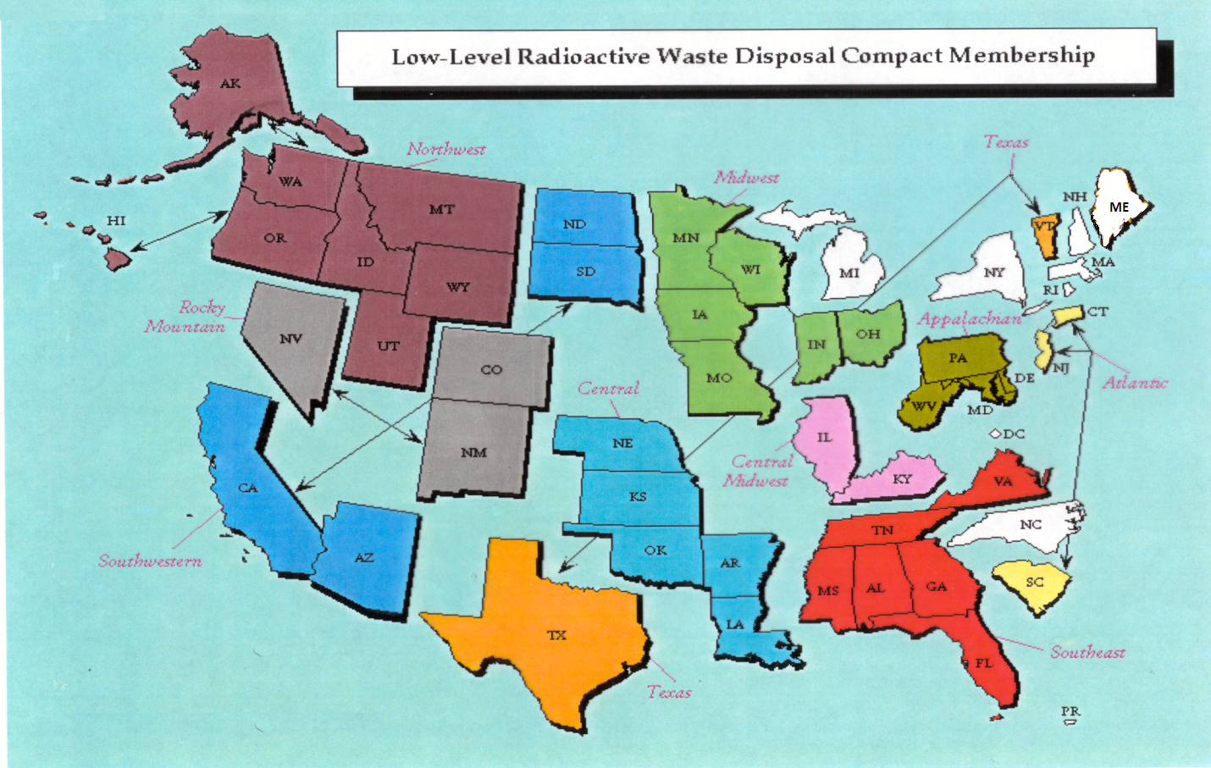
Status of LLRW Compacts

Slide 14
Status of Commercial LLRW Disposal Facilities
Barnwell Disposal Facility in South Carolina (Regional Facility)
Accepts Class A, B and C wastes from the Atlantic Compact (CT, NJ, SC)
Closed to generators outside the Atlantic Compact as of July 1, 2008
Current projected closure date is 2038
Richland Facility in Washington (Regional Facility)
Accepts Class A, B and C wastes from the Northwest and Rocky Mountain Compacts (11 states in 2 compacts)
Accepts radium sources for disposal from other compacts
Current projected closure date is 2056
Energy Solutions Facility in Utah (not a Regional Facility)
Accepts Class A waste from the entire nation except the Northwest and Rocky Mountain Compacts
Approval for disposal of Class A radioactive sealed sources expected
Current projected closure date is 2050

Slide 15
Status of Commercial LLRW Disposal Facilities
WCS Disposal Facility in Texas (Regional Facility)
Two facilities: one license
Compact facility (initially licensed for 2.3 Mft³ and 3.9 MCi)
Federal facility for DOE waste (26 Mft³ and 5.6 MCi)
Accepts commercial LLRW (Class A, B and C) and federal LLRW and mixed waste
Annual limit on radioactivity of out-of-compact waste is 275,000 Ci
No annual limit on volume of out-of-compact waste
Volume expansion from 2.3 Mft³ to 9 Mft³ granted by TCEQ
Disposal of Depleted Uranium (DU) and Greater-Than-Class C (GTCC) waste is being considered
Current projected closure date is 2045
TCEQ – Texas Commission on Environmental Quality

Slide 16
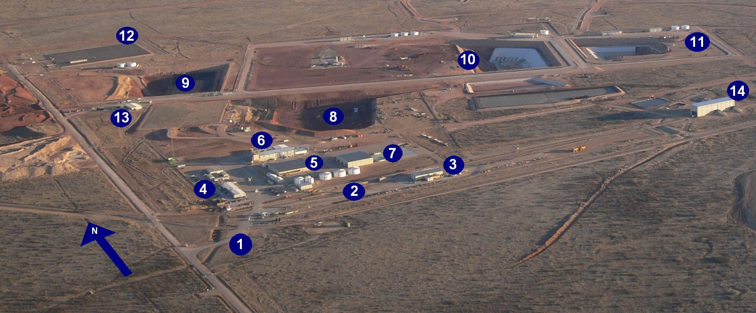
WCS Disposal Facility in Texas
Access road to 1,338-acre fenced site (guard house entrance)
On-site rail spur and rail-unloading facility
3. Maintenance building
4. Administration buildings with analytical and radiological laboratories
5. Container Storage Building (CSB)
6. Stabilization Building (SB) (West portion) and Mixed Waste Treatment Facility (MWTF) (East portion)
7. Bulk/Bin Storage Units (BSUs)1-3 (bin storage area [BSA-1] is covered)
RCRA Subtitle C landfill will expand to the East, with closed cells to the West
9. 11e (2) Byproduct material landfill
10. Federal Waste Disposal Facility (FWF) for LLW and LLMW will expand to the West
11. Compact Waste Disposal Facility (CWF) for LLW will expand to the East
12. Ten-acre storage area for low-specific-activity (LSA) waste
13. Low-level disposal operations administration building
14. Rail unloading building for emptying gondola cars

