Slide 1
TENORM Study Update
Appalachian Compact Commission Meeting
November 5, 2014
Tom Corbett, Governor Dana Aunkst, Acting Secretary

Slide 2
Background
Technologically Enhanced Naturally Occurring Radioactive Material
TENORM, a naturally occurring radioactive material not subject to regulation under the laws of the Commonwealth or the Atomic Energy Act of 1954, whose radionuclide concentrations or potential for human exposure have been increased above levels encountered in the natural state by human activities.
PA DEP Regulations, Title 25, Chapter 271

Slide 3
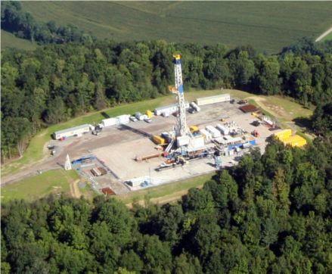
Background
Generation of TENORM has increased significantly. This is mainly due to the recent expansion in natural gas exploration and production in Pennsylvania.
There are many issues with TENORM
that must be managed effectively.
These issues include:
Potential Worker Radiation Exposure
Possible Public Radiation Exposure
Environmental Contamination (soil, water, etc.)
Waste Disposal

Slide 4
Site Categories for Sampling
Waste water treatment plants (WWTPs)
Landfills
Waste sludge loads to landfills
Well pads
Underground natural gas storage sites
Gas-fired electricity generating facilities
Compressor stations
Beneficial use sites
Decommissioned well casings

Slide 5
Work Completed in 2013
184 Site visits
114 Locations
1,000 Samples analyzed
25 WWTPs / 73 visits (3 rounds)
48 Landfills (9 extensively sampled)
1 Set of facilities to evaluate the effect of waste sludge transport on external radiation levels

Slide 6
Work Completed in 2013
20 Well pads / 41 visits
13 Beneficial use sites
1 Decommissioned well casings disposal site
7 Facilities that compress, store and utilize natural gas

Slide 7
Sample Types
Natural gas samples
Liquid samples (i.e., frac, flowback and produced water)
Solid samples (i.e., drill cuttings, proppant, sludge, soil and sediment)
Radiation surveys
‘Swipe’ samples

Slide 8
Sample Analysis
The samples are being analyzed for the presence of alpha, beta and gamma radiation (gross counting and spectroscopy).
The gas is being sampled for the presence of radon-222.

Slide 9
Field Work in 2014
Well pad sampling (23 visits to 11 pads)
Continued landfill leachate collection (5 facilities)
Landfill ‘bulking’ operations (2 facilities)
Beneficial use sites (4 sites)
Gas-fired power plants (1 facility)
Gas storage facilities (4 facilities)

Slide 10
Field Work in 2014
Compressor stations (1 facility)
Gas processing facilities (1 facility)
Wastewater impoundments (2 facilities)
Evaluating the effect of transport on sludge external radiation levels (5 events)

Slide 11
Field Work in 2014
Landfills – recovered deployed radon detectors (8 facilities)
• Landfills – waste bulking (2 facilities)
• Well Pad – completed, 1 production phase gas collection for radon
Well Pads – ambient gamma surveys of areas with buried rock cuttings

Slide 12
Lessons Learned
Well pad field work schedule changes
Logistical and technical challenges
Science-based study plan - had to make some adjustments and additions in numbers of sites

Slide 13
Schedule
Field work has been completed as of August
Sample analysis, data analysis and report preparation from March through fall 2014
Internal DEP final review now on-going
Peer review fall 2014
Final study report planned for completion in 2014.

Slide 14
TENORM Study Information
Study-related documents are available at www.dep.state.pa.us Keyword “TENORM”
Updates are being provided to the appropriate DEP advisory committees and other stakeholders

Slide 15
QUESTIONS?

Slide 16
David J. Allard, CHP PA DEP Bureau of Radiation Protection PO Box 8469 Harrisburg, PA 17105-8469 Tel: 717-787-2480 djallard@pa.gov

