Slide 1
DEP Presentation on the U.S. Environmental Protection Agency’s Proposed Cross-State Air Pollution Rule Update for the 2008 Ozone NAAQS
Citizens Advisory Council (CAC)
March 15, 2016
Harrisburg, PA
Tom Wolf, Governor
John Quigley, Secretary

Slide 2
History of EPA’s CSAPR and
CSAPR Update Proposed Rulemaking
The U.S. Environmental Protection Agency (EPA) issued the Cross-State Air Pollution Rule (CSAPR) in July 2011.
As amended, CSAPR required 28 states in the eastern half of the United States to significantly improve air quality by reducing power plant emissions that cross state lines and contribute to ozone and fine particle pollution in other states.
CSAPR was scheduled to replace the Clean Air Interstate Rule beginning January 1, 2012.

Slide 3
History of EPA’s CSAPR and
CSAPR Update Proposed Rulemaking
A number of petitioners challenged CSAPR in the D.C. Circuit in EME Homer City v. EPA (Case No. 11-1302).
The D.C. Circuit subsequently issued decisions that stayed and then vacated the CSAPR rule before implementation began.
On April 29, 2014, the U.S. Supreme Court reversed the D.C. Circuit’s vacatur.
The April 2014 U.S. Supreme Court decision also remanded the CSAPR litigation to the D.C. Circuit.
On October 23, 2014, the D.C. Circuit granted the EPA’s motion to lift the stay and shift the CSAPR compliance deadlines by three years.

Slide 4
History of EPA’s CSAPR and
CSAPR Update Proposed Rulemaking
The EPA issued an interim final rule revising the compliance deadlines in its regulations, and the CSAPR Phase I implementation began on January 1, 2015, for the annual programs and May 1, 2015, for the ozone season program, with Phase II to begin in 2017.
On June 30, 2015, the EPA issued a final notice finding that a number of states failed to submit “good neighbor” SIPs for the 2008 ozone standard. These findings established a 2-year deadline for the EPA to either approve an SIP or finalize an FIP that addresses the “good neighbor” requirement.
On July 28, 2015, the D.C. Circuit remanded the ozone season budgets for 11 states to the EPA for reconsideration.

Slide 5
Overview of EPA’s
CSAPR Update Proposed Rulemaking
On November 16, 2015, the EPA proposed an update to the Cross-State Air Pollution Rule (CSAPR) for the 2008 ozone National Ambient Air Quality Standards (NAAQS) by issuing the proposed CSAPR Update Rule.
On December 3, 2015, the “Cross-State Air Pollution Rule Update for the 2008 Ozone NAAQS” was published in the Federal Register (80 FR 75706).
The EPA proposed that the CSAPR Update Rule will reduce interstate air pollutant emission transport that significantly contributes to nonattainment, or interferes with maintenance, of the 2008 ozone NAAQS in the eastern U.S.
To achieve this goal, the proposed CSAPR Update Rule would further limit ozone season (May 1 through September 30) nitrogen oxide (NO_{X}) emissions from Electric Generating Units (EGUs) in 23 eastern states.

Slide 6
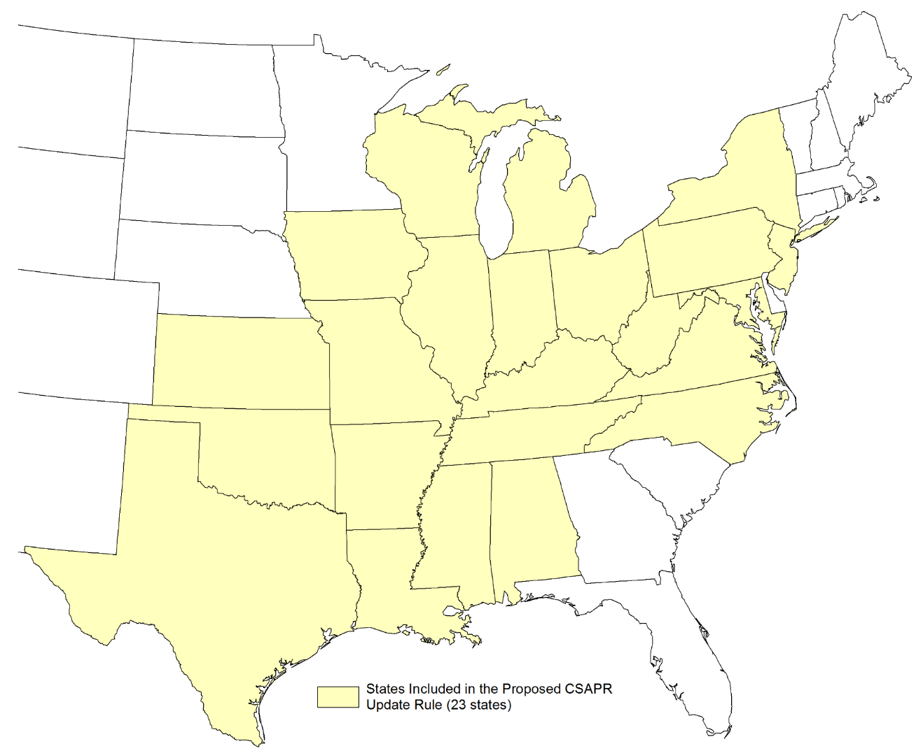
Overview of EPA’s CSAPR Update Proposed Rulemaking - States Affected

Slide 7
Overview of EPA’s
CSAPR Update Proposed Rulemaking
The EPA’s proposed CSAPR Update Rule also responds to the July 2015 remand of certain CSAPR NO_{X} emissions budgets by the United States Court of Appeals for the D.C. Circuit.
In response to the D.C. Circuit remand in EME Homer City, the EPA proposed the CSAPR Update Rule to replace the existing Phase II CSAPR ozone season NO_{X} emissions budgets for nine states (Maryland, New Jersey, New York, North Carolina, Ohio, Pennsylvania, Texas, Virginia, and West Virginia) with updated budgets designed to address interstate transport with respect to the 2008 ozone NAAQS.
The EPA also proposed to remove two states (South Carolina and Florida) from the CSAPR ozone season NO_{X} trading program.

Slide 8
Impact of EPA’s
CSAPR Update Proposed Rulemaking
The EPA anticipates, starting in 2017, that the CSAPR Update Rule will reduce summertime NO_{X} emissions from power plants in 23 states in the eastern U.S. and provide up to $1.2 billion in health benefits to millions of Americans.
The EPA predicts that the effects of this proposed rule on employment and retail electricity prices will be modest and vary year by year.
The EPA analysis shows small employment gains and losses in both the electricity generation and fuels sectors as some companies upgrade and optimize existing NO_{X} pollution control equipment to comply with the proposed rule.
Some electricity generation is shifted from coal-fired EGUs to gas-fired units.

Slide 9
Other NAAQS and the
CSAPR Update Proposed Rulemaking
The annual PM2.5 NAAQS was updated in 2012 after CSAPR was promulgated (78 FR 306, January 15, 2013).
The CSAPR Update proposed rule does not address the 2012 PM2.5 standard.
The EPA acknowledges that, in EME Homer City II, the D.C. Circuit also remanded without vacatur the CSAPR Phase II SO2 emissions budgets for four states (Alabama, Georgia, South Carolina, and Texas)
The proposal does not address the remand of these CSAPR Phase II SO2 annual emissions budgets which will be addressed separately by EPA.
The existing CSAPR emissions budgets and implementation programs for annual SO2 and NO_{X} requirements, which address interstate transport for the 1997 and 2006 PM2.5 NAAQS, continue to apply at this time.

Slide 10
Largest Contributions by State
Upwind State | Largest Downwind Contribution to Nonattainment Receptors for Ozone (ppb) | Largest Downwind Contribution to Maintenance Receptors for Ozone (ppb)
AL | 0.79 | 1.28
AR | 0.98 | 2.15
CT | 0.00 | 0.46
DE | 0.37 | 2.23
DC | 0.06 | 0.73
FL | 0.54 | 0.72
GA | 0.47 | 0.58
IL | 17.48 | 23.17
IN | 6.24 | 14.95
IA | 0.61 | 0.85
Upwind State | Largest Downwind Contribution to Nonattainment Receptors for Ozone (ppb) | Largest Downwind Contribution to Maintenance Receptors for Ozone (ppb)
KS | 0.80 | 1.03
KY | 0.75 | 11.17
LA | 3.09 | 4.23
ME | 0.00 | 0.08
MD | 2.07 | 7.11
MA | 0.10 | 0.37
MI | 2.69 | 1.79
MN | 0.40 | 0.47
MS | 0.78 | 1.48

Slide 11
Largest Contributions by State
Upwind State | Largest Downwind Contribution to Nonattainment Receptors for Ozone (ppb) | Largest Downwind Contribution to Maintenance Receptors for Ozone (ppb)
MO | 1.63 | 3.69
NE | 0.24 | 0.36
NH | 0.02 | 0.07
NJ | 8.84 | 12.38
NY | 16.96 | 17.21
NC | 0.55 | 0.93
ND | 0.11 | 0.28
OH | 2.18 | 7.92
OK | 1.70 | 2.46
PA | 9.39 | 15.93
Upwind State | Largest Downwind Contribution to Nonattainment Receptors for Ozone (ppb) | Largest Downwind Contribution to Maintenance Receptors for Ozone (ppb)
RI | 0.02 | 0.08
SC | 0.16 | 0.21
SD | 0.08 | 0.12
TN | 0.51 | 1.67
TX | 2.44 | 2.95
VT | 0.01 | 0.05
VA | 1.87 | 5.29
WV | 0.95 | 3.11
WI | 0.34 | 2.59

Slide 12
Proposed Ozone Season NO_{X} Emission Budgets by State
State | EGU NO_{X} Ozone Season Emissions Budgets | Variability Limits | EGU NO_{X} Ozone Season Assurance Levels
Alabama | 9,979 | 2,096 | 12,075
Arkansas | 6,949 | 1,459 | 8,408
Illinois | 12,078 | 2,536 | 14,614
Indiana | 28,284 | 5,940 | 34,224
Iowa | 8,351 | 1,754 | 10,105
Kansas | 9,272 | 1,947 | 11,219
Kentucky | 21,519 | 4,519 | 26,038
Louisiana | 15,807 | 3,319 | 19,126
Maryland | 4,026 | 845 | 4,871
State | EGU NO_{X} Ozone Season Emissions Budgets | Variability Limits | EGU NO_{X} Ozone Season Assurance Levels
Michigan | 19,115 | 4,014 | 23,129
Mississippi | 5,910 | 1,241 | 7,151
Missouri | 15,323 | 3,218 | 18,541
New Jersey | 2,015 | 423 | 2,438
New York | 4,450 | 935 | 5,385
North Carolina | 12,275 | 2,578 | 14,853
Ohio | 16,660 | 3,499 | 20,159
Oklahoma | 16,215 | 3,405 | 19,620

Slide 13
Proposed Ozone Season NO_{X} Emission Budgets by State
State | EGU NO_{X} Ozone Season Emissions Budgets | Variability Limits | EGU NO_{X} Ozone Season Assurance Levels
Pennsylvania | 14,387 | 3,021 | 17,408
Tennessee | 5,481 | 1,151 | 6,632
Texas | 58,002 | 12,180 | 70,182
Virginia | 6,818 | 1,432 | 8,250
West Virginia | 13,390 | 2,812 | 16,202
Wisconsin | 5,561 | 1,168 | 6,729
Region Cap | 311,867 | 65,493

Slide 14
Impact of EPA’s proposed NO_{X} Budgets
The EPA’s proposed CSAPR Update NO_{X} budgets result in the following reductions, by state:
Connecticut – not part of CSAPR
Maryland – 44% reduction
New Jersey – 46% reduction
New York – 57% reduction
Ohio – 57% reduction
Pennsylvania – 72% reduction
Virginia – 52% reduction
West Virginia – 42% reduction

Slide 15
PA DEP Comments on
CSAPR Update Proposed Rulemaking
The CSAPR Update proposed rulemaking provided for a public comment period ending January 19, 2016. The EPA extended the comment period on December 29, 2015, to a 60-day public comment period which ended on February 1, 2016 (80 FR 81251).
PA DEP submitted comments on several aspects of the proposed CSAPR Update, including the following:
The cost thresholds used by the EPA to develop the State NO_{X} Budgets;
The timing and compliance requirements;
Shifting electricity generation to lower NO_{X}-emitting EGUs;
The EPA’s proposed “Banked Allowance Surrender Ratio.”

Slide 16
PA DEP Comments on
CSAPR Update Proposed Rulemaking
DEP supports the EPA’s use of the following four-step analytical process:
Identify downwind receptors that are expected to have problems attaining or maintaining NAAQS;
Determine which upwind states contribute to these identified problems;
Identify upwind emissions that significantly contribute to downwind nonattainment or interfere with maintenance and quantify the available upwind emission reductions and apportion the upwind responsibility among the linked states;
States found to significantly contribute to nonattainment or interfere with maintenance will reduce the identified upwind emissions via regional emissions allowance trading programs.

Slide 17
PA DEP Comments on
CSAPR Update Proposed Rulemaking
DEP commented on the EPA’s evaluation of its cost thresholds analysis and the need to consider PA’s RACT II emission limits.
The EPA used a 50 percent analysis for setting NOx reduction cost thresholds for existing selective catalytic reduction (SCR) systems. For example, installed SCRs on EGUs can operate in a range of $350 -$750 per ton of NOx reduction.
Fifty percent of the $350 - $750 range is $500 per ton of NOx reduced.
DEP urged the EPA to consider the NOx emission limitations for the EGU sector in the PA final-form RACT regulation when establishing the final NOx ozone season trading budget for PA in the CSAPR Update Rule.
The next slide shows a table of the EPA’s assumed cost thresholds.

Slide 18
EPA NOx Cost Thresholds
EGU NOX Cost Threshold
$500/ton | CSAPR ozone season NO_{X} cost threshold; fully operating post-combustion controls that are already running
$1,300/ton | Widespread availability of restarting idled SCRs and state of the art combustion controls
$3,400/ton | NO_{X} SIP Call ozone season NO_{X} cost threshold, adjusted to 2014$; widespread availability of restarting idled SNCRs
$5,000/ton | Widespread availability of new SCRs
$6,400/ton | Widespread availability of new SNCRs
$10,000/ton | Upper bound

Slide 19
PA DEP Comments on
CSAPR Update Proposed Rulemaking
PA DEP comments on the EPA’s evaluation of its cost threshold analysis.
The EPA’s $500 per ton of NOx cost threshold for operating existing SCR is too low.
PA DEP suggests EPA use cost thresholds of $800 - $1,000 per ton NOx which is slightly above the $750 at the top end of its assumptions.
The $1,300 per ton cost threshold does not consider technical limitations of SCR controls when EGUs operate at lower capacity.
PA DEP suggests the cost threshold for bringing SCRs back on line is higher than $1,300 per ton, and the NOx reductions should be based upon on $800 - $1000 per ton.

Slide 20
PA DEP Comments on
CSAPR Update Proposed Rulemaking
PA DEP comments on the Technical Infeasibility of Meeting the Proposed Allocations.
The EPA’s analysis assumes NOx emission reductions are readily available by 2017 through the optimization and operation of controls.
Affected EGUs would be required to meet a statewide average emissions rate of 0.057 lbs/MMBtu of NOx of heat input based upon the EPA’s proposed Ozone Season NOx Budget for PA.
The existing controls will not be able to meet the average emissions rates assumed by the EPA. Therefore, EGU owners and operators would need to purchase NOx allowances to achieve compliance.
It is not technically feasible to operate SCRs properly when EGUs are operated at low temperatures and low operating capacities during the night-time hours.

Slide 21
PA DEP Comments on
CSAPR Update Proposed Rulemaking
PA DEP comments on special consideration for Coal Refuse-Fired Facilities.
Pennsylvania has 184,000 acres of unclaimed mining area filled with coal refuse.
Coal refuse piles cause acid mine drainage and sometimes catch fire and cause air emissions.
Pennsylvania has 15 coal refuse facilities that beneficially use 12 million tons of waste coal annually and restore these degraded unclaimed mining areas.
PA DEP’s comments to the EPA point out that these waste coal facilities provide great benefits to PA and its residents and that they are an insignificant portion of the pollution transported to other states.
PA suggested that the EPA tailor the final CSAPR Update to ensure the waste coal refuse units can continue to operate and generate environmental benefits for PA.

Slide 22
PA DEP Comments on
CSAPR Update Proposed Rulemaking
PA DEP comments on shifting generation to Lower NOx emitting EGUs.
The EPA indicates in its analysis that high NOx emitting generators will also be able to shift generation to lower emitting generation as lower emitting generation is in place and that investment has already been made.
PA DEP does not agree with the EPA’s premise and suggests that the EPA reconsider this position.
The Department believes it is just as likely for generation to shift to higher emitting small EGUs, demand response, and high electric demand day units that are not regulated by CSAPR.

Slide 23
PA DEP Comments on
CSAPR Update Proposed Rulemaking
PA DEP comments on banking and retirement of banked NOx allowances.
The EPA’s use of a NOx allowance retirement ratio for facilities that comply with CSAPR through the use of banked allowances was not supported by PA DEP because banked NOx allowances allow facilities to address operational variability.
The EPA asked for comments on ratios such as 2:1 and 4:1 to reduce the size of the NOx allowance bank.
These high NOx allowance retirement ratios could create instability in the allowance market and cause large price swings or ozone season allowance shortages under some conditions.
DEP did indicate that a banked NOx allowance cap could be used to address the large number of allowances in the allowance bank or the EPA could just allow old allowances to expire.

Slide 24
PA DEP Comments on
CSAPR Update Proposed Rulemaking
PA DEP comments on EPA’s Non-EGU NOx Mitigation Strategies.
The EPA requests comment on two issues associated with NOx mitigation from non-EGUs:
The EPA indicates it will continue to evaluate whether non-EGUs emission reductions can be made at a later date and ask for comment on its preliminary evaluation;
The EPA asks for comment on allowing legacy non-EGUs to participate in the CSAPR program.
The CSAPR Update only provides a partial remedy to address ozone transport to downwind states. The EPA needs to address NOx emissions from non-EGUs as part of its strategy.
Non-EGUs can contribute to transport issues even if the EGUs in a state do not.
There may be cost-effective NOx reductions available from non-EGUs which the EPA does not address.
The “good neighbor provisions” in the CAA apply to all sources not, just EGUs.

Slide 25
PA DEP Comments on
CSAPR Update Proposed Rulemaking
PA DEP comments on the EPA’s Non-EGU NOx Mitigation Strategies.
PA DEP recommended that legacy non-EGUs should continue to be included in the CSAPR trading program.
PA DEP submitted comments on the EPA’s request for comment on future steps needed to resolve the good neighbor obligations:
NOx emissions could be capped across all sectors based upon achievable emission rates, with the option to buy CSAPR allowances to meet compliance obligations.
This would also help address the size of the NOx allowance banks.

Slide 26
PA DEP Comments on
CSAPR Update Proposed Rulemaking
Comments made by PA DEP can be reviewed on the EPA Docket at
http://www.regulations.gov
Docket No. EPA-HQ-OAR-2015-0500
Questions?

Slide 27
Contact Information:
Randy Bordner at ranbordner@pa.gov
717-772-3921
Krishnan Ramamurthy at kramamurthy@pa.gov 717-783-9476

