Slide 1

Appalachian States Low-Level Radioactive Waste Commission
Update on Clive and WCS LLRW Disposal Facilities
Appalachian Compact Commission Annual Meeting
November 1, 2024

Slide 2
Clive LLRW Disposal Facility
Clive Facility is approximately 80 miles west of Salt Lake City, Utah.
Holds a license from the State of Utah for disposal of Class A LLRW and mixed waste
Provides for disposal of bulk waste, containerized waste, and large components
Approximately 62 percent of LLRW by Volume from the Appalachian Compact was disposed of at Clive in 2023
Received approval for disposal of Class A sealed sources
Seeking approval for license renewal of Class A waste, licensing of a federal cell and exempted waste cell

Slide 3
Waste Control Specialists (WCS) LLRW Disposal Facility
  WCS is approximately 30 miles from the city of Andrews in Texas.
  Holds a license from the State of Texas for the disposal of Class A, B and C LLRW and mixed waste
  Provides for disposal of bulk waste, containerized waste and large components
  Approximately 38 percent of LLRW by volume from the Appalachian Compact was disposed of at WCS in 2023
  License renewal application review in progress
  Construction of a new disposal cell completed and operational

Slide 4
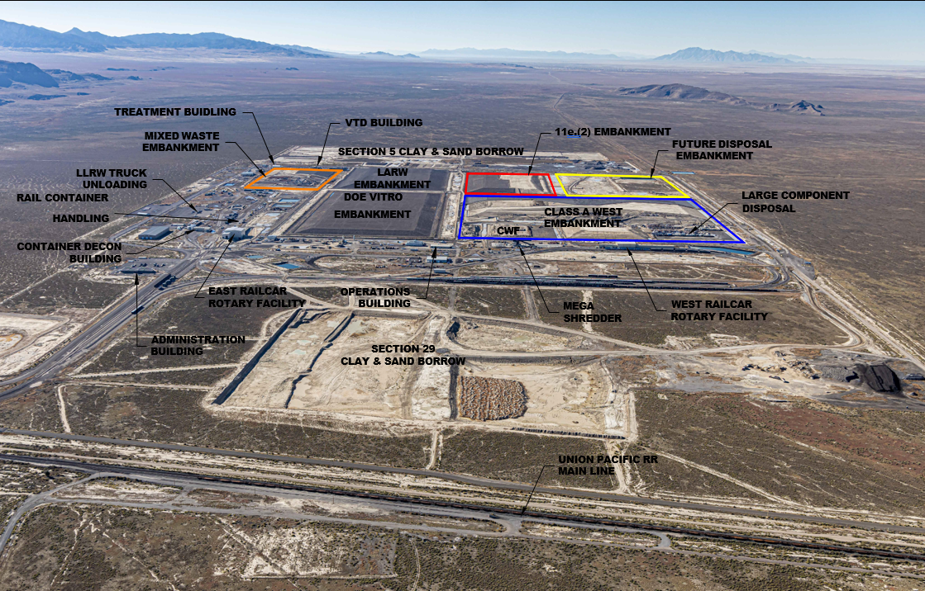
Energy Solutions Clive Facility, Utah

Slide 5
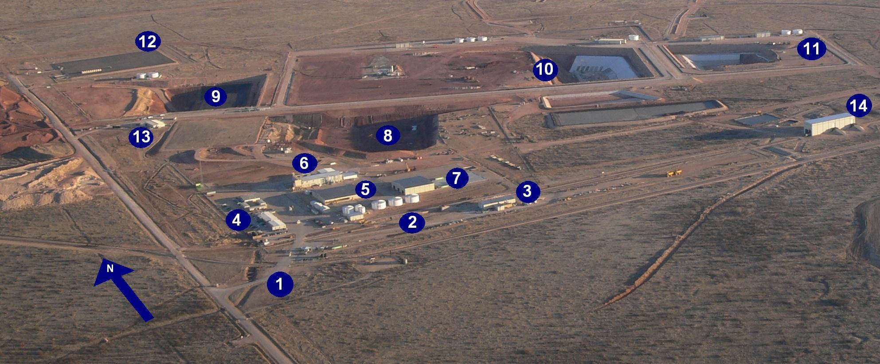
WCS Facility in Andrews County, Texas
1. Access road to 1,338-acre fenced site (guard house entrance)
2. On-site rail spur and rail-unloading facility
3. Maintenance building
4. Administration buildings with analytical and radiological laboratories
5. Container Storage Building (CSB)
6. Stabilization Building (SB) (West portion) and Mixed Waste Treatment Facility (MWTF) (East portion)
7. Bulk/Bin Storage Units (BSUs)1-3 (bin storage area [BSA-1] is covered)
8. RCRA Subtitle C landfill will expand to the East, with closed
cells to the West
9. 11e (2) Byproduct material landfill
10. Federal Waste Disposal Facility (FWF) for LLW and LLMW will expand to the West
11. Compact Waste Disposal Facility (CWF) for LLW will expand to the East
12. Ten-acre storage area for low-specific-activity (LSA) waste
13. Low-level disposal operations administration building
14. Rail unloading building for emptying gondola cars

Slide 6
Questions?
Thank you
Rich Janati, M.S.
Administrator
Appalachian Compact Commission
Phone: 717-787-2163
rjanati@pa.gov

