Slide 1
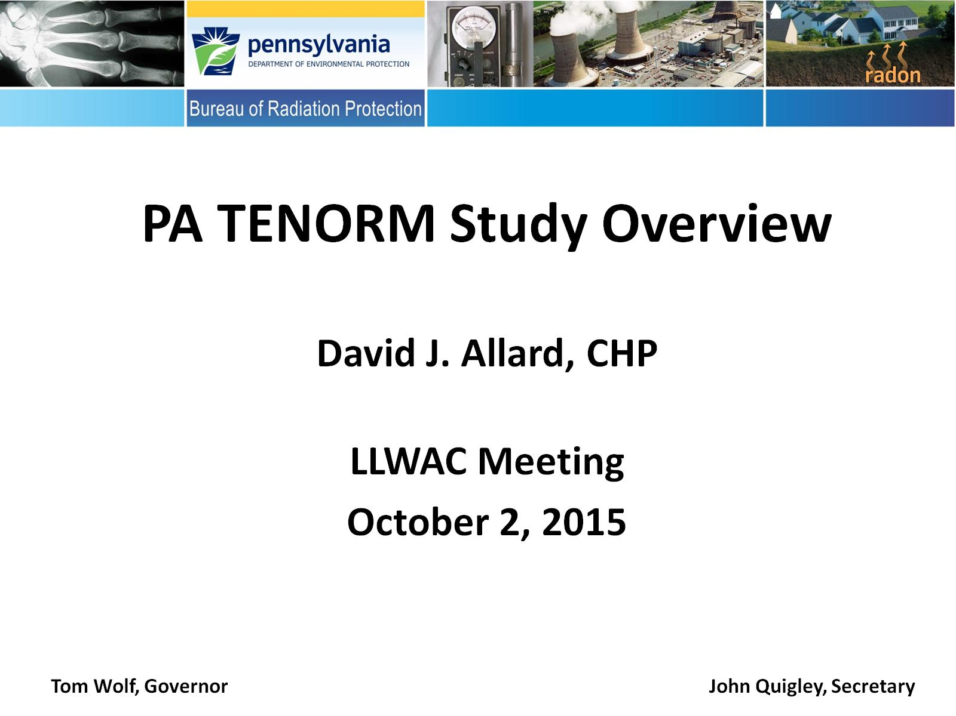
PA TENORM Study Overview
David J. Allard, CHP
ASCC Meeting
November 6, 2015

Slide 2
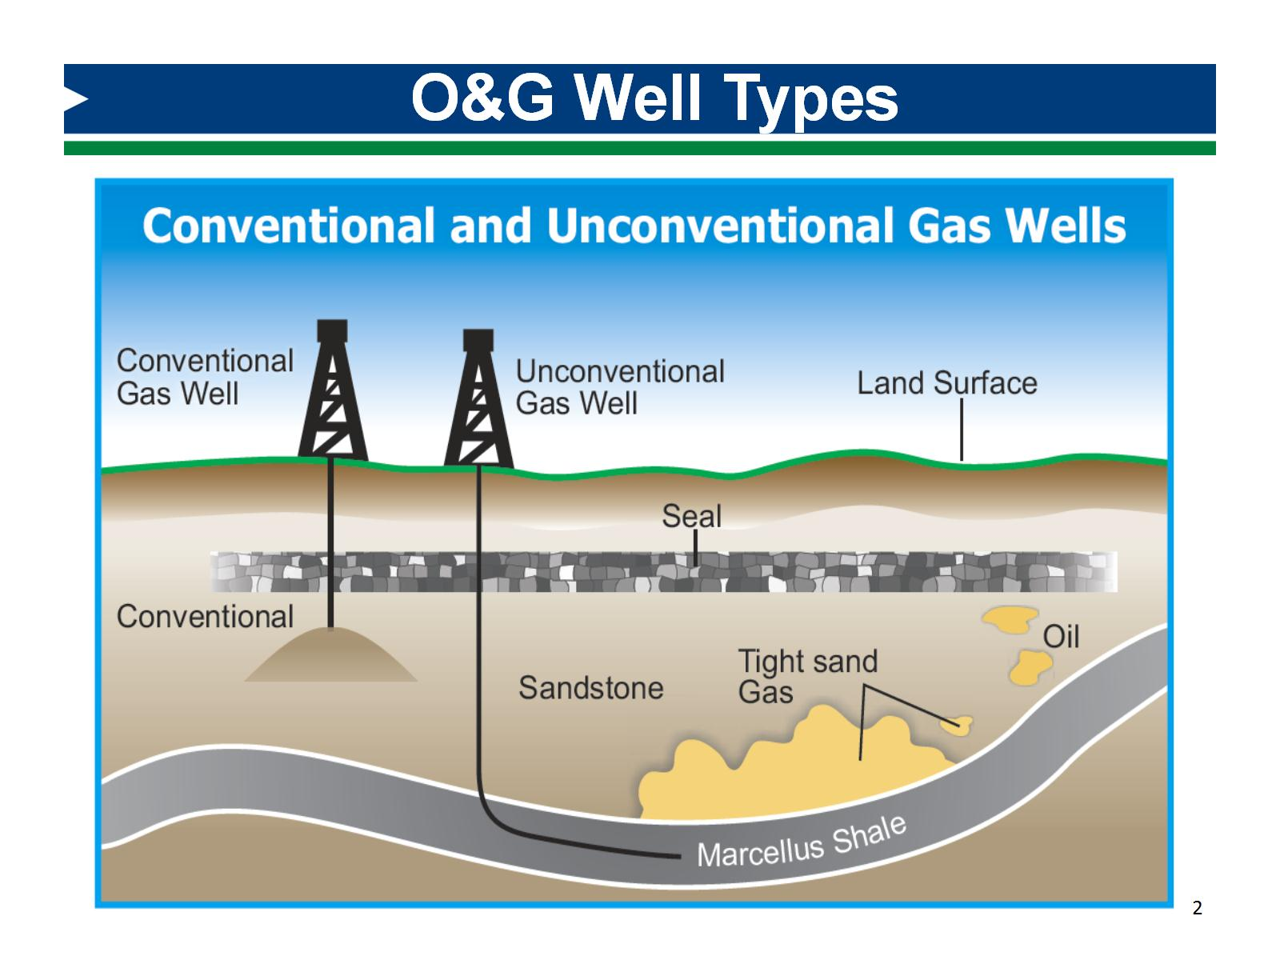
O&G Well Types

Slide 3
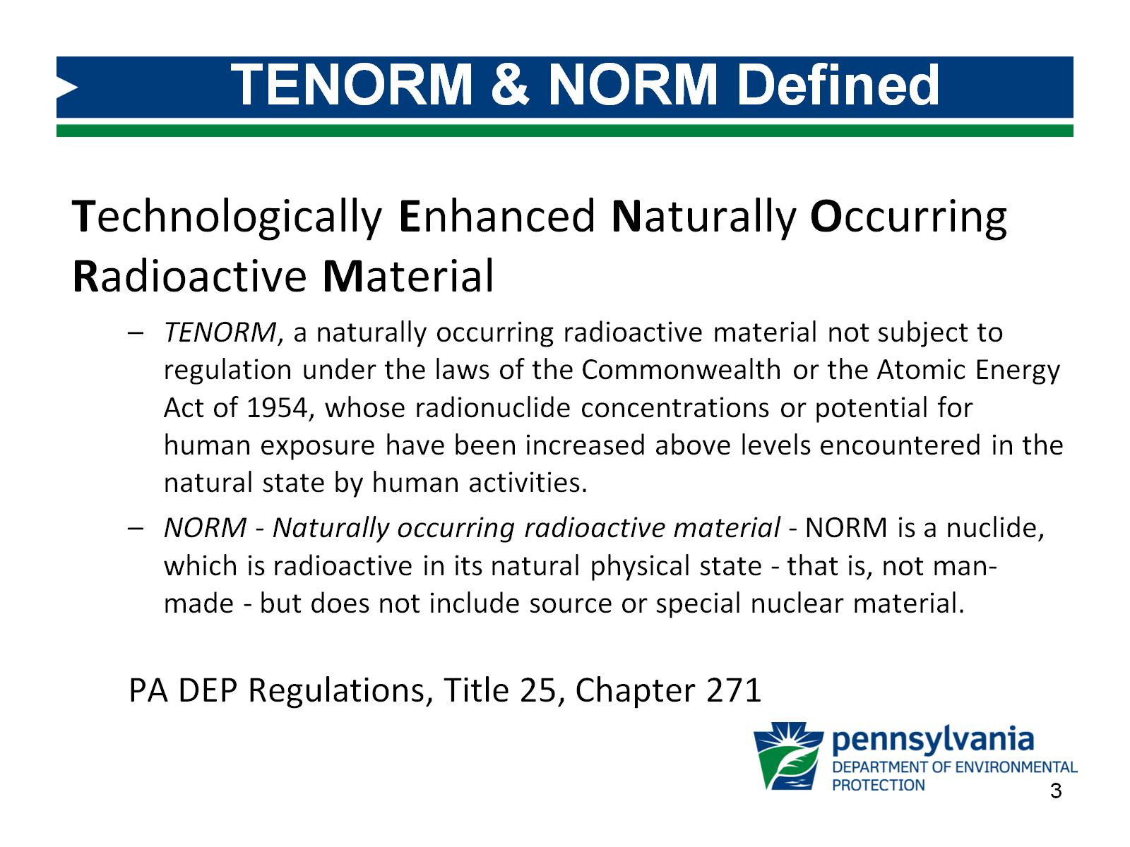
TENORM & NORM Defined

Slide 4
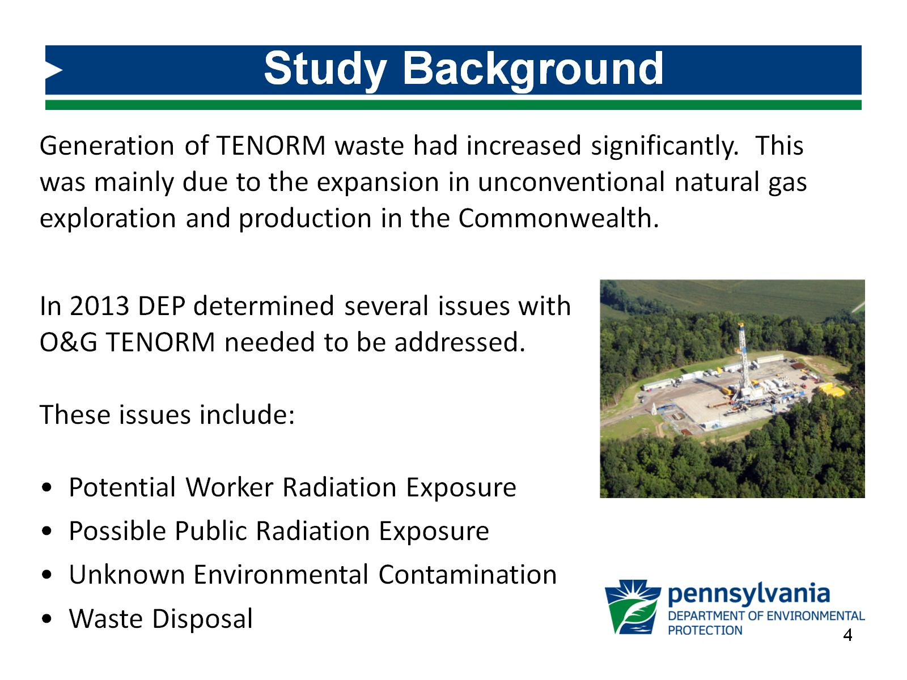
Study Background

Slide 5
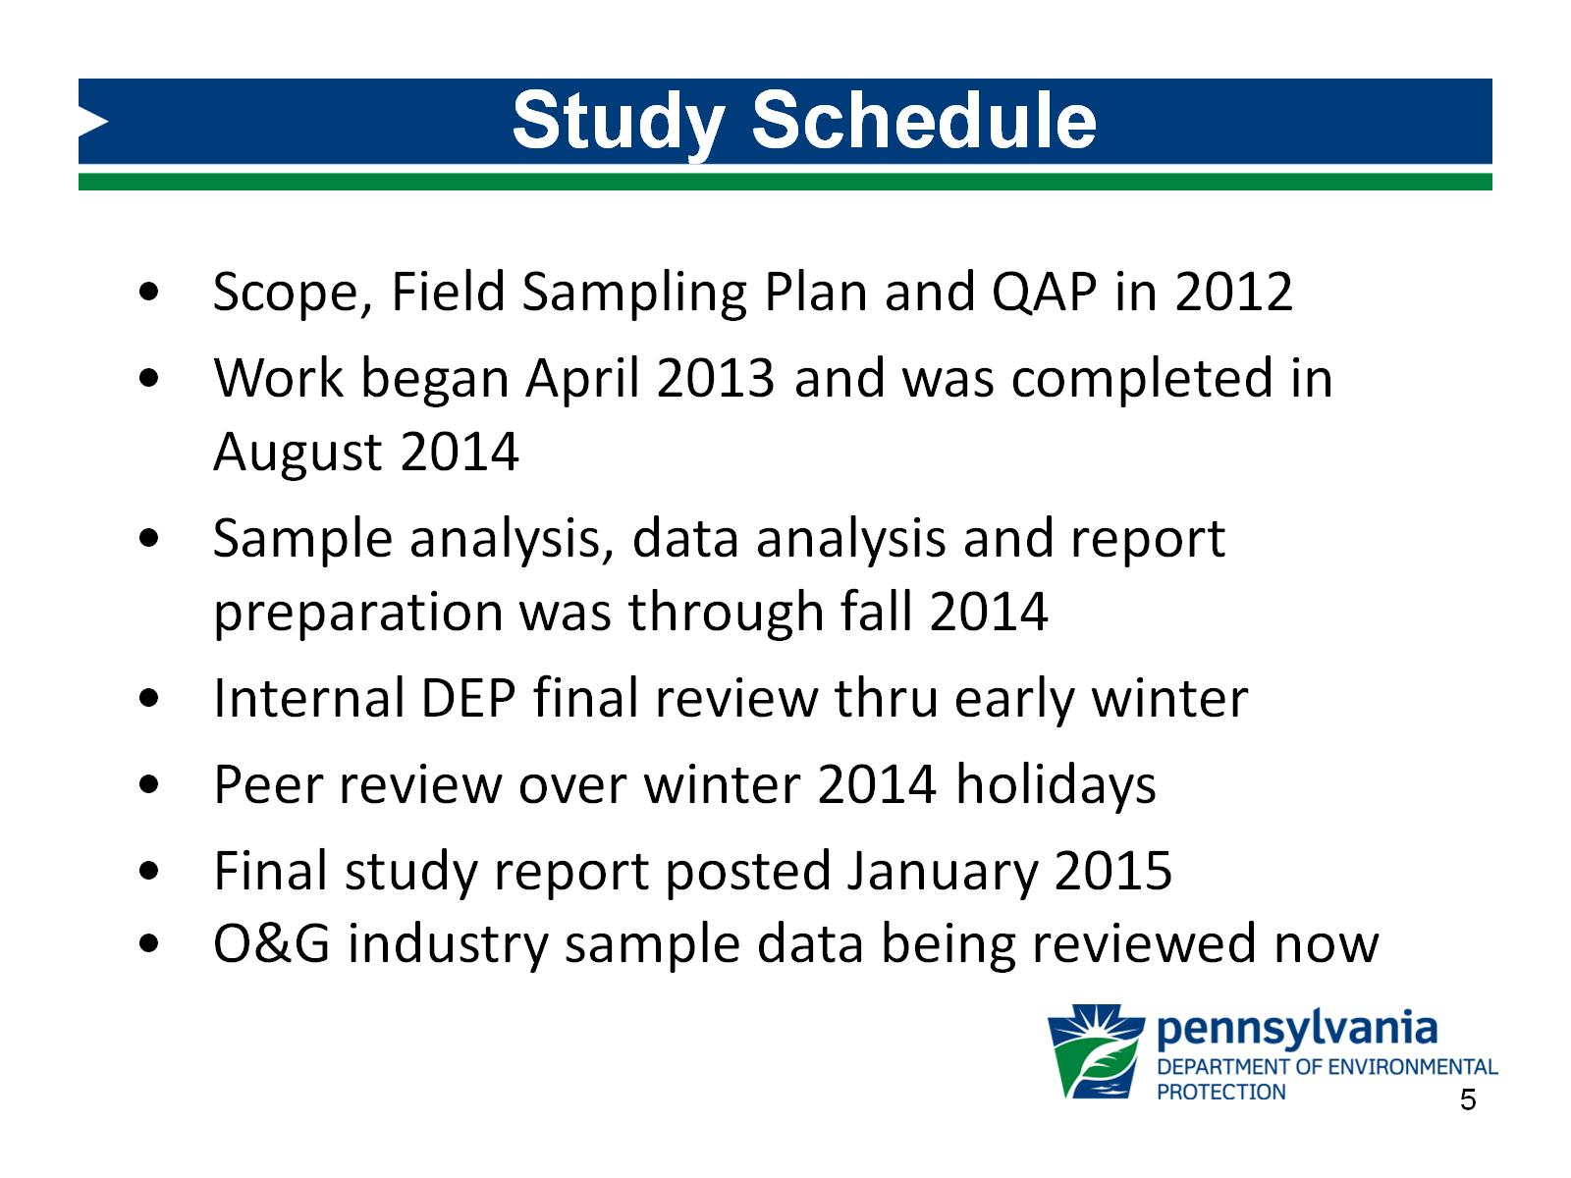
Study Schedule

Slide 6
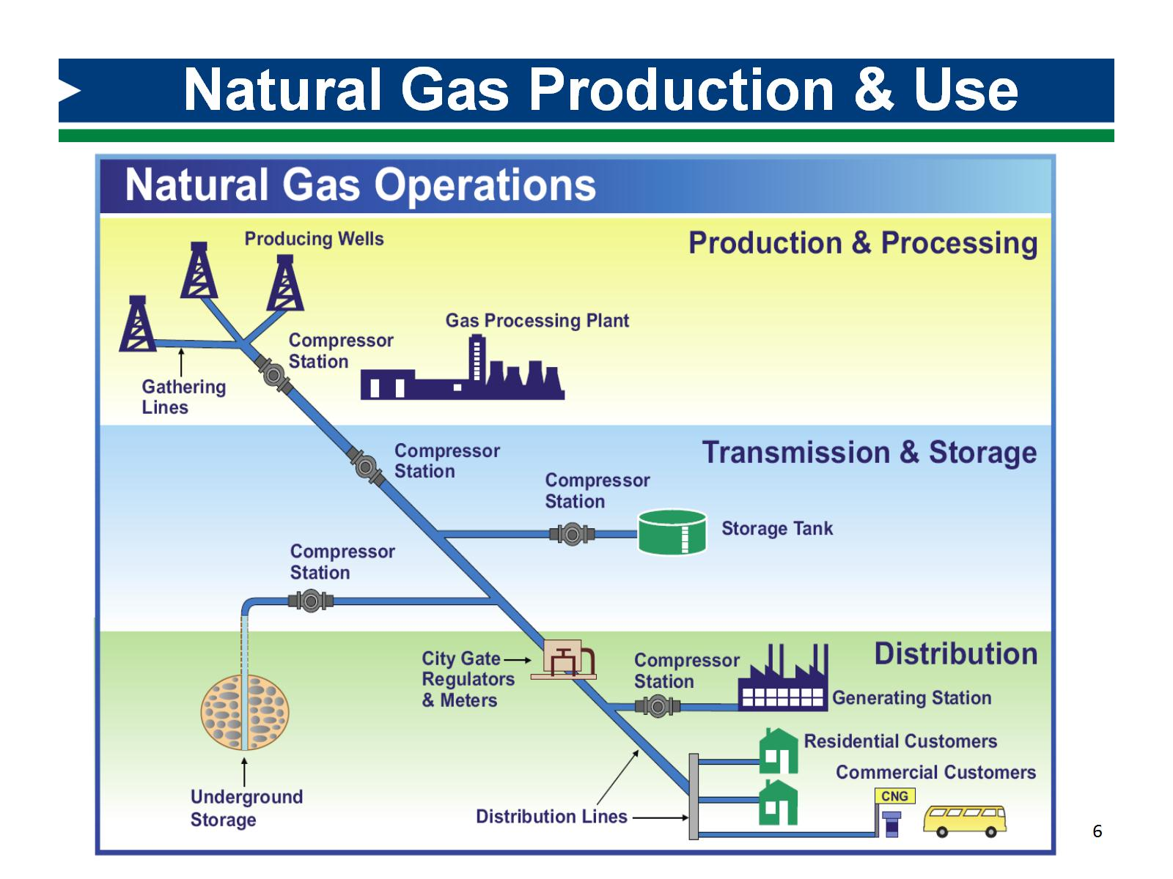
Natural Gas Production & Use

Slide 7
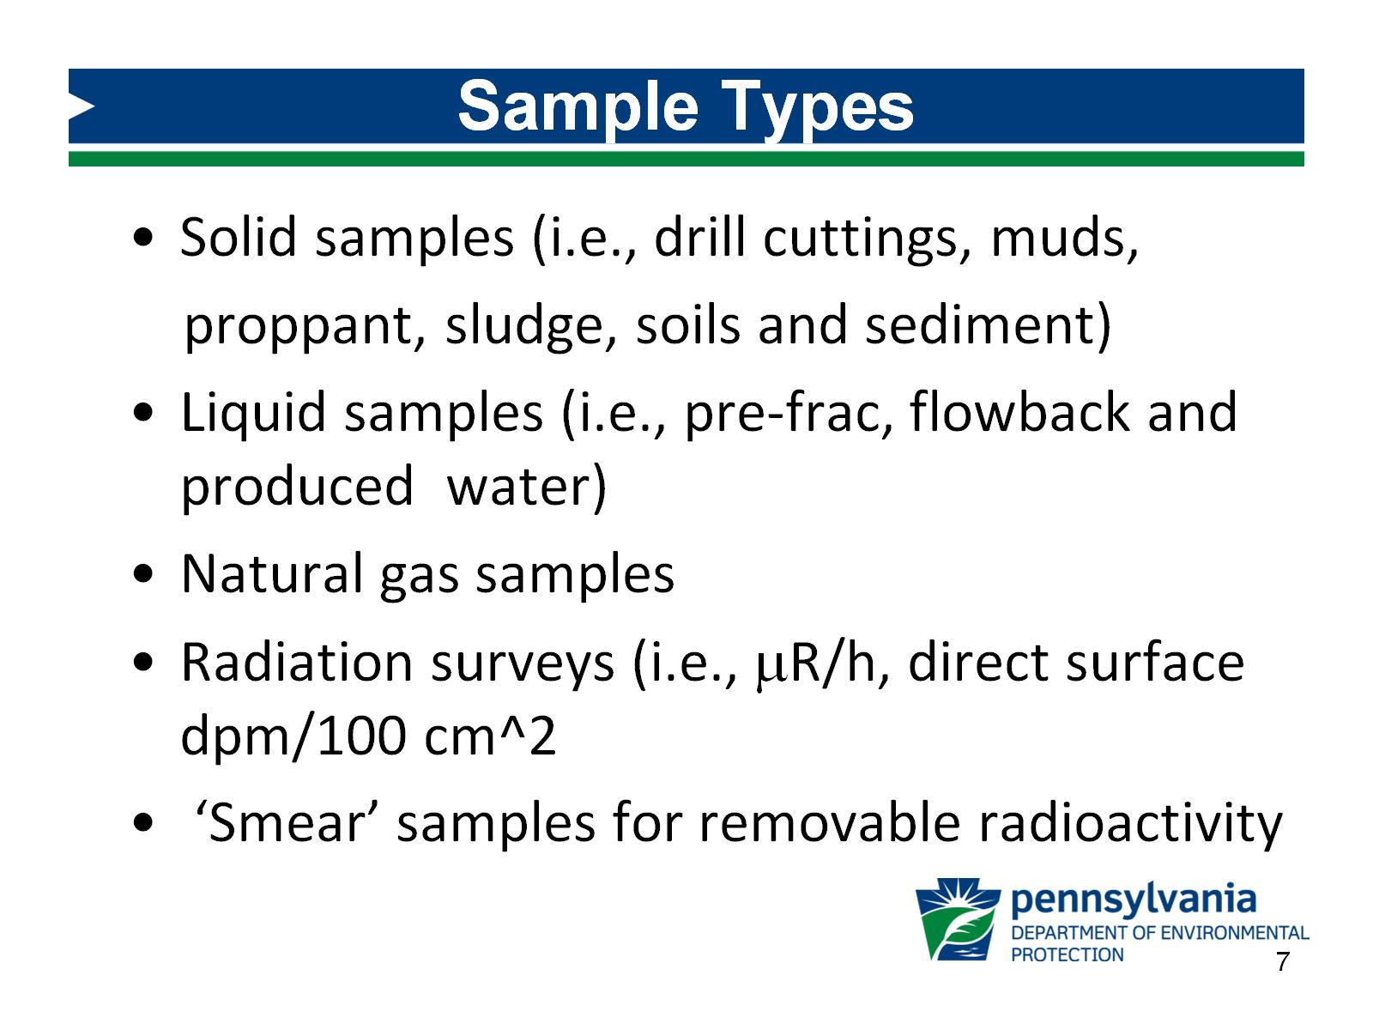
Sample Types

Slide 8
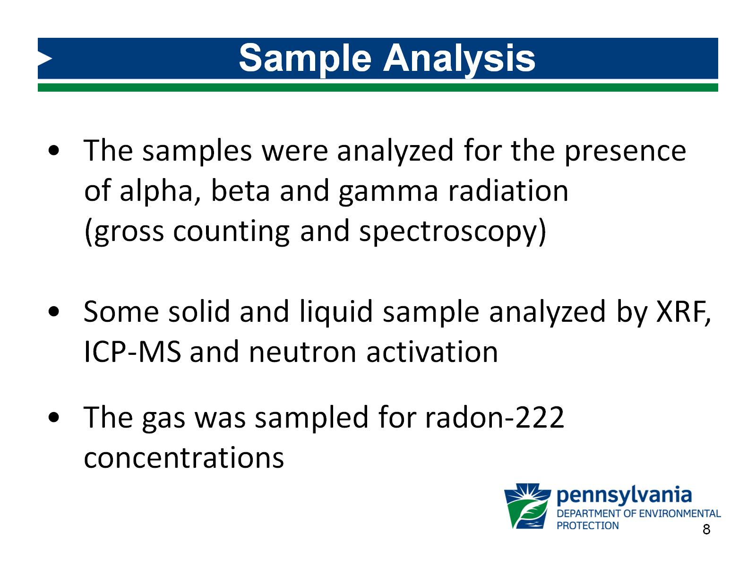
Sample Analysis

Slide 9
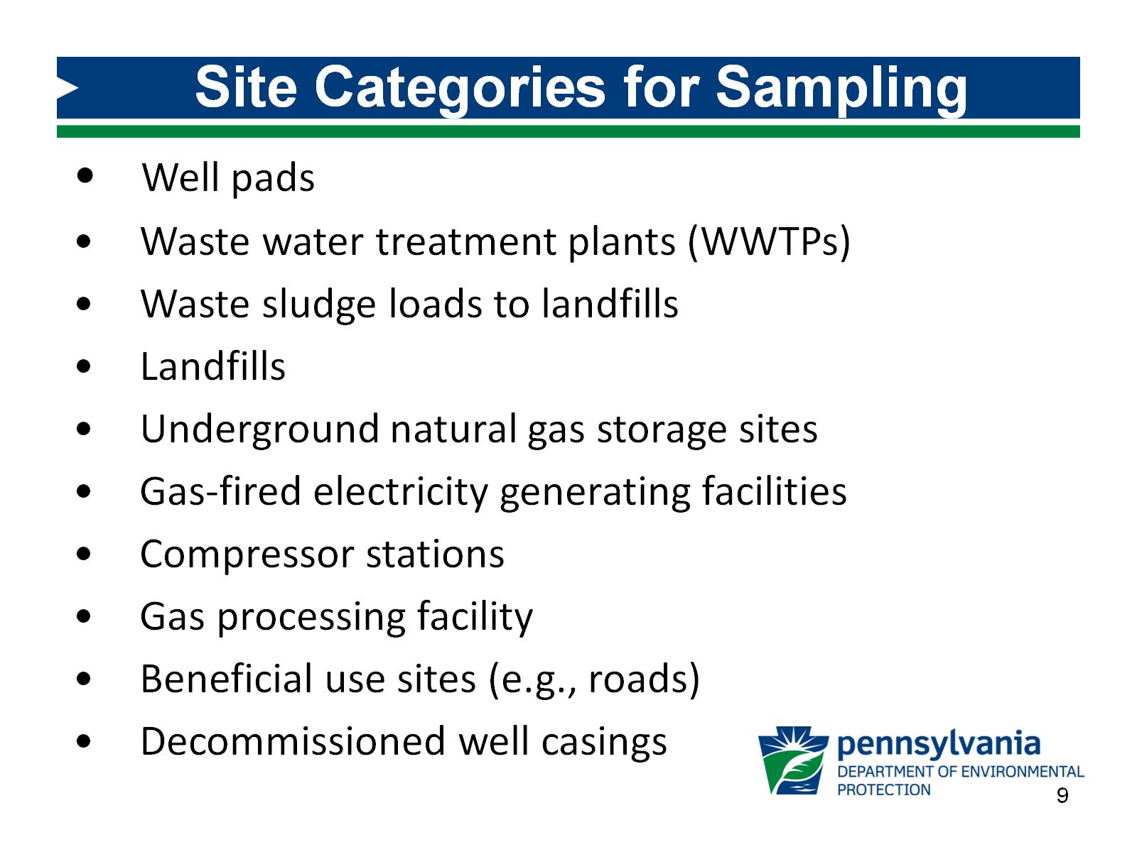
Site Categories for Sampling

Slide 10
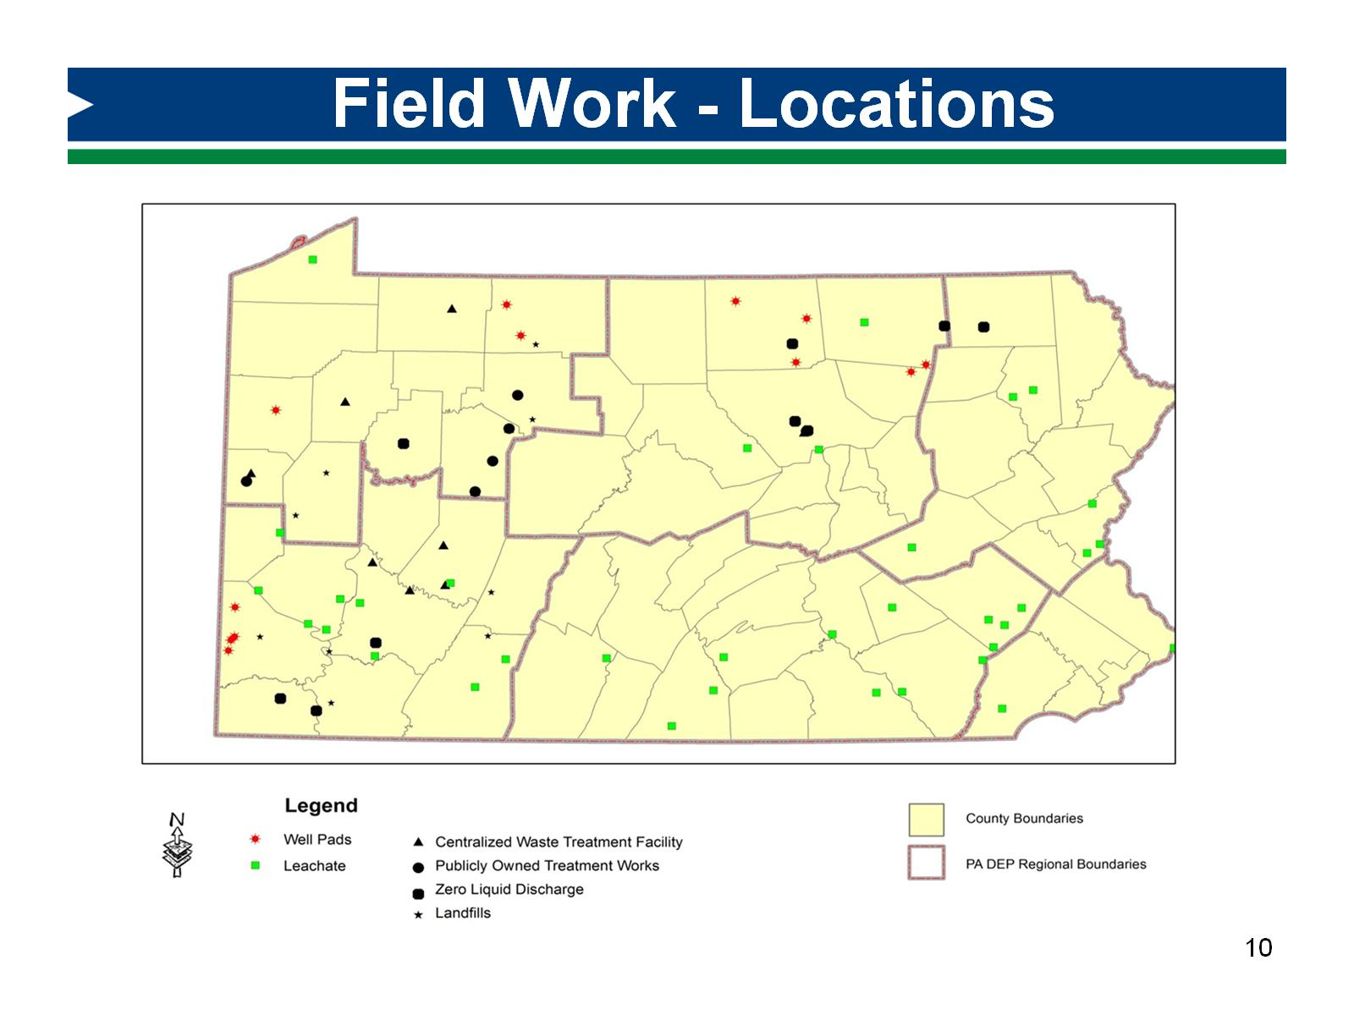
Field Work - Locations

Slide 11
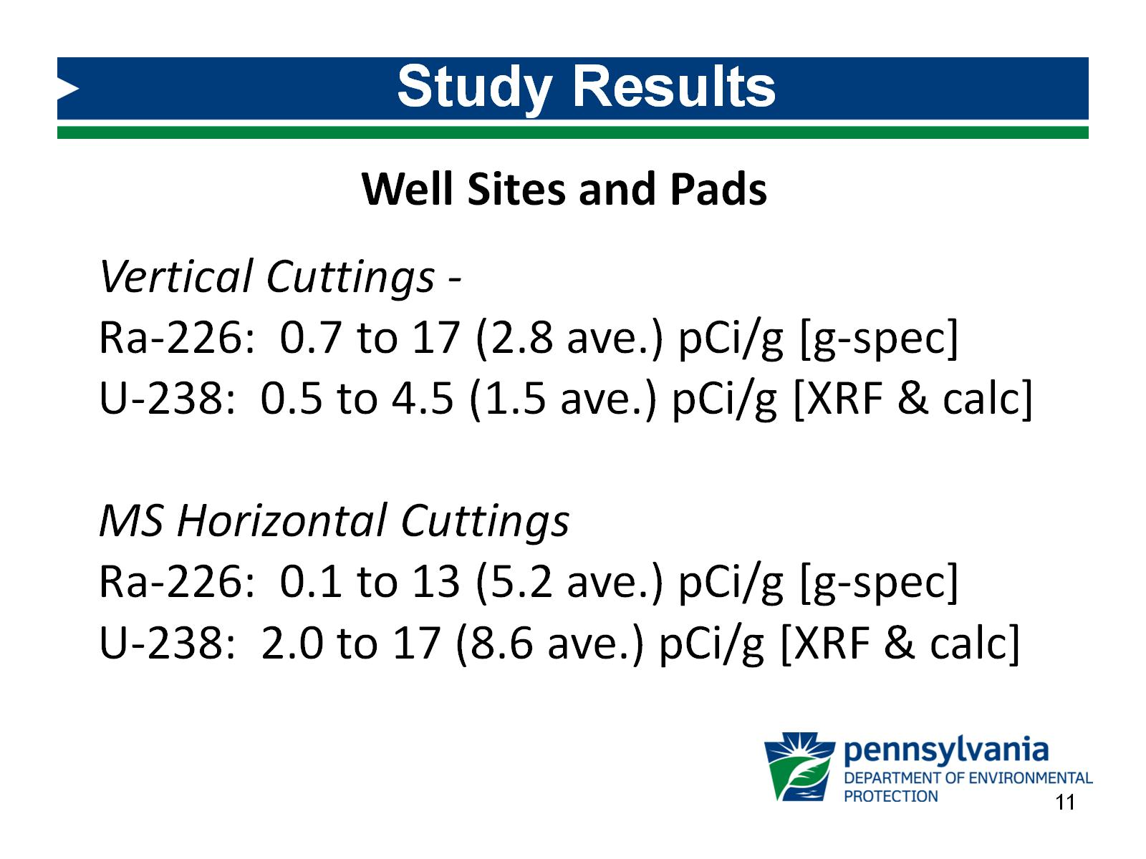
Study Results

Slide 12
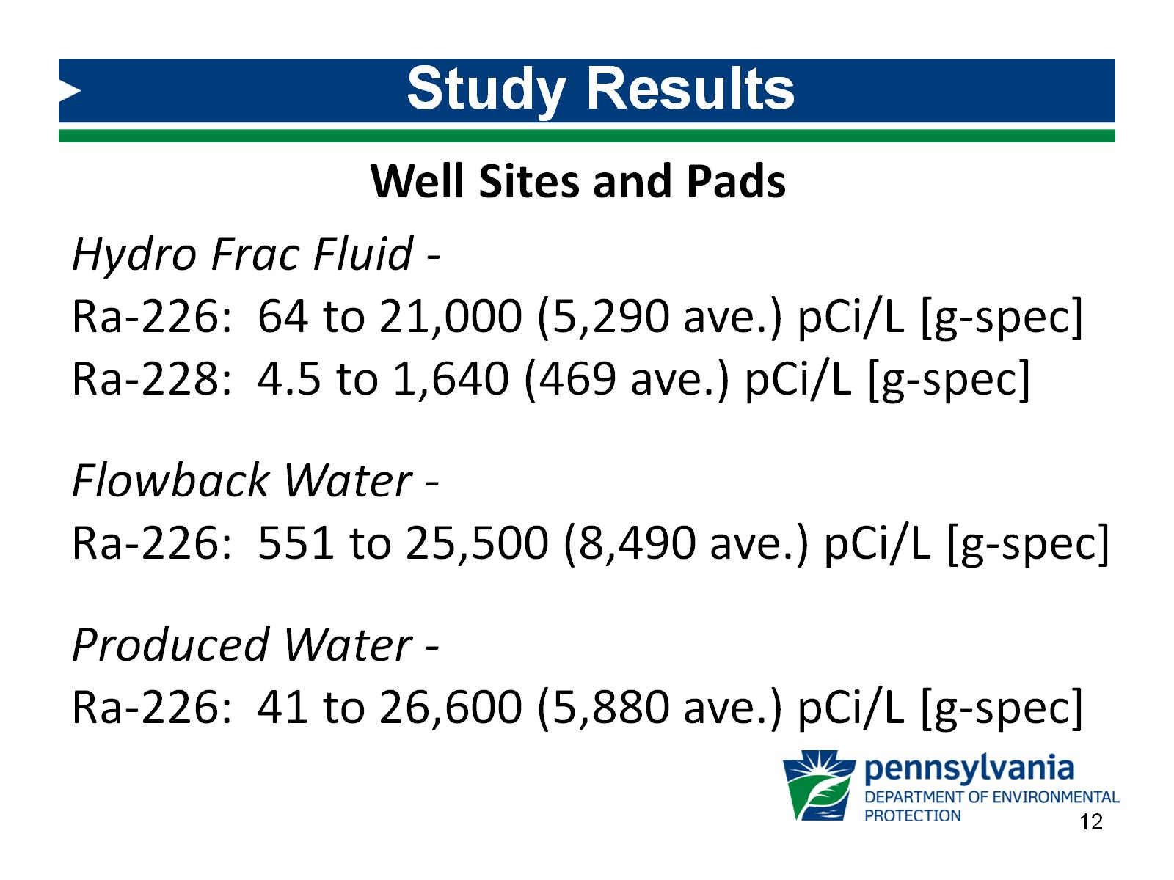
Study Results

Slide 13
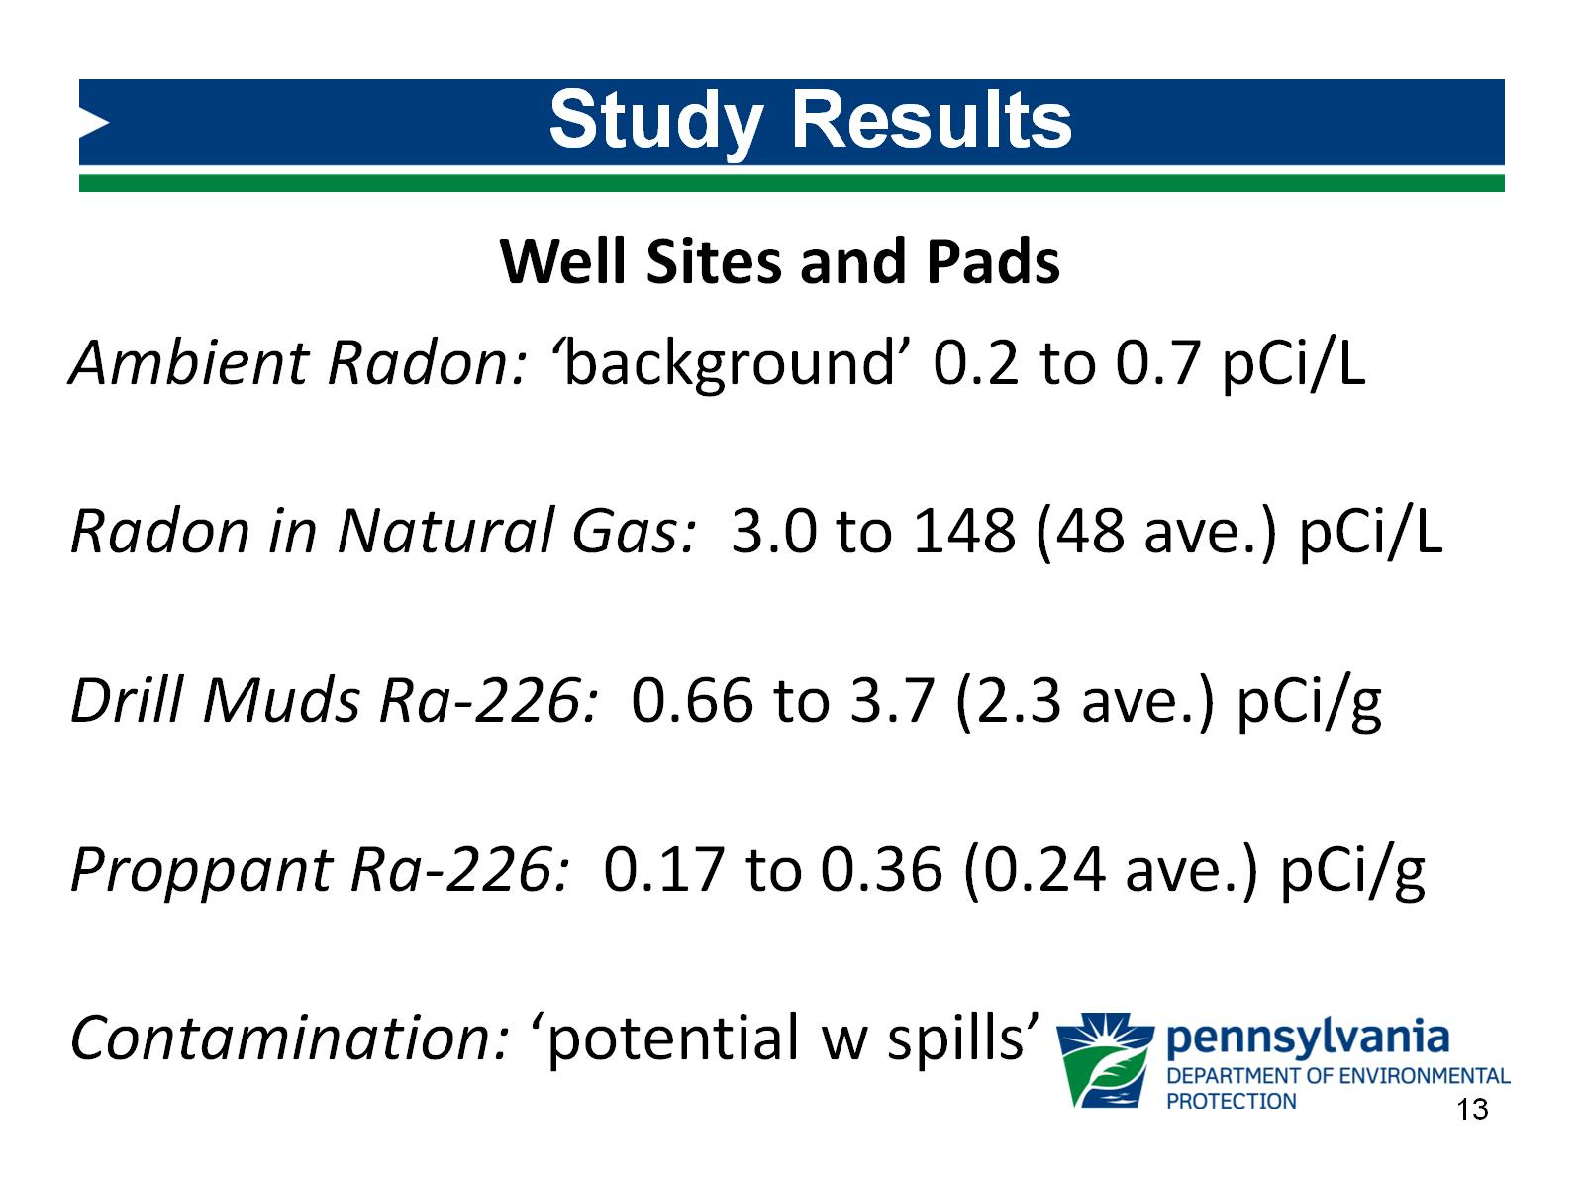
Study Results

Slide 14
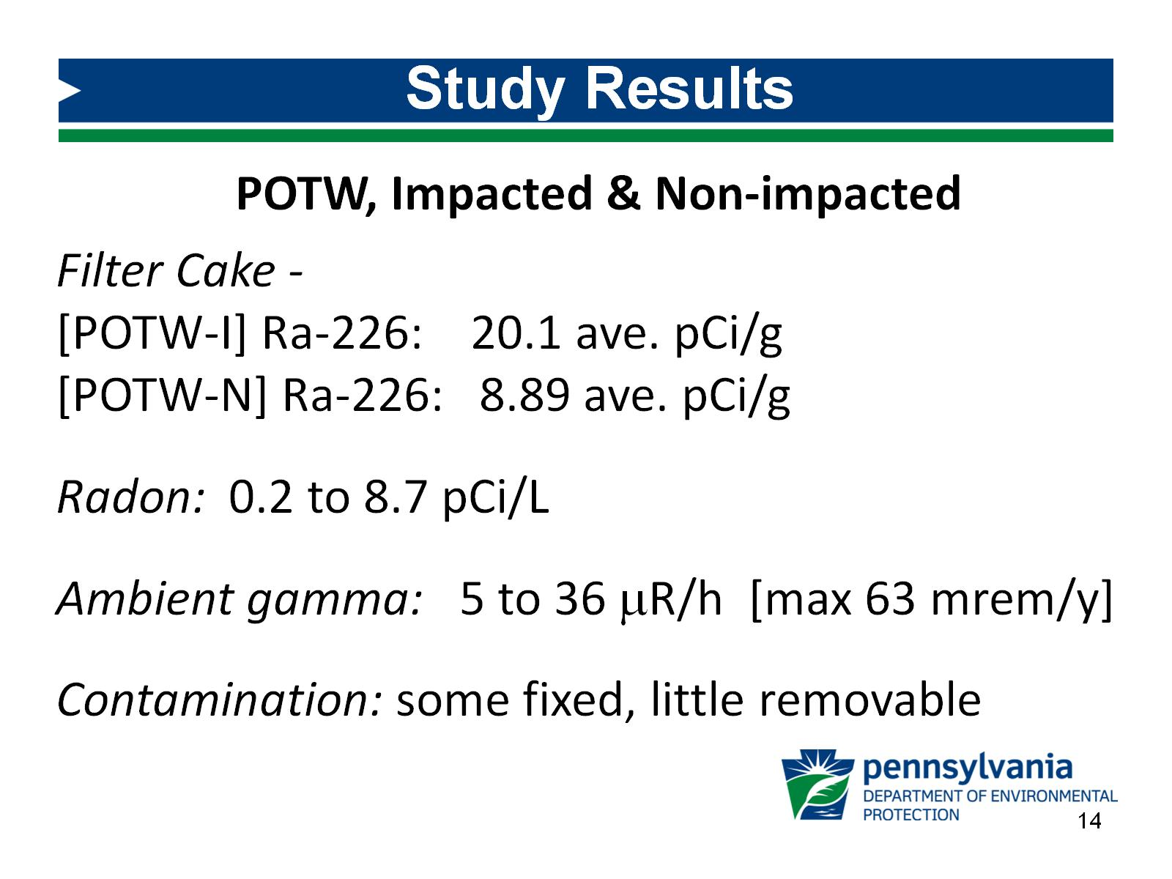
Study Results

Slide 15
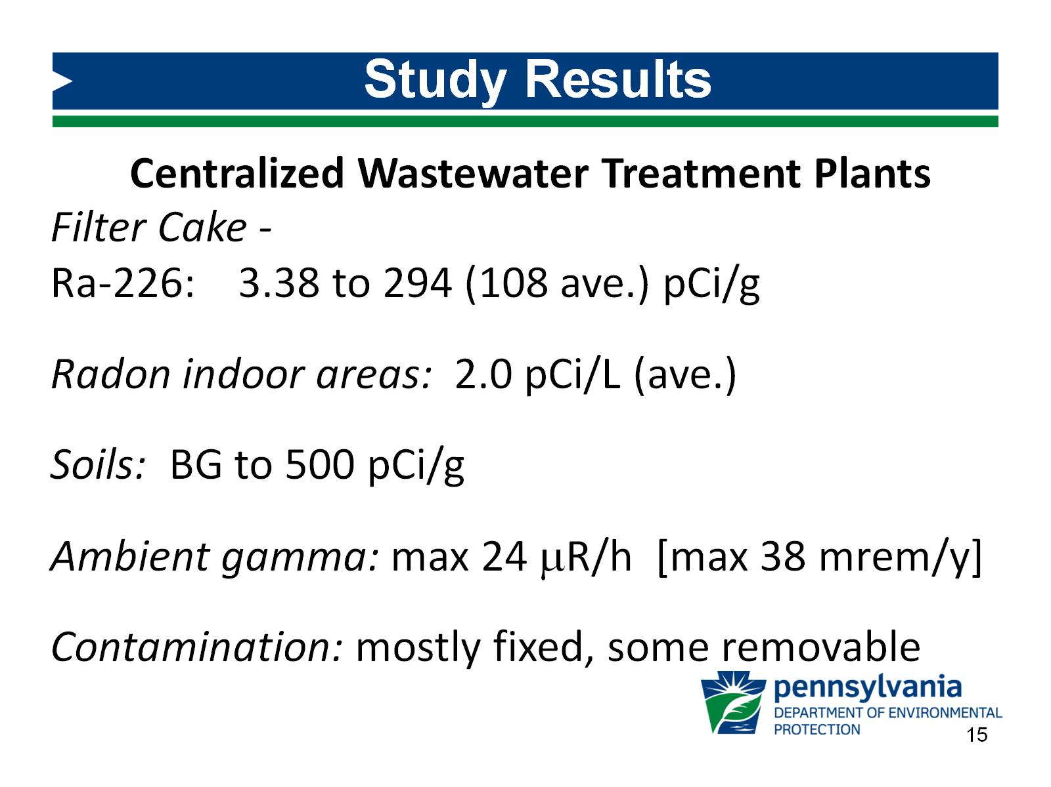
Study Results

Slide 16
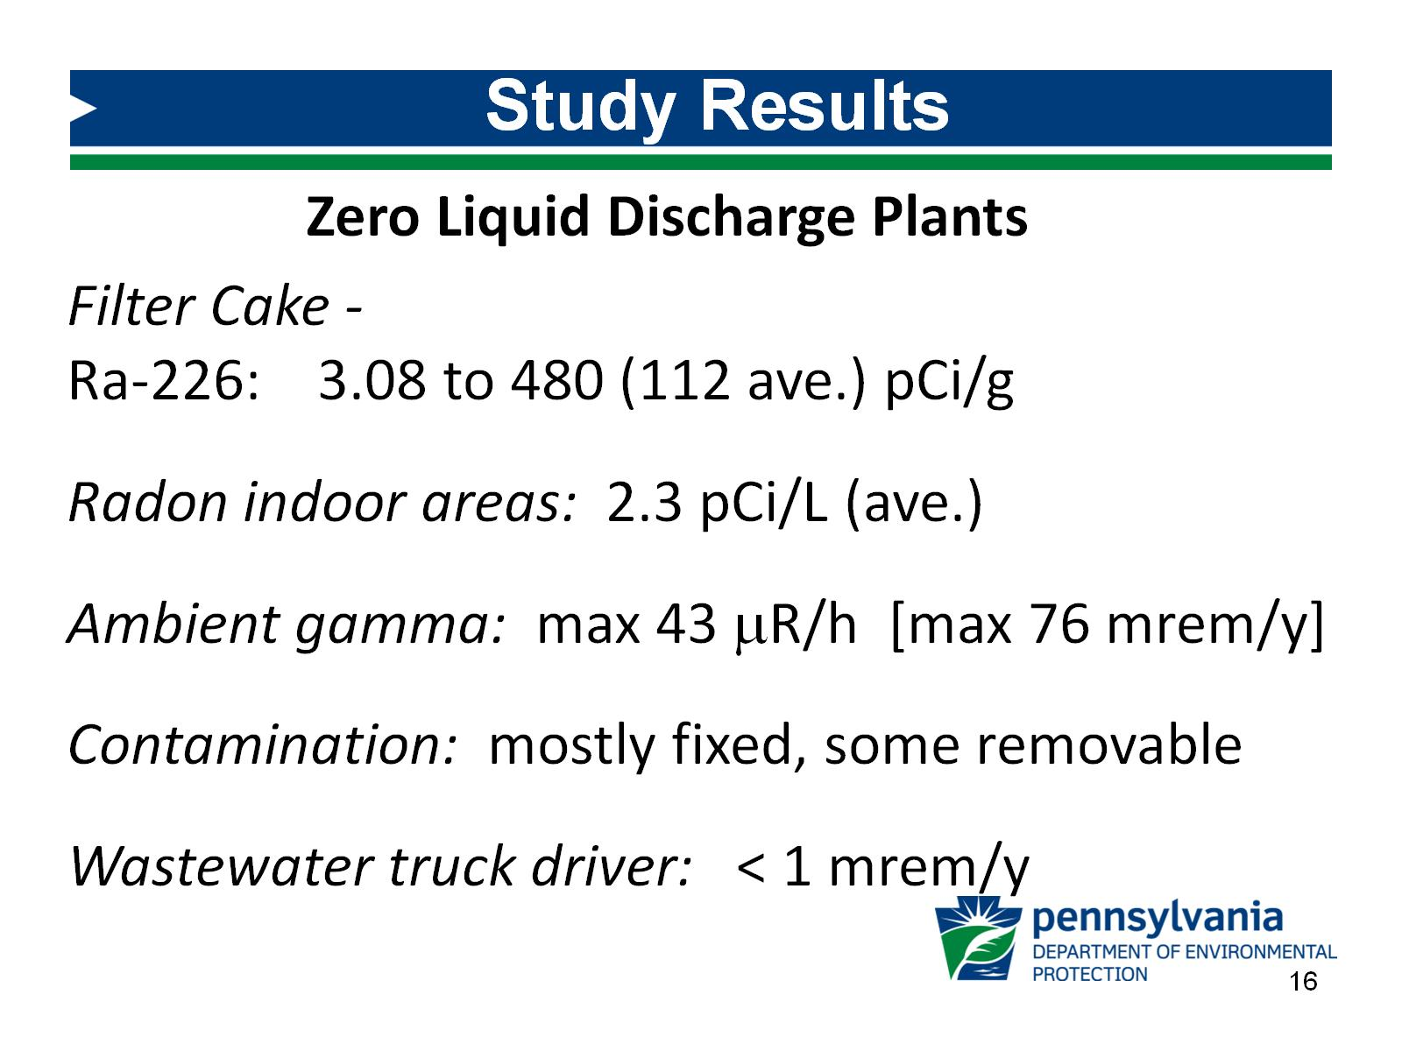
Study Results

Slide 17
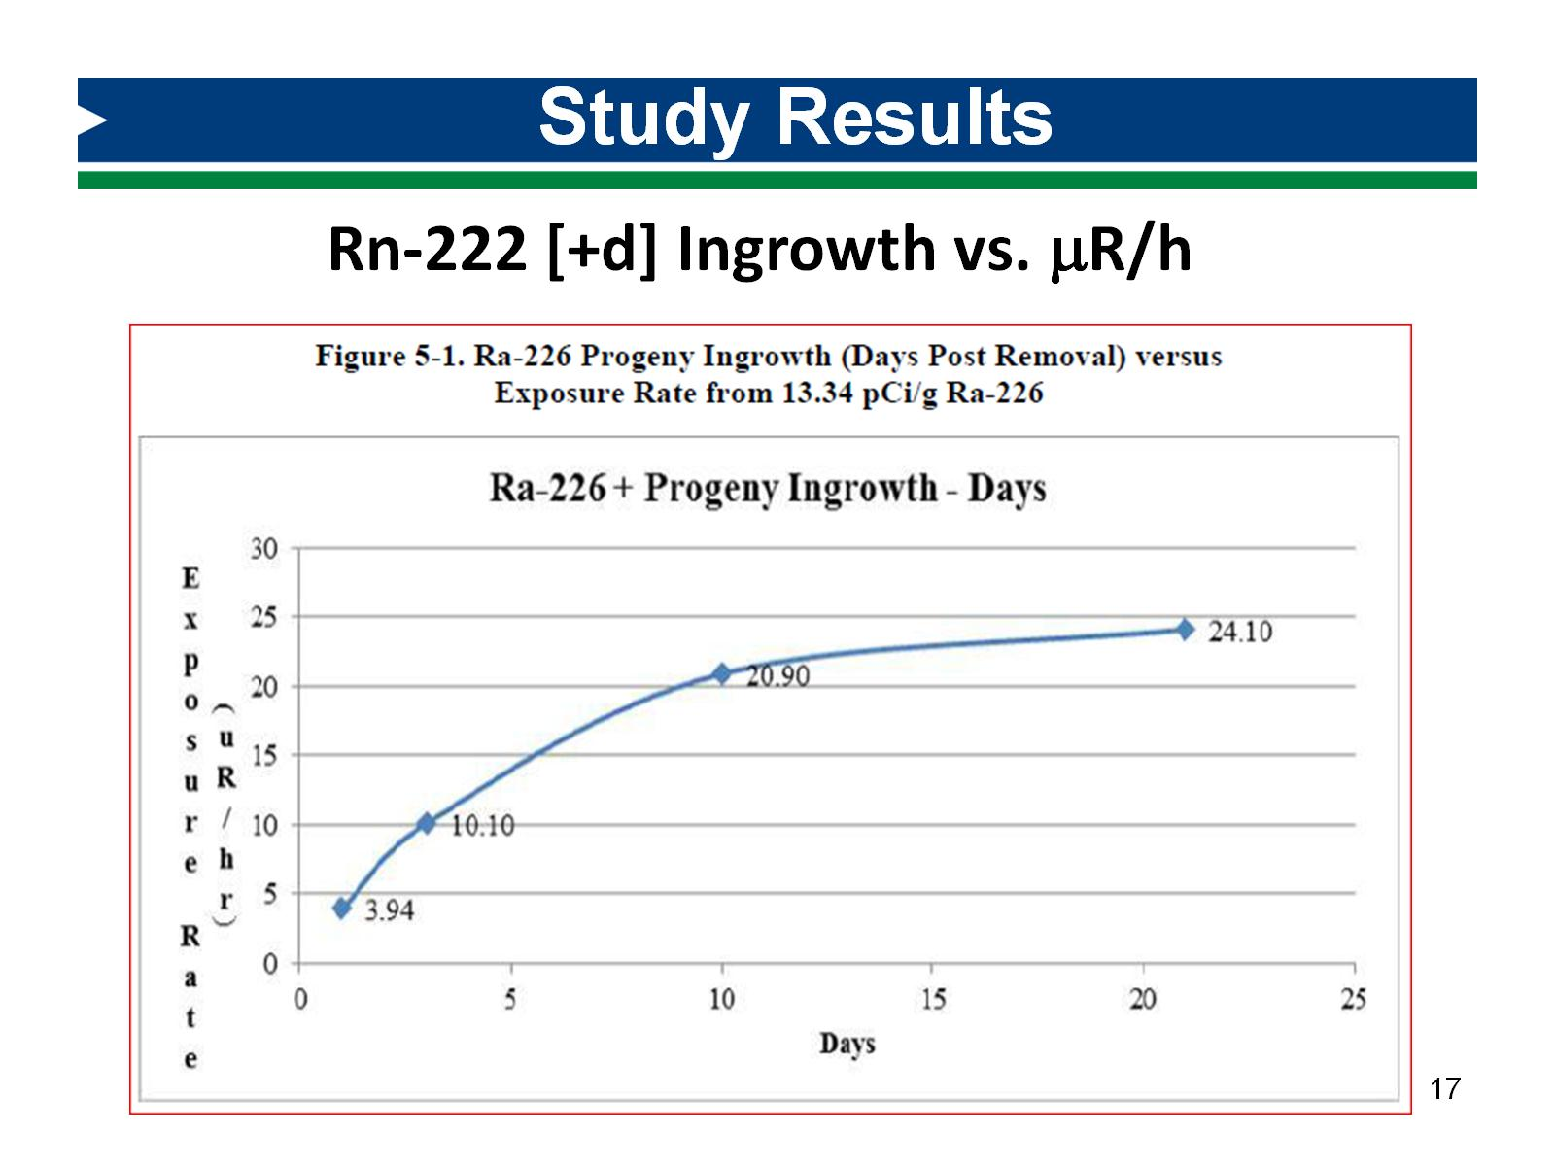
Study Results

Slide 18
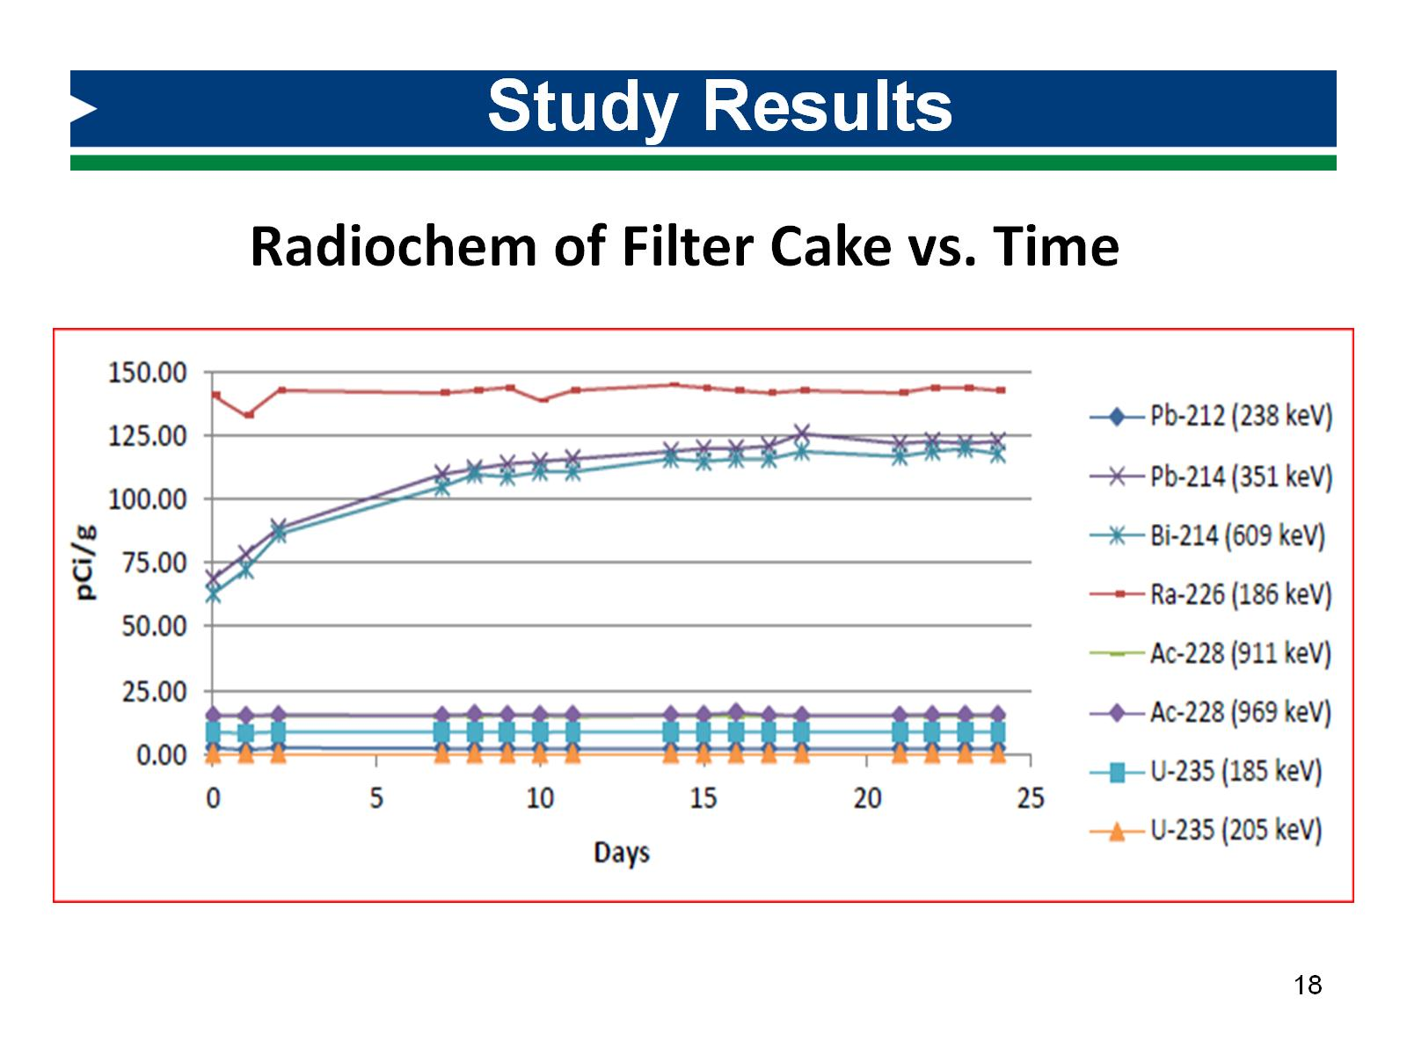
Study Results

Slide 19
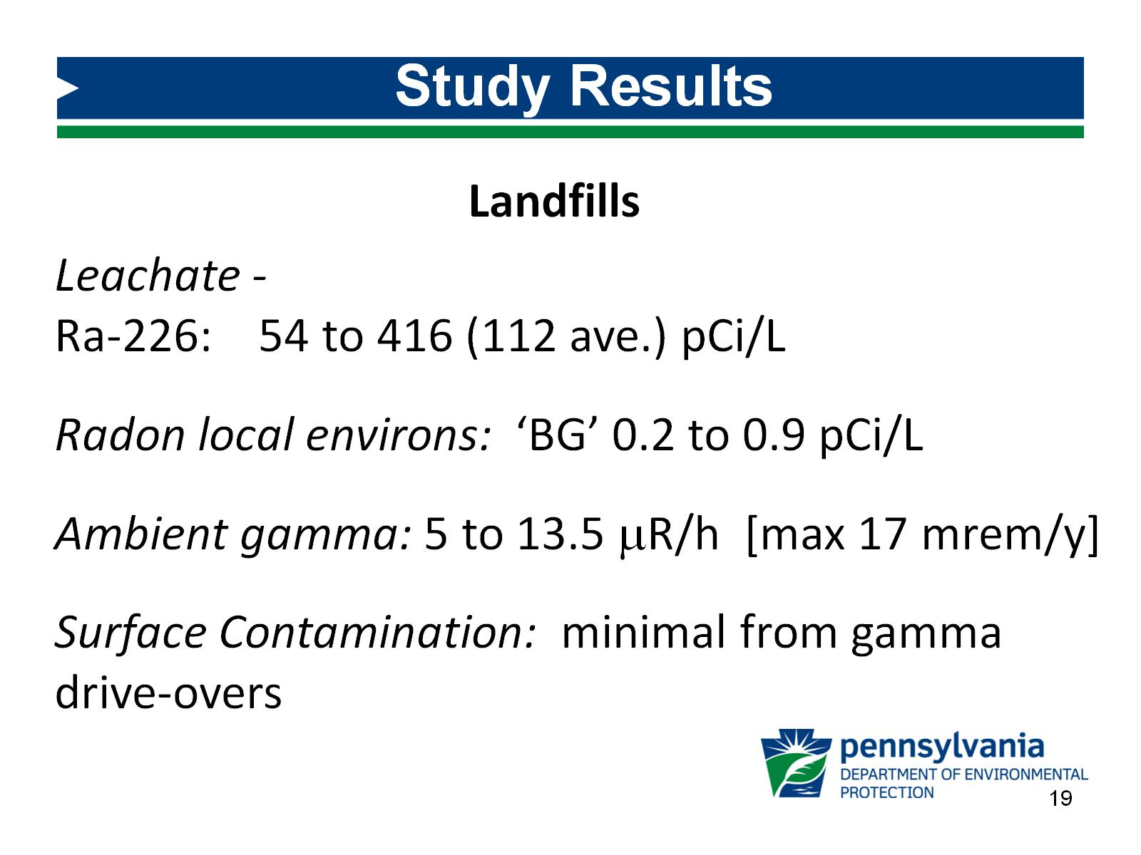
Study Results

Slide 20
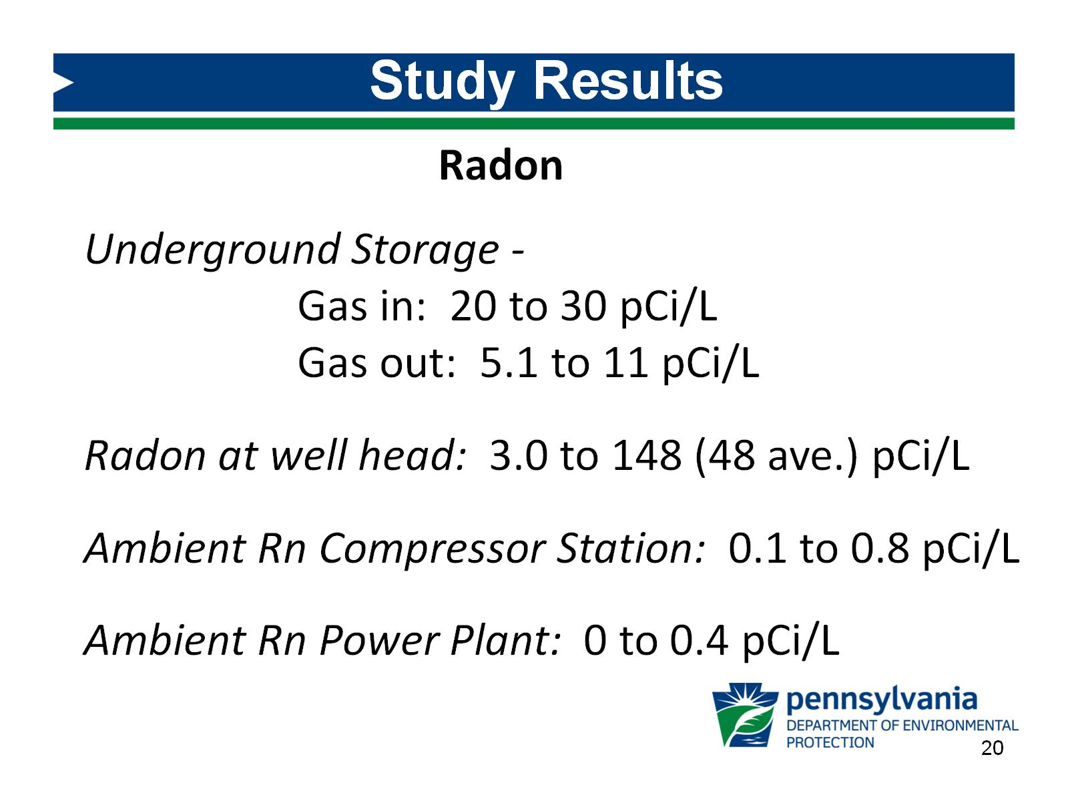
Study Results

Slide 21
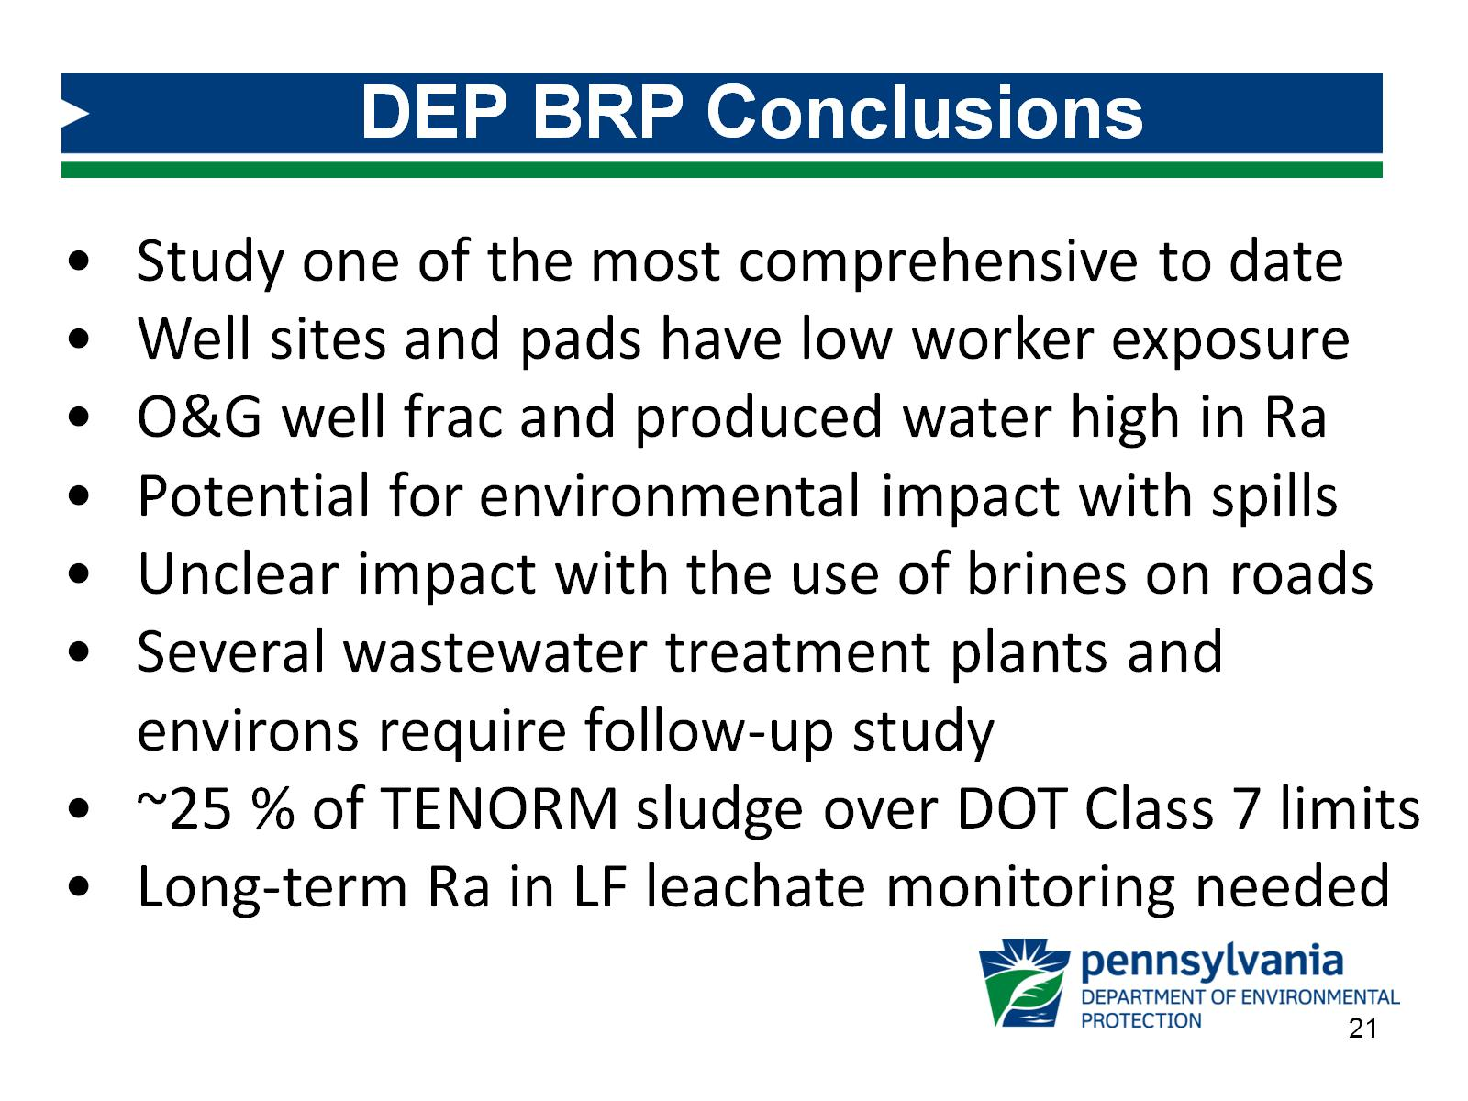
DEP BRP Conclusions

Slide 22
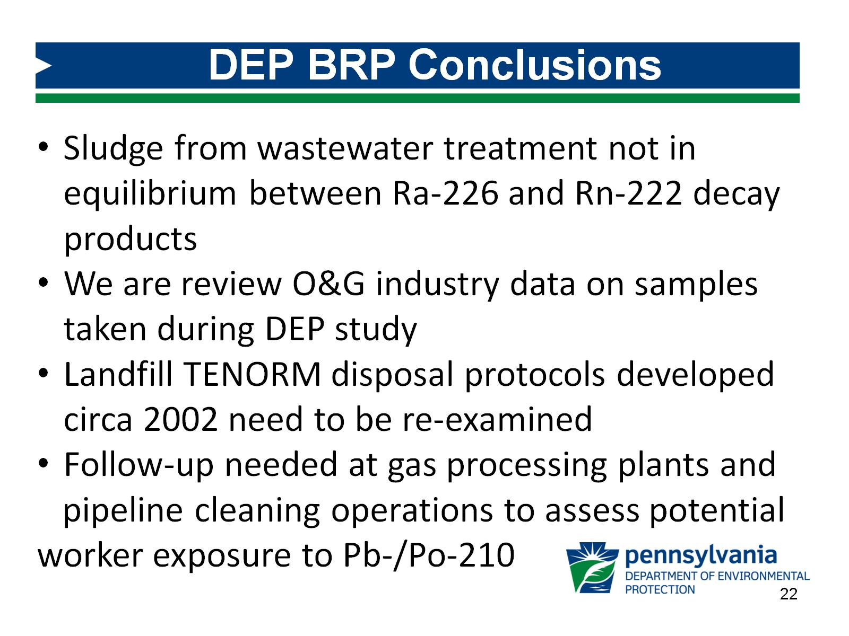
DEP BRP Conclusions

Slide 23
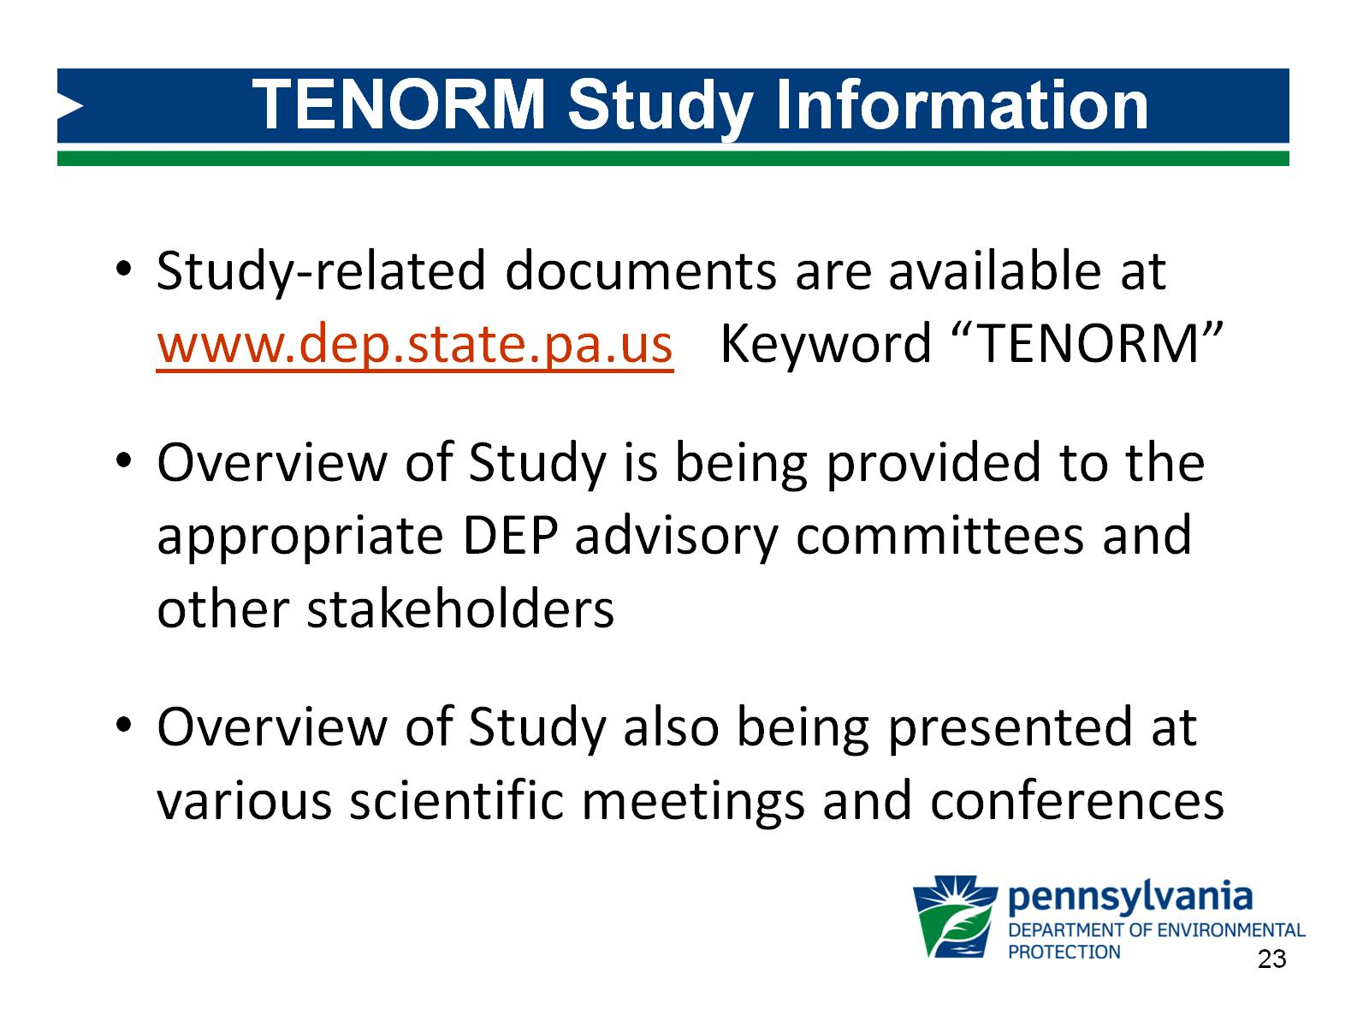
TENORM Study Information

Slide 24
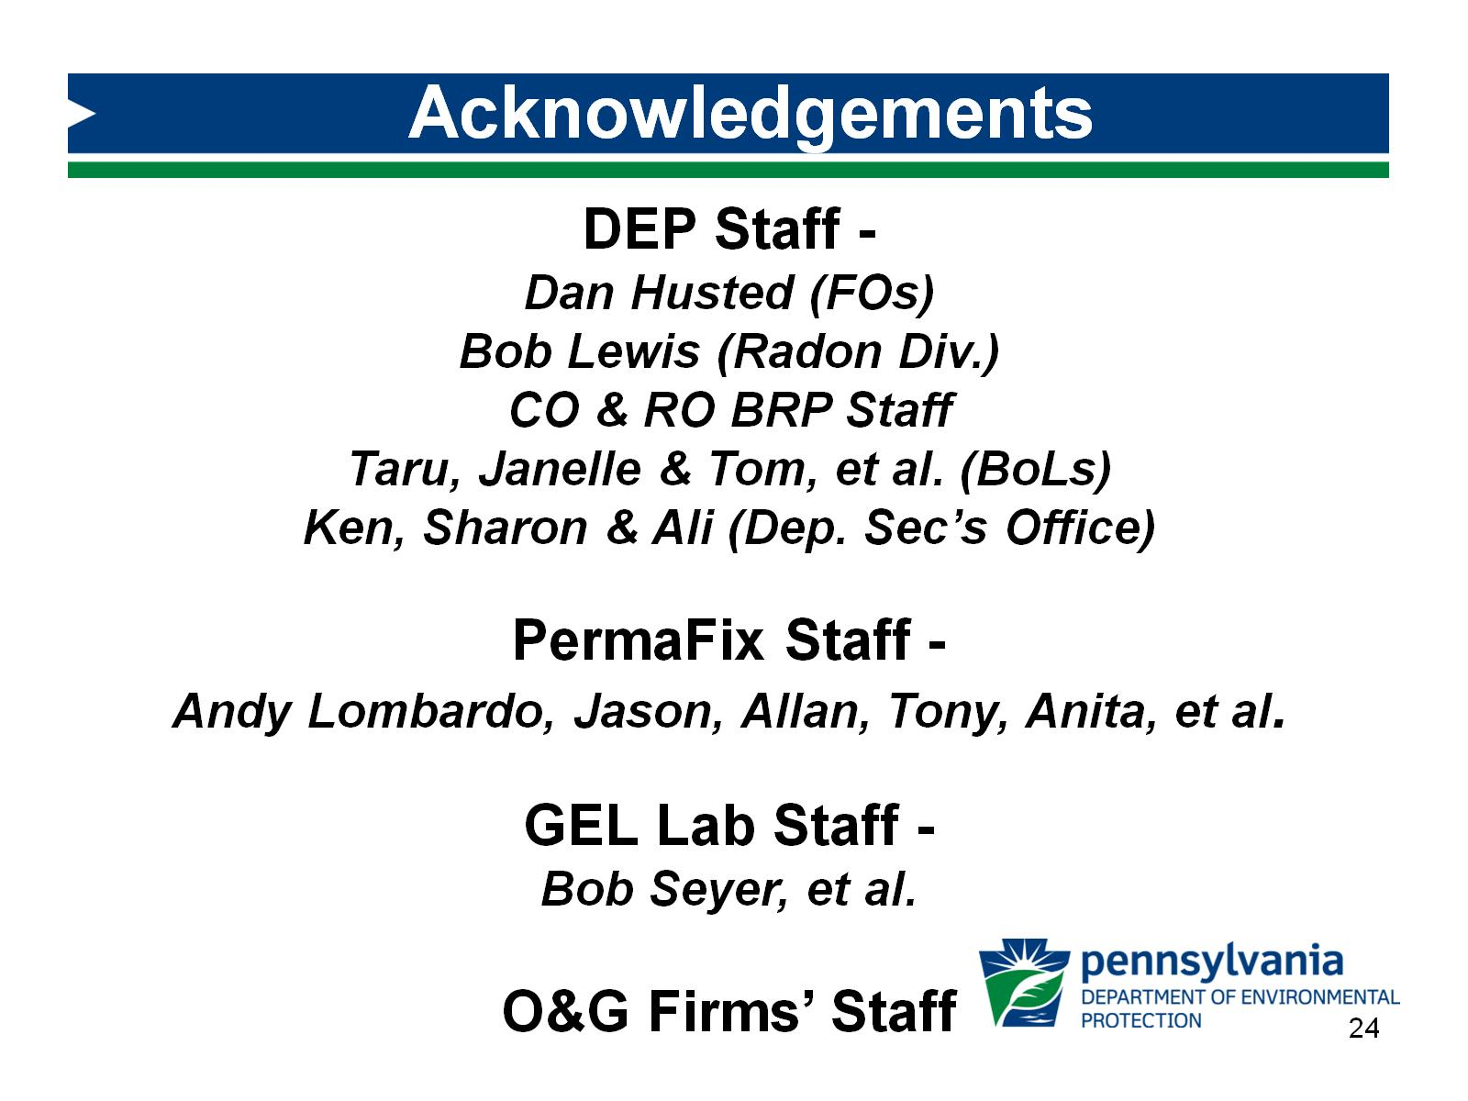
Acknowledgements

Slide 25

David J. Allard, CHP
PA DEP Bureau of Radiation Protection
PO Box 8469
Harrisburg, PA 17105-8469
Tel: 717-787-2480 djallard@pa.gov

Slide 26

Questions?

