Slide 1

Orphan Well Grant Program (OWPG)
Information / Training
August 2024
Josh Shapiro, Governor
Jessica Shirley, Acting Secretary

Slide 2

Orphan Well Plugging Grant
Title 1V Non-Discrimination Notice
Federal and State law prohibit discrimination on the basis of age, color, creed, mental and/or physical disability, gender identity, national origin, pregnancy, race, religion, sex, or sexual orientation. If you believe you have been discriminated against in any program, activity or facility as described above, or if you desire further information, please contact DEP’s Non-Discrimination Coordinator at ra-epnondiscrim@pa.gov.
For more information, please visit DEP’s web page on Non-Discrimination

Slide 3
Orphan Well Plugging Grant
Infrastructure Investment and Jobs Act (IIJA)
Acts 96/136 (Orphan Well Plugging Grant)
  Chapter 28 of the Oil & Gas Act
  (58 PA.C.S. §§ 2801 et. seq.)

Slide 4
Orphan Well Plugging Grant
Optional Checklist
  Pre-application
  Pre-plugging
  Plugging
  Post-plugging

Slide 5
Pre-application
Eligible Well
  Abandoned_Orphan_Web - Report Viewer (pa.gov)
  Exclude IIJA Wells
PA Oil and Gas Mapping
  Well Type (select all), Well Status (DEP Orphan)

Slide 6
Pre-application
Eligible Applicant
  Qualified Well Plugger
  Oil and Gas Compliance - Report Extracts (pa.gov)
Obtain UEI Number
  Go to SAM.gov to register

Slide 7
Pre-application
Well Plugging and Restoration Agreement
  Landowner Consent Form
Visit Well
  Confirm location (take photo)
  Methane screening (required)
  Check for soil contamination

Slide 8
Conditional Application Approval
Complete Grant Application
  15 days for approval/denial
    letter 3 days after
    Conditional per EID requirements
  Submit Environmental Information Documentation (EID) for ESA/NHPA Clearances

Slide 9
Conditonal Application Approval
DOI Terms and Conditions
  Environmental Information Documentation
    Project Scope and Description
    ESA Clearances
    NHPA Clearances
      Package must be approved by DOI before NTP Issued

Slide 10
Application Approval
Grant Agreement
  45 days awardee to sign
  DEP sign (executed)
  Notice to Proceed (NTP) issued

Slide 11
Pre-plugging
Methane Measurement
  Methane Measurement Service Provider form
    Submitted pre-measurement
  Methane Measurement Report form
    All readings, submitted at end of project
SAP Vendor #

Slide 12
Pre-plugging
Notice of Intent to Plug (NOI)
  Submit to Oil and Gas Inspector
  District office
  Copy ra-eporphangrant@pa.gov

Slide 13
Plugging
Daily Log of Activities
  Submitted Weekly
Daily Electronic Briefing
  Brief e-mail, submitted daily

Slide 14
Plugging
Davis Bacon Act Compliance
  Wage Determinations
    Sent to grantee with grant agreement
  Weekly Certified Payroll
    Submitted weekly to ra-eporphangrant@pa.gov

Slide 15
Plugging
Tech Specs
Expectations
Oversight

Slide 16
Post-Plugging
Certificate of Well Plugging
Methane Measurement Report
Orphan Well Completion Worksheet
Itemized Expenses for Reimbursement form

Slide 17
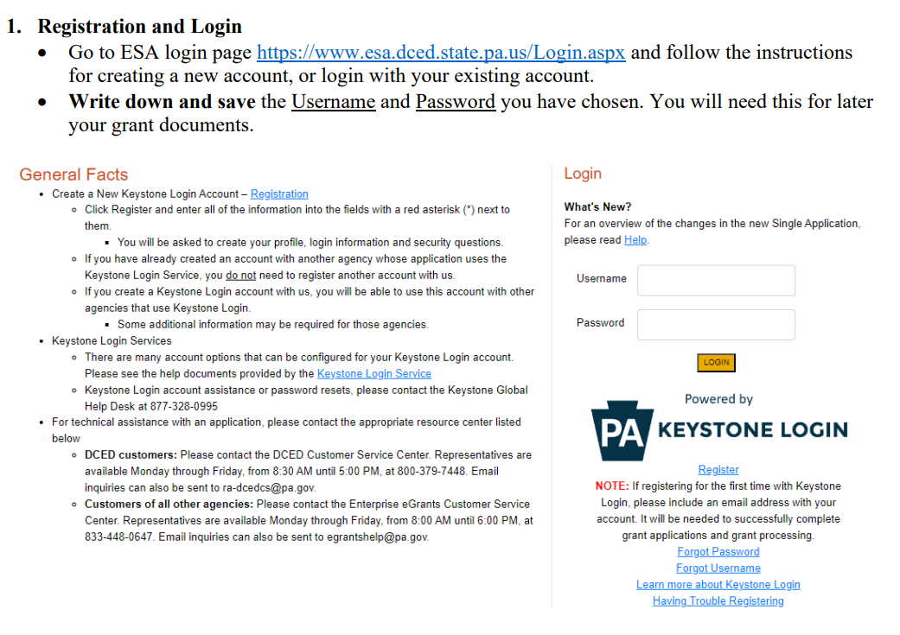
Application

Slide 18
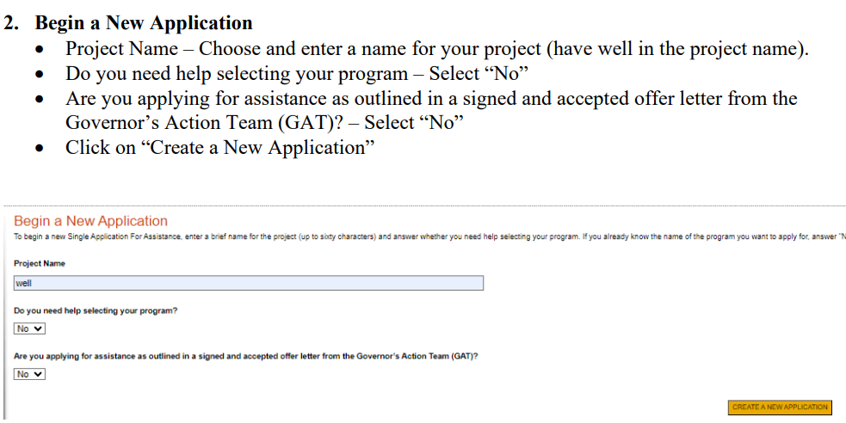
Application

Slide 19
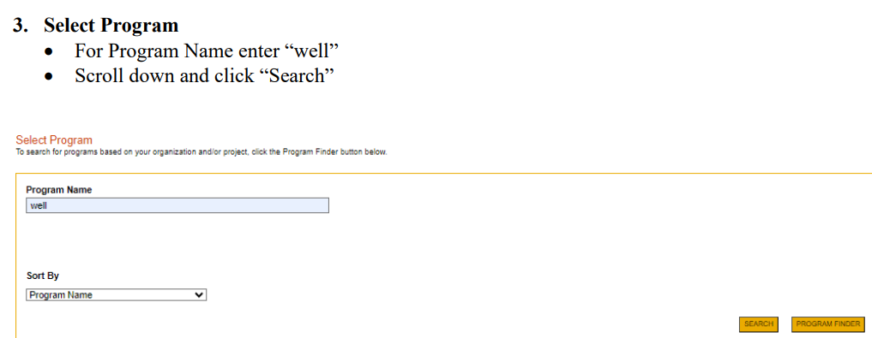
Application

Slide 20
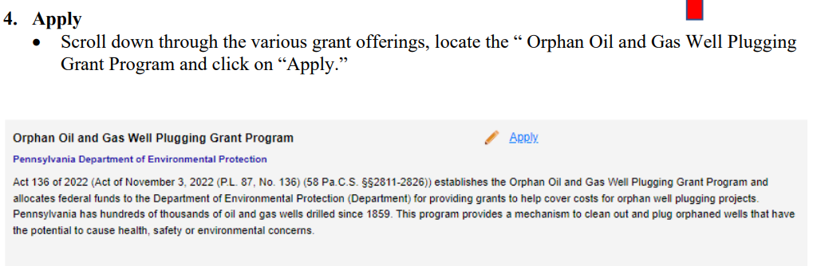
Application

Slide 21
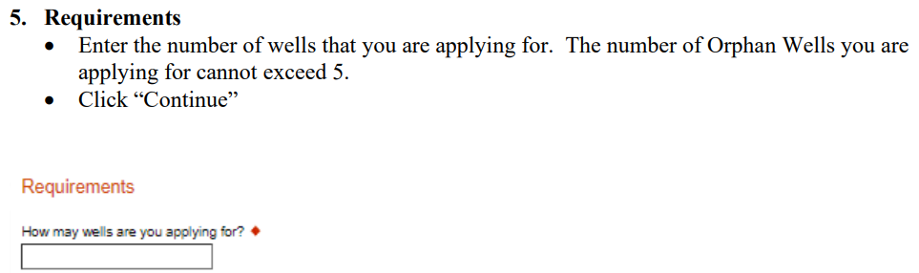
Application

Slide 22
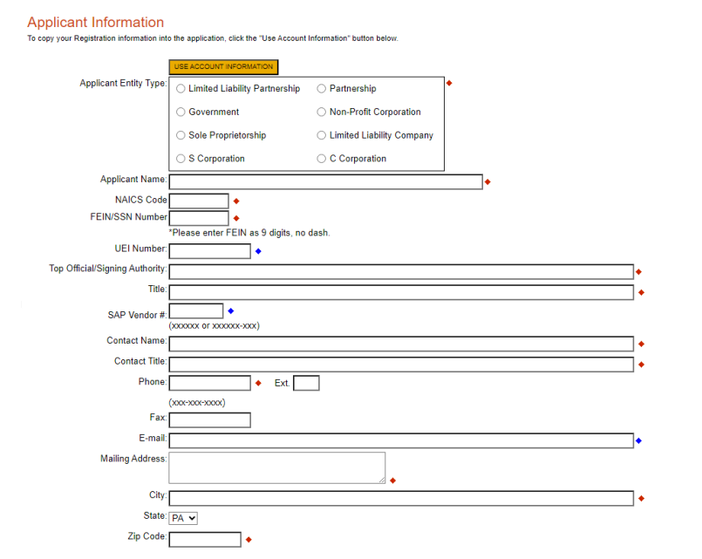
Application

Slide 23
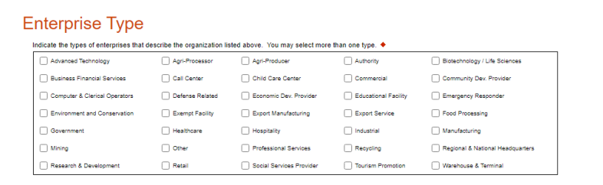
Application

Slide 24
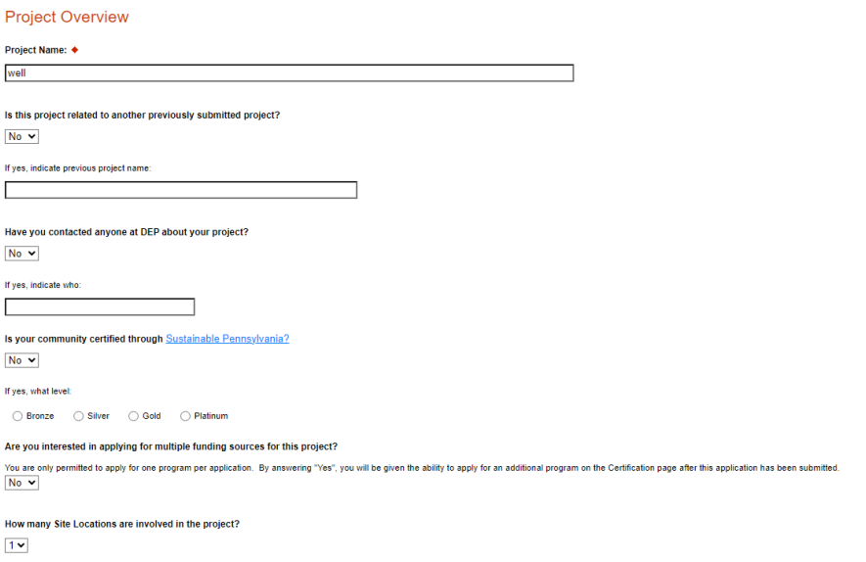
Application

Slide 25
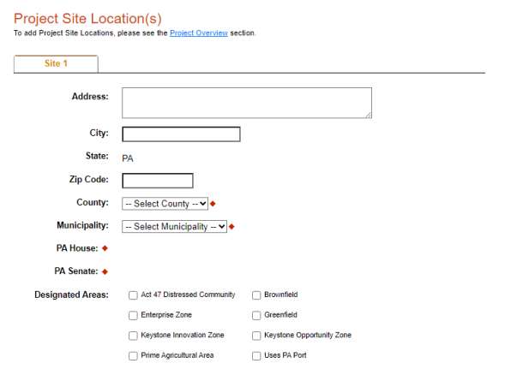
Application

Slide 26
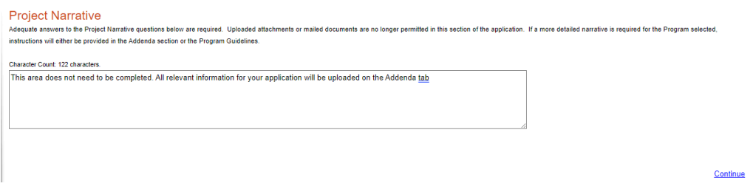
Application

Slide 27
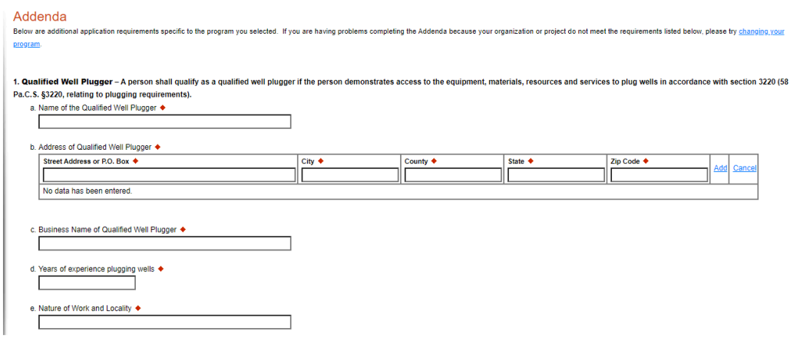
Application

Slide 28
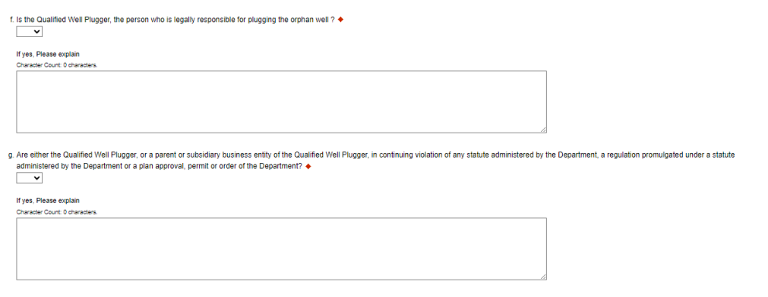
Application

Slide 29
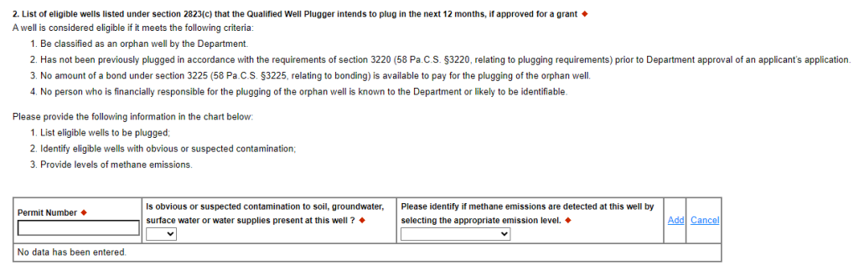
Application

Slide 30
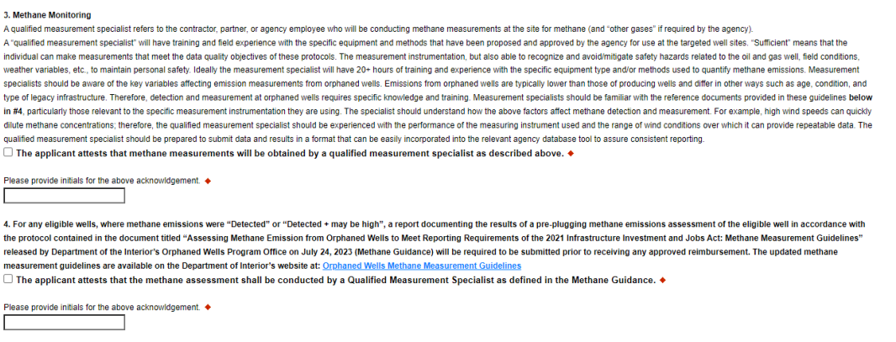
Application

Slide 31
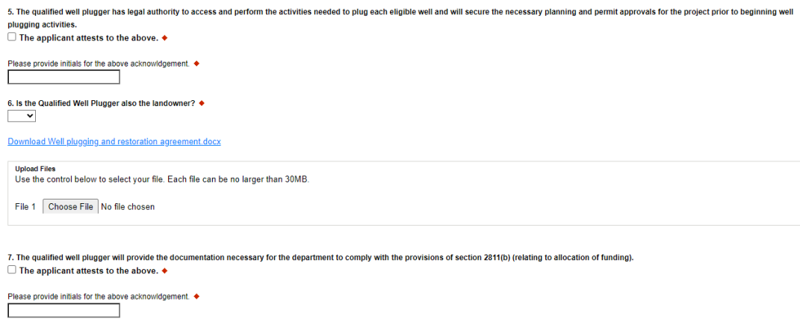
Application

Slide 32
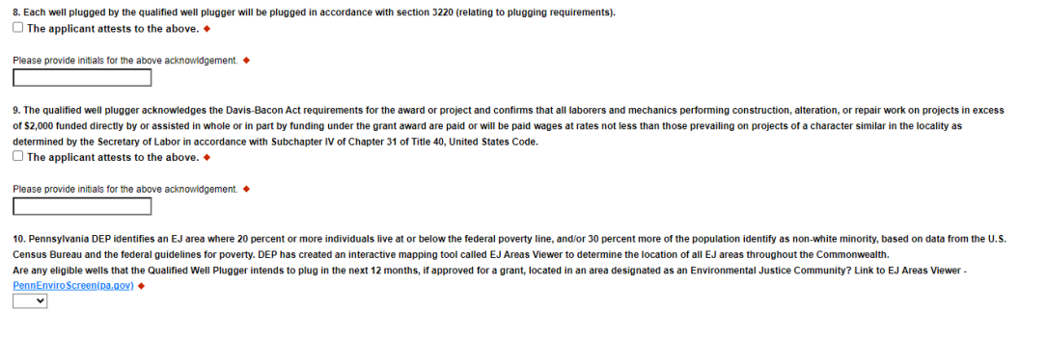
Application

Slide 33
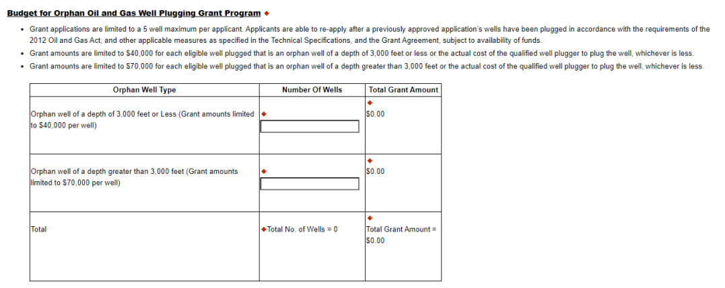
Application

Slide 34
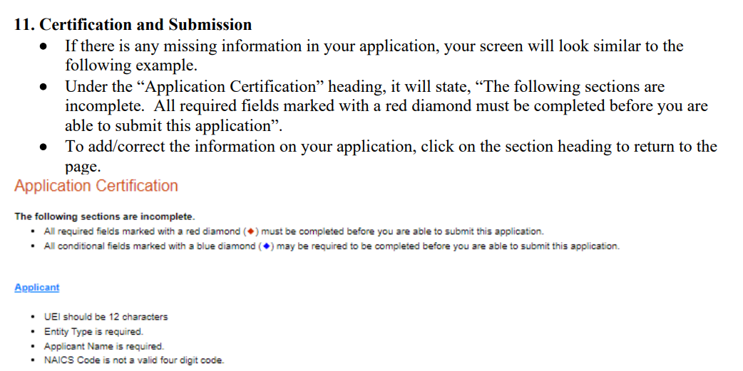
Application

Slide 35
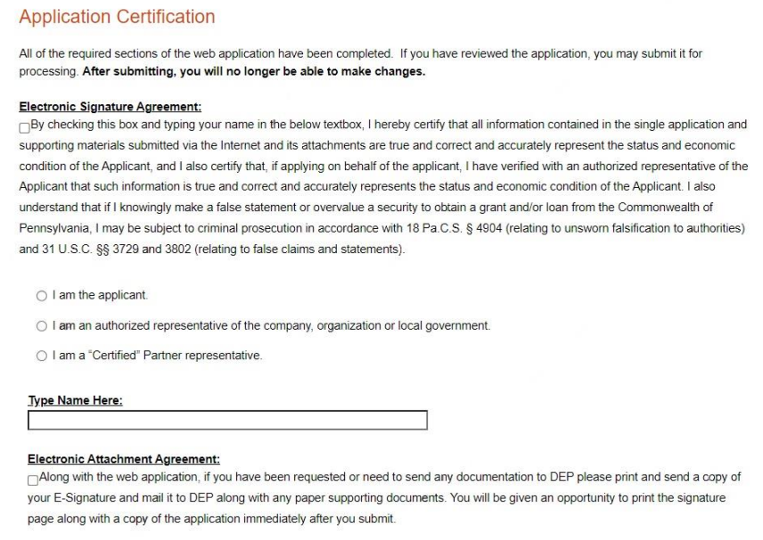
Application

Slide 36
Environmental Considerations
Chapter 102 Requirements (earth disturbance)
  < 5 acres total earth disturbance = E&S Plan
  Minimize disturbance, use BMPs, seed and mulch
  Site remediation: achieve ≥ 70% perennial vegetative cover

Slide 37
Environmental Considerations
Chapter 105 Requirements (water obstructions and encroachments to streams, wetlands, etc.)
  Permitting (typically GP-8, sometimes Environmental Assessment for waived activities)
  Avoid and minimize, steel plates over culverts, temporary bridges, fiberglass or wood timber matting to reduce soil compaction

Slide 38
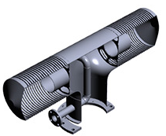



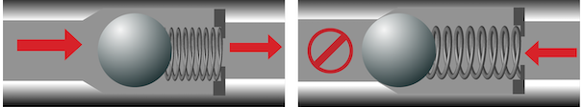
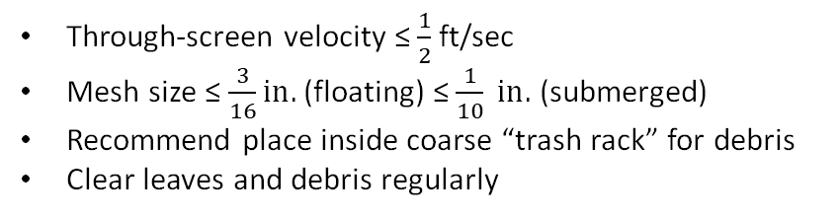
Environmental Considerations
Example intake screen
Image credit: Federal Screen Products, Inc.
Water Withdrawals
  Prevent impingement & entrainment
  Prevent spread of aquatic invasive species
    Resources: PFBC and StopAquaticHitchHikers.Org
    Backflow preventer + Clean, Drain, Dry and/or Disinfect
Through-screen velocity ≤ $\frac{1}{2}$ft/sec
Mesh size ≤ $\frac{3}{16}in.$ (floating) ≤ $\frac{1}{10} in.$ (submerged)
Recommend place inside coarse “trash rack” for debris
Clear leaves and debris regularly
Flex Hose
Pumping
Pump Off
Intake side
Pump/Tank side
Ball check valve example (one-way flow)
Image credit: Tameson.com

Slide 39
Environmental Considerations
Control and disposal
  Fluids: brine, chemicals, drilling mud, water
  Reuse water when possible
  Contaminated soils - dispose at a certified facility
  Trash, well remnants, tanks, pipes, etc.
    Recycle when possible
    Historic properties – DEP will consult PHMC

Slide 40
Environmental Considerations
PNDI Conservation Explorer Tool
  Federal law: Endangered Species Act (ESA)
  PA Law: Wild Resource Conservation Act, Fish & Boat Code, Game & Wildlife Code
  Resource agencies: USFWS, PFBC, PGC, DCNR
  Free account, submit projects free, $40 fee for final receipt

Slide 41
Environmental Considerations
PA-SHARE Tool
  Federal law: Section 106 of National Historic Preservation Act (NHPA)
  PA Law: State History Code
  Resource agencies: PHMC's SHPO Office (state), ACHP (federal)
  Free account, submit projects free, receive receipt
Notes:
Pennsylvania Historic and Museum Commission – State Historic Preservation Office (SHPO) or "The SHPO" as in "Officer" = the Executive Director of PHMC
ACHP = Advisory Council on Historic Preservation
Other consulting parties may include:
Tribal Historic Preservation Officers of federally recognized Indian Tribes (18 with historic presence in Pennsylvania), local historical societies, and other organizations with interests in cultural resource preservation.

Slide 42
Additional Opportunities
IIJA Plugging Contracts
  Invitation to Bid (Low bid)
  Request for Proposal (Technically Qualified Well Plugging Contractor)
Methane Emissions Reduction Program (MERP)

Slide 43
Additional Opportunities
Methane Emissions Reduction Program (MERP)
Marginal Conventional Well (MCW)
$420,000 for any single applicant within each application period
  $20,000 for each eligible well <or= 3,000 feet
  $35,000 for each eligible well > than 3,000 feet
Applicants: Operator of wells, Qualified Well Plugger, Third Party
MERP Small Operator Assistance: Operator of 10 or less wells
MERP General Assistance: Operator of 11 or more wells

Slide 44
Joe Gaboff jgaboff@pa.gov
Any further questions can be sent to ra-epoilandgas@pa.gov

