Slide 1
Community Solar and Low-Income Access: A National Perspective
Erica McConnell
Attorney
Shute, Mihaly & Weinberger
December 4, 2017

Slide 2
Regulatory Reform
Consumer Empowerment
Quality Workforce

Slide 3
What do we mean by Community Solar?
Image courtesy of US Department of Energy, SunShot Initiative, http://energy.gov/eere/sunshot/community-and-shared-solar

Slide 4
The WHO and the WHY of Community Solar
Multitenant Property Owner
Low-Income Customers
Low-Income Customers
Commercial Customer
Community Organization
Residential Customer
ENERGY SAVINGS
ENVIRONMENTAL BENEFITS
JOBS
Public Interest Non-Profit
EDUCATION/ TRAINING
PRICE HEDGE
RESILIENCY
Project Developer
EQUITABLE ACCESS
CUSTOMER
CHOICE
ECONOMIC DEVELOPMENT
Local Government
CAPACITY
ROI
LOCATIONAL GRID BENEFITS
Investors
Regulator
Utility
Consumer
Advocate
Policymaker

Slide 5
Program Design Options
Dedicated low-income community solar (100% low-income participation)
California MASH and SOMAH (AB 693) programs
Grand Valley Power Low-Income Community Solar Program (Colorado cooperative utility)

Slide 6
Program Design Options
Low-income program or project carve-out
Colorado community solar gardens program—5% project carve-out
Some changes this year
Maryland community solar pilot program—2 separate program carve-outs
Oregon community solar program—10% program carve-out (still being implemented)

Slide 7
Overcoming Financial Barriers
Potential mechanisms include:
Incentives—direct and tax Example: CA programs
Anchor tenants/subscribers Example: Carve-out programs
On-bill repayment and financing Example: Grand Valley Power non-low-income community solar program

Slide 8
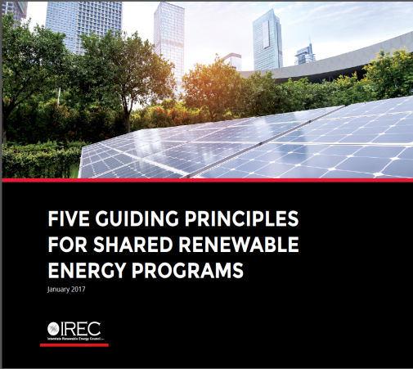
Tools you can use
www.irecusa.org/publications
http://solarmarketpathways.org

Slide 9
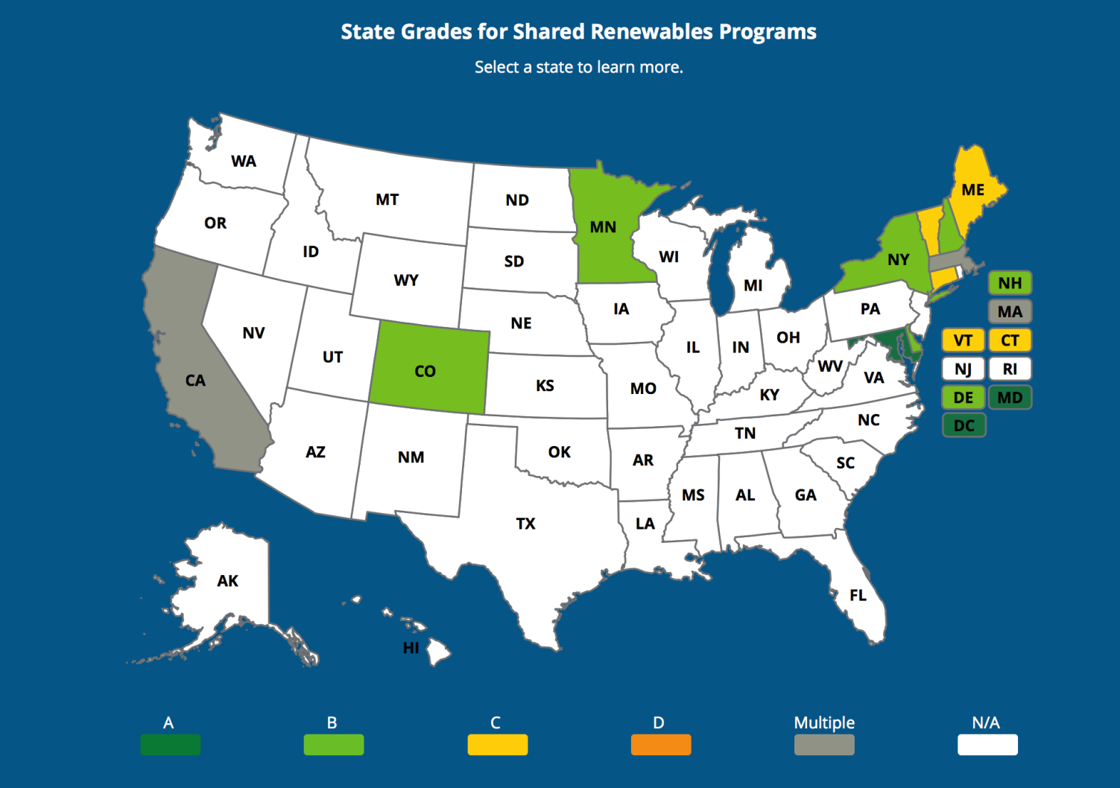
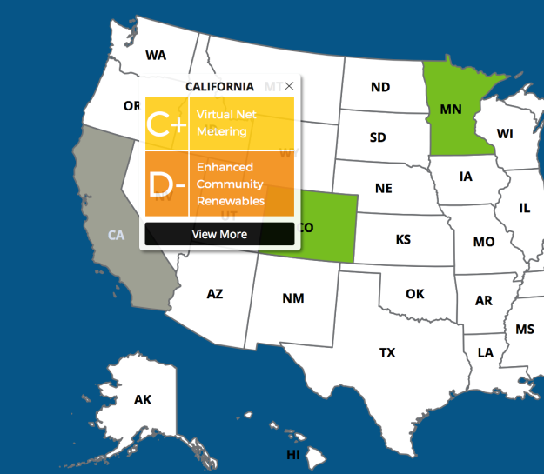
www.SharedRenewablesScorecard.org

Slide 10
www.irecusa.org
info@irecusa.org
Erica McConnell mcconnell@smwlaw.com
@IRECUSA
Facebook & LinkedIn
@Interstate Renewable Energy Council
Text 22828
enter email for news, reports, & insights

