Slide 1
Low-Level Radioactive Waste Generation Information for Appalachian Compact September 2014

Slide 2
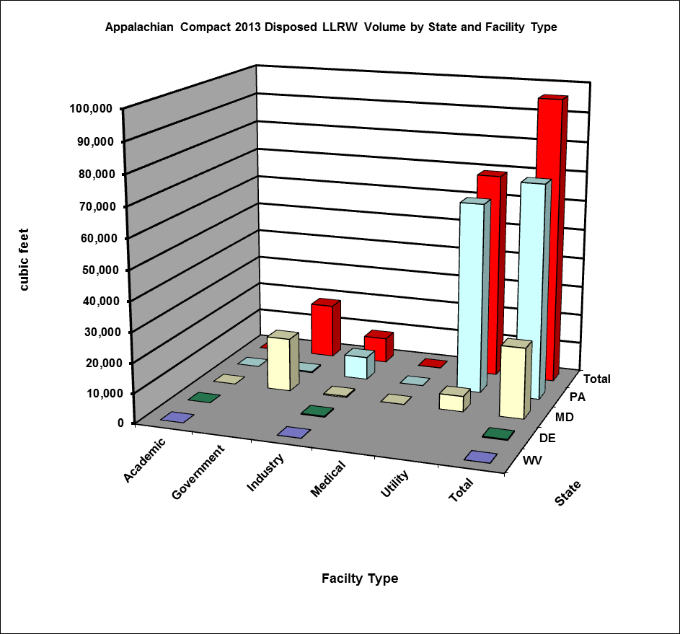
Appalachian Compact 2013 Disposed LLRW Volume by State and Facility Type
Facility Type/State | WV | DE | MD | PA | Total
Academic | 0.8 | 3.7 | 1.4 | 1.5 | 7.4
Government | 0 | 0 | 17,932.8 | 381.0 | 18,313.8
Industry | 44.0 | 335.8 | 425.5 | 7,701.1 | 8,462.3
Medical | 0 | 0 | 40.2 | 15.7 | 55.9
Utility | 0 | 0 | 5,197.4 | 63,967.6 | 69,209.0
Total | 44.8 | 339.5 | 23,597.2 | 72,066.9 | 96,048.4
This information is from the Pennsylvania Department of Environmental Protection and
EnergySolutions as of August 2014; volume is in cubic feet (ftᶟ). Data contains LLRW burial
at the EnergySolutions facility in Clive, Utah.

Slide 3
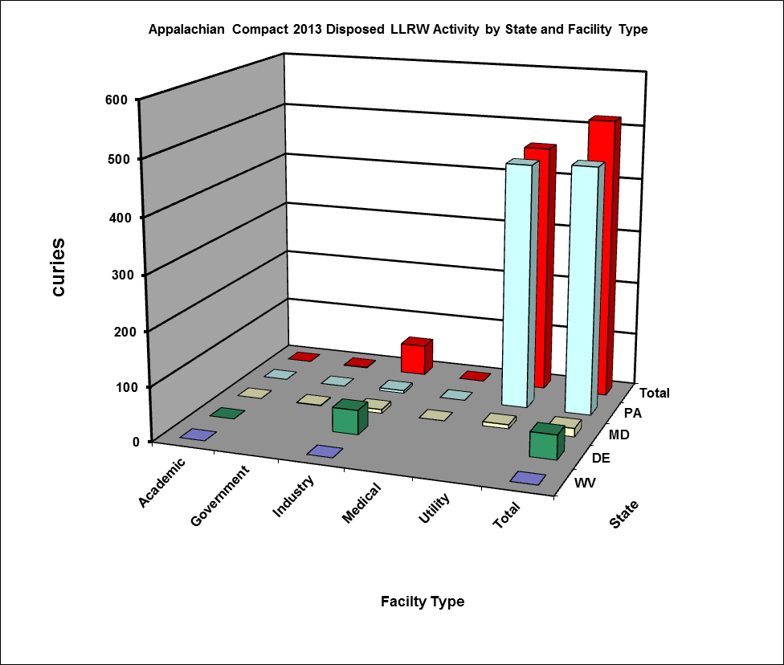
Appalachian Compact 2013 Disposed LLRW Activity by State and Facility Type
Facility Type/State | WV | DE | MD | PA | Total
Academic | 0.005 | 0.005 | 0.005 | 0.005 | 0.02
Government | 0 | 0 | 0.98 | 0.04 | 1.02
Industry | 0.005 | 45.26 | 7.07 | 5.04 | 57.38
Medical | 0 | 0 | 0.06 | 0.03 | 0.09
Utility | 0 | 0 | 7.60 | 453.43 | 461.03
Total | 0.01 | 45.27 | 15.72 | 458.55 | 519.54
This information is from the Pennsylvania Department of Environmental Protection and EnergySolutions as of August 2014; activity is in curies (Ci). Data contains LLRW burial at the EnergySolutions facility in Clive, Utah.

Slide 4
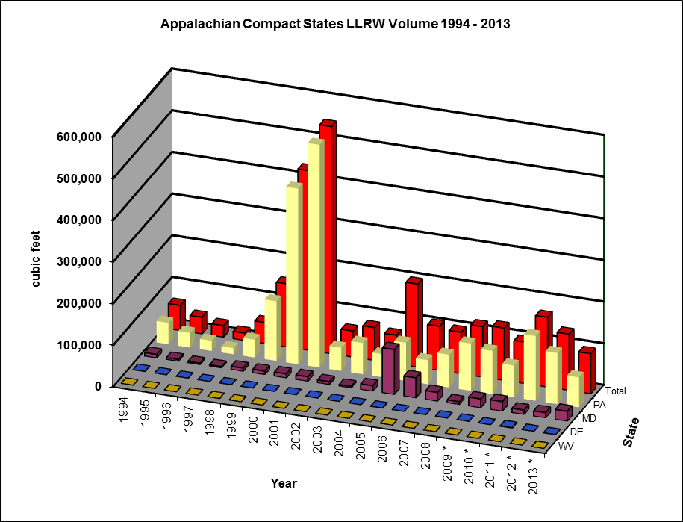
Appalachian Compact Disposed LLRW Volume from 1994 to 2013
.
Year | WV | DE | MD | PA | Total
1994 | 81.8 | 374.8 | 8,421.10 | 51,441.60 | 60,319.3
1995 | 4.2 | 57.8 | 4,428.70 | 35,199.60 | 39,690.3
1996 | 34.8 | 127.2 | 3,391.10 | 24,203.10 | 27,756.2
1997 | 1.8 | 23.9 | 3,096.50 | 14,486.20 | 17,608.4
1998 | 48 | 173.8 | 7,604.60 | 42,686.00 | 50,512.4
1999 | 158.7 | 80.6 | 8,406.80 | 143,043.70 | 151,689.8
2000 | 53.4 | 27.6 | 9,766.80 | 421,398.10 | 431,245.9
2001 | 44.1 | 76.2 | 10,759.90 | 534,429.40 | 545,309.6
2002 | 183.3 | 366.4 | 6,752.80 | 55,371.40 | 62,673.9
2003 | 151.8 | 73.5 | 3,703.10 | 74,901.00 | 78,829.4
2004 | 34.8 | 48.8 | 13,177.80 | 55,136.00 | 68,397.4
2005 | 2.4 | 74.2 | 107,956.40 | 91,292.60 | 199,325.6
2006 | 38 | 59.2 | 48,131.80 | 57,627.70 | 105,856.7
2007 | 48.69 | 42.7 | 21,015.60 | 78,454.50 | 99,561.5
2008 | 132.15 | 414.8 | 6,702.50 | 113,483.20 | 120,732.7
2009 * | 134.08 | 431.2 | 21,451.30 | 103,666.90 | 125,683.5
2010 * | 11.3 | 29.4 | 22,957.60 | 76,519.40 | 99,517.7
2011 * | 19.1 | 1,061.00 | 10,568.70 | 155,508.50 | 167,157.3
2012 * | 21 | 75.2 | 12,364.30 | 122,380.20 | 134,840.7
2013 * | 44.8 | 339.5 | 23,597.2 | 72,066.9 | 96,048.4
Total 1994 | 1,248.2 | 3,957.8 | 354,254.6 | 2,323,296.0 | grand total
to 2013 |  |  |  |  | 2,682,756.6
This information is from the Pennsylvania Department of Environmental Protection and EnergySolutions as of August 2014.
* The volume of LLRW reported includes burial at the EnergySolutions facility in Clive, Utah. Data for prior years includes burial at the Barnwell facility in South Carolina and the EnergySolutions facility.

Slide 5
Appalachian Compact Disposed LLRW Activity from 1994 to 2013
Year | WV | DE | MD | PA | Total
1994 | 0.5 | 69.3 | 1,439.70 | 93,729.60 | 95,239.00
1995 | 4.6 | 0.01 | 346.2 | 5,691.90 | 6,042.70
1996 | 0.1 | 5.6 | 349.1 | 71,900.50 | 72,255.40
1997 | 0.03 | 1.3 | 198.5 | 8,017.90 | 8,217.70
1998 | 37.3 | 0.1 | 531.5 | 43,691.00 | 44,259.90
1999 | 0.5 | 0.1 | 1,335.70 | 86,618.00 | 87,954.30
2000 | 2.2 | 0.02 | 484 | 357,624.40 | 358,110.70
2001 | 0.03 | 0.03 | 903.3 | 168,919.60 | 169,822.90
2002 | 0.1 | 0.5 | 244.5 | 6,777.40 | 7,022.50
2003 | 0.2 | 24.7 | 166.3 | 241,649.80 | 241,840.90
2004 | 0.8 | 0.2 | 11,830.70 | 18,890.30 | 30,722.00
2005 | 0.7 | 31.3 | 156.8 | 58,786.20 | 58,974.90
2006 | 0.03 | 11.9 | 60.1 | 91,719.10 | 91,791.10
2007 | 0.16 | 12.9 | 25,304.70 | 492,579.30 | 517,897.00
2008 | 0.14 | 12.2 | 2,181.50 | 283,328.80 | 285,522.60
2009 * | 0.02 | 0.5 | 4.7 | 1,001.40 | 1,006.60
2010 * | 0.01 | 0.03 | 1.4 | 656.8 | 658.2
2011 * | 0.02 | 1 | 1.8 | 492.6 | 495.5
2012 * | 0.003 | 0.007 | 2.1 | 449.3 | 451.4
2013 * | 0.01 | 45.3 | 15.7 | 458.5 | 519.5
Total 1994 | 47.5 | 217.0 | 45,558.3 | 2,032,982.4 | grand total
to 2013 |  |  |  |  | 2,078,804.8
This information is from the Pennsylvania Department of Environmental Protection and EnergySolutions as of August 2014. *The activity of LLRW reported includes burial at the EnergySolutions facility in Clive, Utah and does not include Class B and C waste disposal. Data for prior years includes burial at the Barnwell facility in South Carolina and the EnergySolutions facility.

