Slide 1
ACT 96/136 ORPHAN OIL AND GAS WELL PLUGGING GRANT PROGRAM
Grant Application Process
May 2024
Josh Shapiro, Governor
Jessica Shirley, Acting Secretary

Slide 2
Orphan Oil and Gas Well Plugging Grant Program
-Pennsylvania’s Formula Grant Award application has NOT been approved by the US Department of the Interior as of today. DOI may require changes as a condition of award
-Training subject to change

Slide 3
Orphan Oil and Gas Well Plugging Grant Program
- In-person training sessions
- Announcement of Grant Application Opening
-Web-based Training
-Pre-application
-Application
-Post-application

Slide 4
Eligibility and Requirements
“DEP Orphan wells”
Vendor Registration
-Open the Office of the Budget website at www.budget.pa.gov, click “for vendors”, vendor registration, non-procurement and complete the sections of the Non-Procurement vendor registration process. (Not-required to submit application)
Commonwealth Of Pennsylvania Supplier Lookup (pa.gov)
Compliance
Oil and Gas Compliance - Report Extracts (pa.gov)
Landowner Consent
Well Plugging and Restoration Agreement
Methane Screening
Detected, not detected, detected; may be high

Slide 5
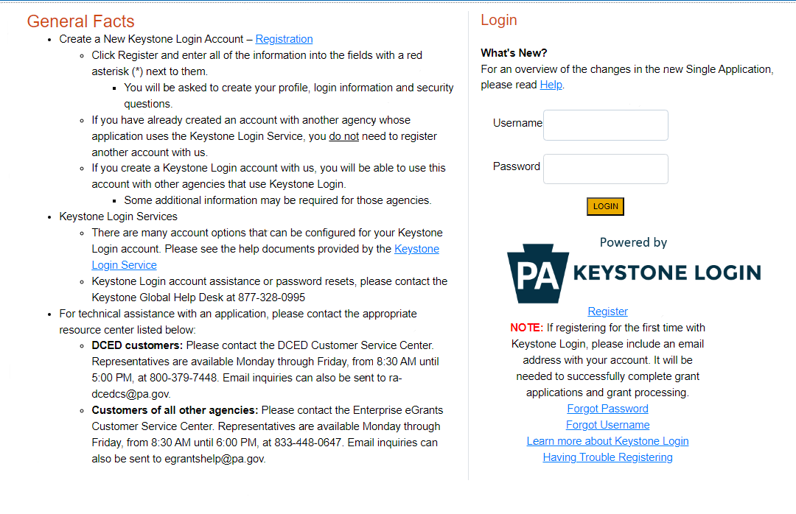
Application
Registration and Login
https://www.esa.dced.state.pa.us/Login.aspx

Slide 6
Application
2. Begin a New Application
• Project Name – Choose and enter a name for your project.
• Do you need help selecting your program – Select “No”
• Click on “Create a New Application”

Slide 7
Application
3. Select Program
For Program Name enter “well”
Scroll down and click “Search”

Slide 8
Application
4. Apply
Scroll down through the various grant offerings, locate the “ Orphan Oil and Gas Well Plugging Grant Program and click on “Apply.”

Slide 9
Application
5. Requirements
Enter the number of wells that you are applying for. The number of Orphan Wells you are applying for cannot exceed 10
Click “Continue”

Slide 10
Application
6. Applicant Information
The Applicant Information section requires data related to the entity for which the application is being submitted.
Applicant Entity Type – select the appropriate type for your organization
Applicant Name – Enter the legal name, the name under which the entity legally conducts business.
NAICS Code – enter the appropriate code for your organization
FEIN/SSN Number - Enter the Federal Tax ID number for the legal name (no dashes).
UEI Number – Unique Entity Identifier. Enter the applying organization’s unique, 12‑character alphanumeric identifier which is assigned to all entities that conduct business with the federal government.
Top Official/Signing Authority – In this block, enter the authorized representative of the municipality.
Title – Enter the title of the authorized representative.

Slide 11
Application
6. Applicant Information
SAP Vendor# - Enter, if known.
Contact Name – Enter the primary contact name for this project.
Contact Title – Enter the primary contact title for this project.
Phone and Fax – Enter the phone and fax numbers for the primary contact title for this project.
E-mail – Enter the e-mail for the primary contact title for this project.
Mailing address, City, State and Zip Code – Enter this information for the primary contact for this project.
Enterprise Type – Select.
Click “Continue”

Slide 12
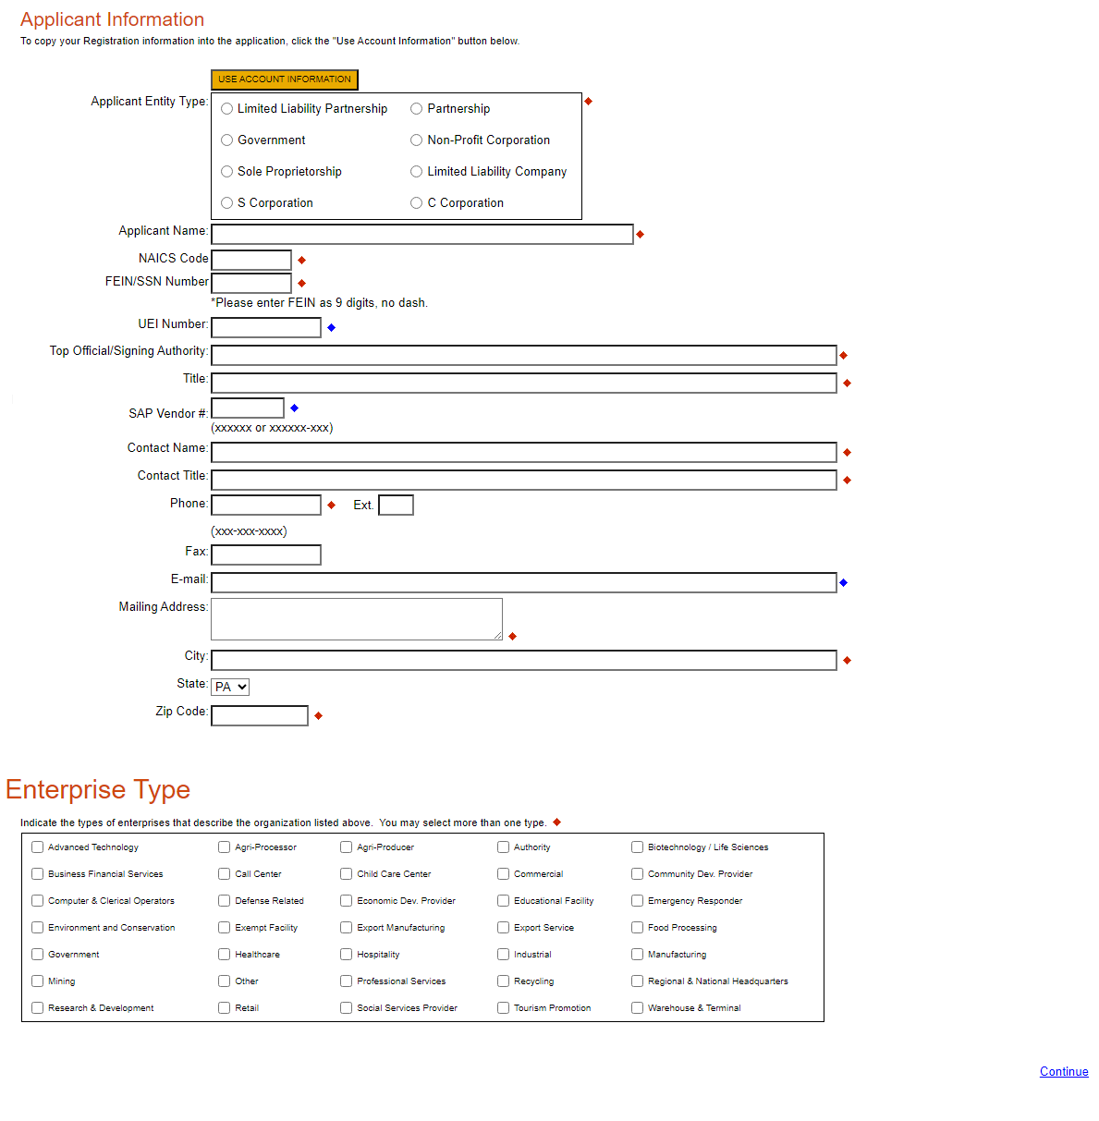
Application
Applicant Information

Slide 13
Application
Applicant Information

Slide 14
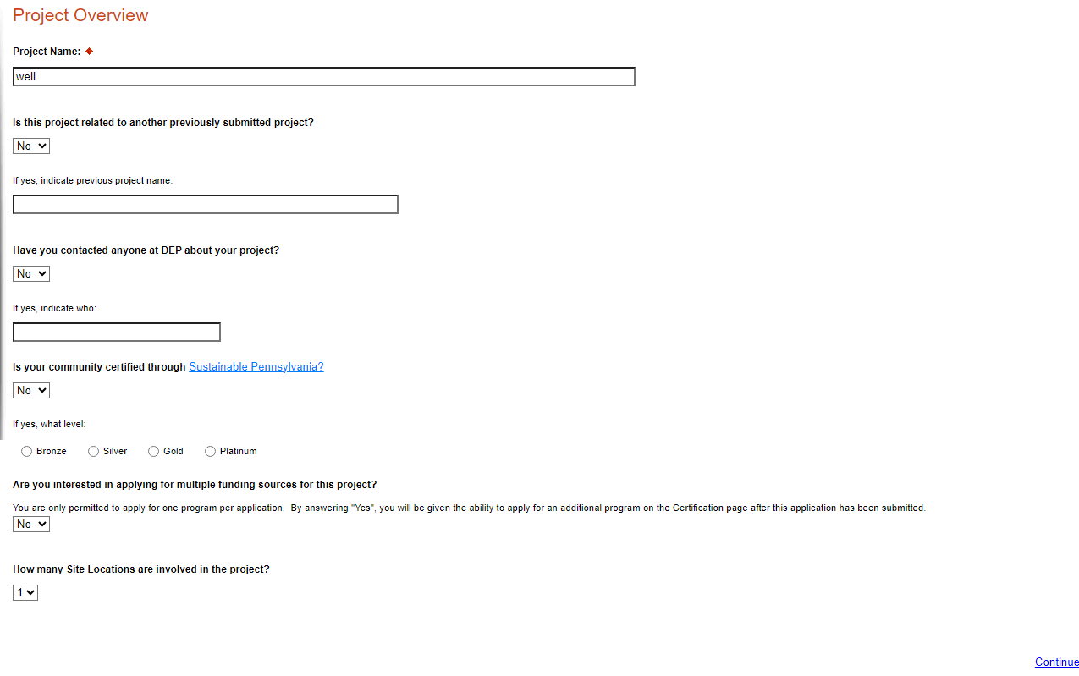
Application
7. Project Overview
The project name will auto-populate. The remaining information in this section is not required.

Slide 15
Application
7. Project Overview
The project name will auto-populate. The remaining information in this section is not required.

Slide 16
Application
8. Project Site
Address – Enter the applicant’s mailing address (street address). P.O. Boxes are not acceptable.
City, State and Zip Code – Enter this information.
County – Select county from the dropdown box.
Municipality – Select municipality from the dropdown box.
PA House and PA Senate – These fields will be auto-populate based on the information entered above.
Designated Areas – Leave blank.

Slide 17
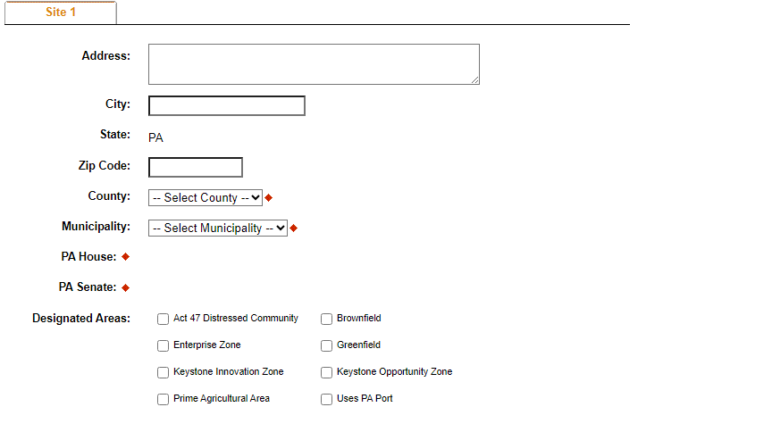
Application
8. Project Site

Slide 18
Application
9. Project Narrative
-This area does not need to be completed, please do not enter any information in the Project Narrative box. All relevant information for your application will be uploaded on the addenda tab.

Slide 19
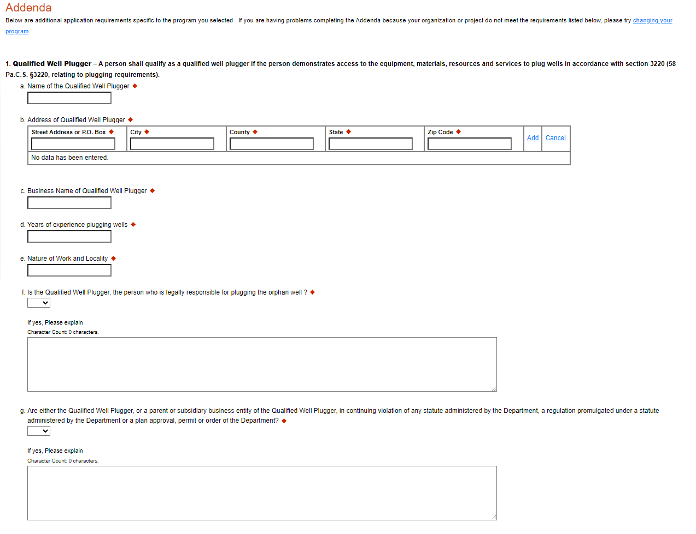
Application
10. Program Addenda
- Complete all fields in this section.

Slide 20
Application
10. Program Addenda

Slide 21
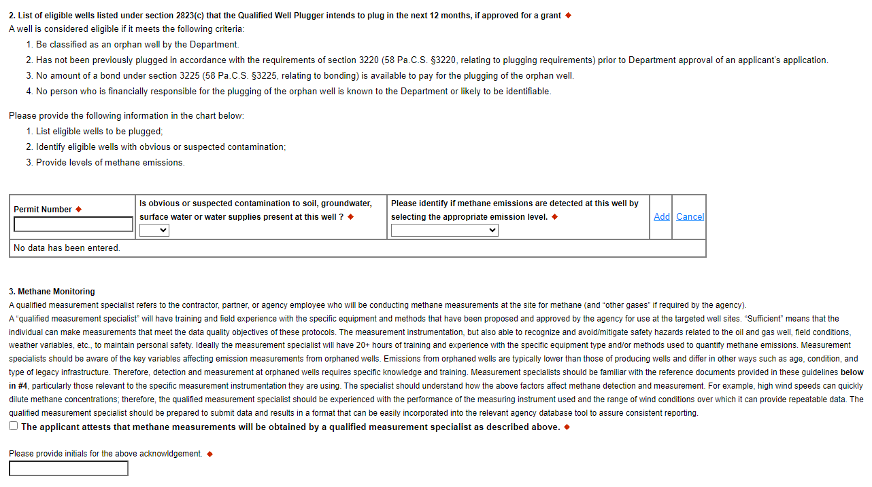
Application
10. Program Addenda

Slide 22
Application
10. Program Addenda
Federal Orphaned Wells Methane Measurement Guidelines (doi.gov)

Slide 23
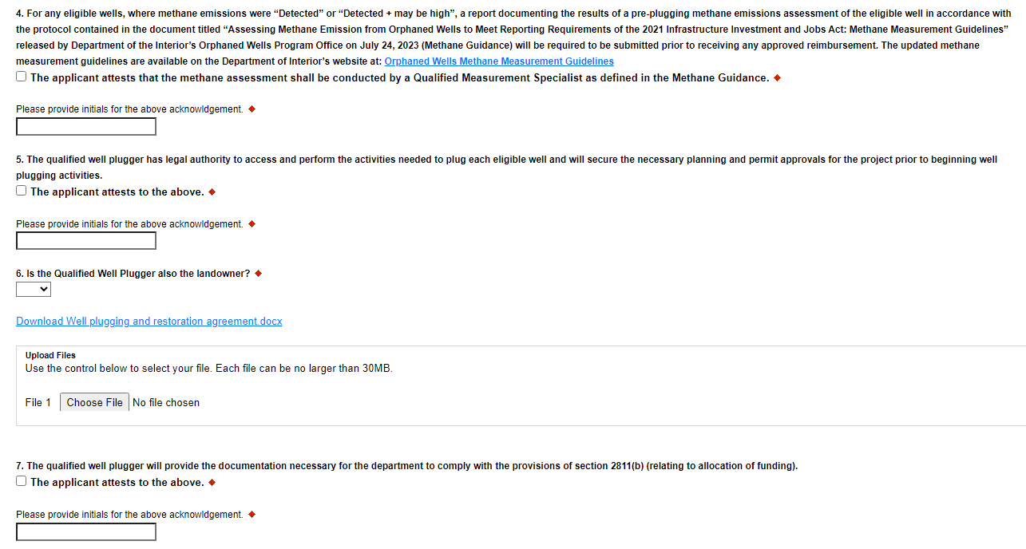
Application
10. Program Addenda

Slide 24
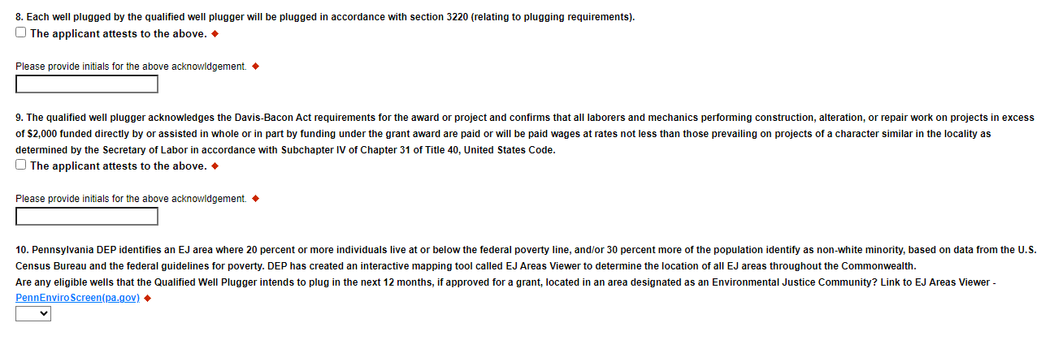
Application
10. Program Addenda
SAM.gov | Wage Determinations

Slide 25
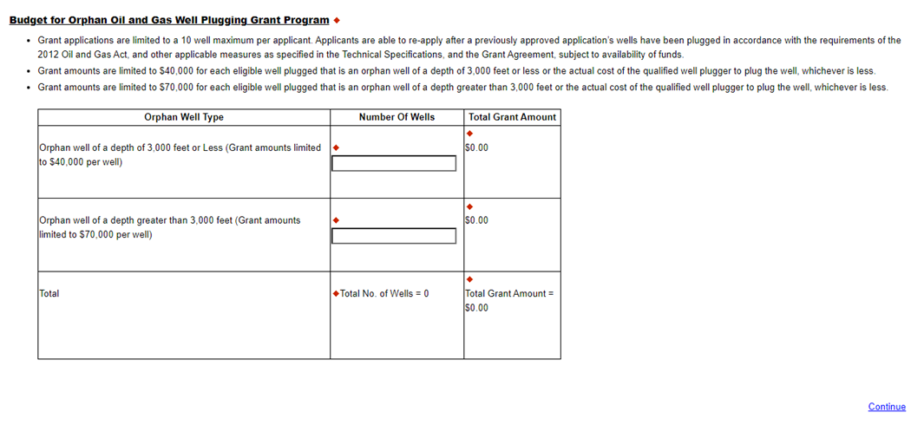
Application
10. Program Addenda

Slide 26
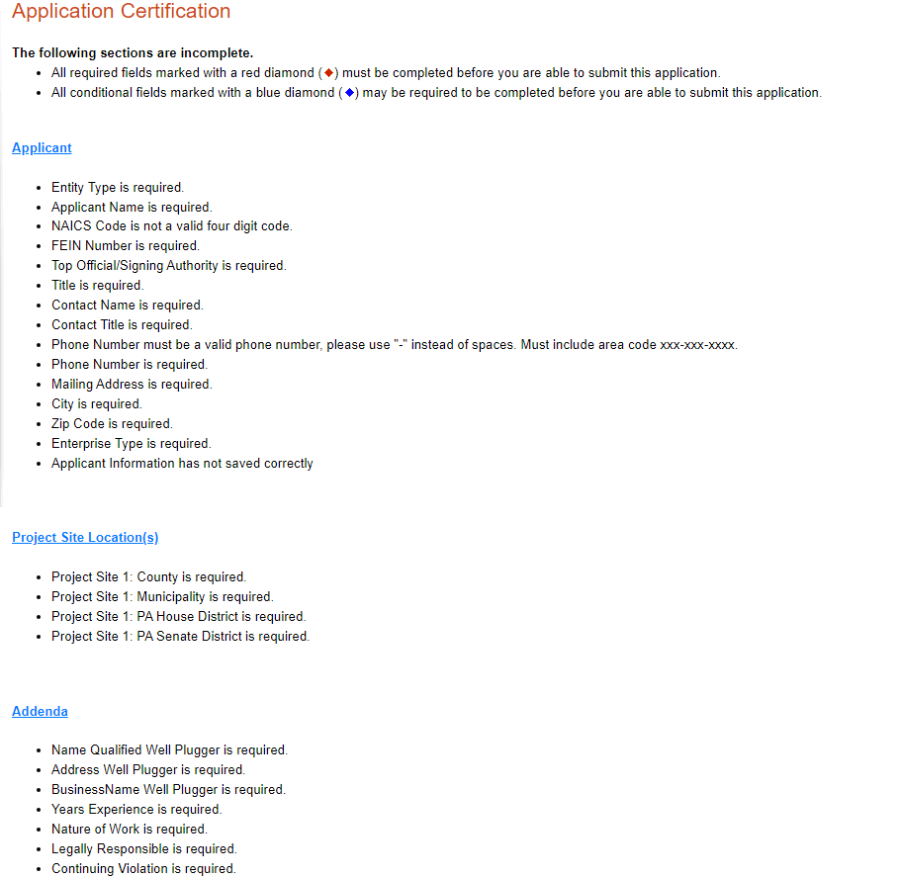
Application
11. Certification and Submission
If there is any missing information in your application, your screen will look similar to the following example.
Under the “Application Certification” heading, it will state, “The following sections are incomplete. All required fields marked with a red diamond must be completed before you are able to submit this application”.
To add/correct the information on your application, click on the section heading to return to the page.

Slide 27
Application
11. Certification and Submission

Slide 28
Application
12. Complete the following fields:
Indicate certification of application information by checking the related checkbox under the Electronic Signature Agreement.
Indicate identity as one of the following:
I am the applicant.
I am an authorized representative of the company, organization or local government.
I am a “Certified” Partner representative.
Type your name in the “Type Name Here” block. This will serve as your official e-signature and authorizes your application.
Check the “Electronic Attachment Agreement” box.
Click on “Submit Application.”

Slide 29
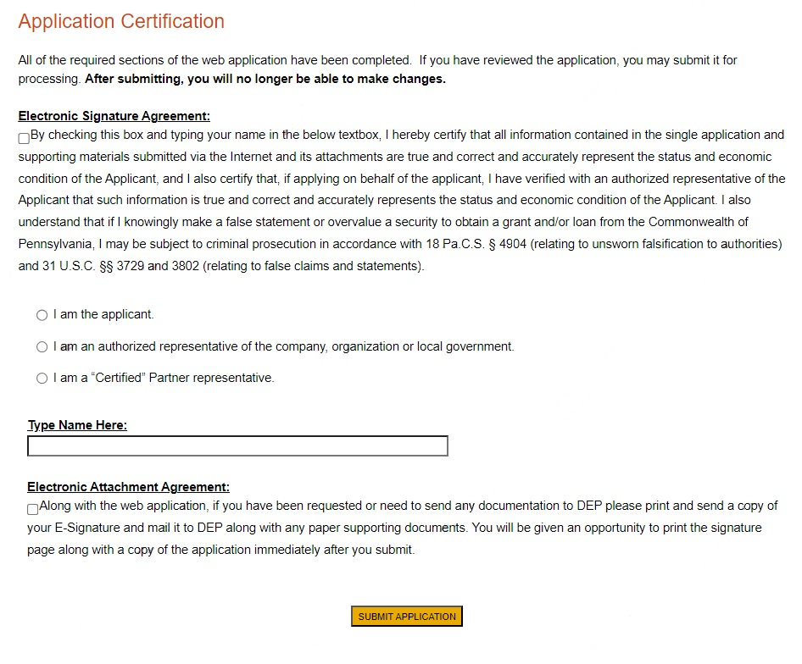
Application
Application Certification

Slide 30
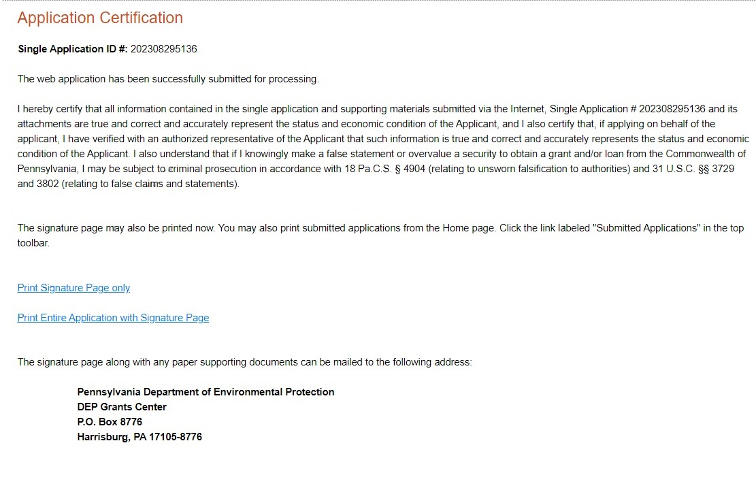
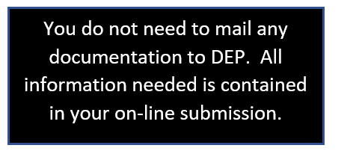
Application
13. Application Receipt Verification

Slide 31
Application
If you have questions completing the application, please contact Enterprise eGrants Customer Service Center at 1-833-448-0647 or email at egrantshelp@pa.gov. Operating hours are Monday through Friday from 8:30 am to 6:00 pm EST.

Slide 32
Post-Application
- 15 Days for decision
-Incomplete Applications
-Approval Letter Sent
-Grant Agreement
-Wage Determination
-Certified Payroll Form
-Reimbursement Forms
-Other forms and requirements
-Notice to Proceed
-Sign within 45 days

Slide 33
Application
Questions?
Orphan Well Plugging Grant Program Webpage
Please reference the Orphan Well Plugging Grant frequently asked questions (FAQ) document. Should you have any specific questions about this grant program, please contact the Department via e-mail at RA-EPORPHANGRANT@pa.gov
-Future “in-person” trainings upon
DOI award

Slide 34
Joe Gaboff Oil and Gas Program Specialist Bureau of Oil & Gas Planning and Program Management jgaboff@pa.gov

